Slide 1
Conducting a Job Hazard Assessment
Chemical Hazards

Slide 2
Overview
A hazard Assessment is process of analyzing potential risks or hazards that employees can encounter while in work situation or work place.

Slide 3
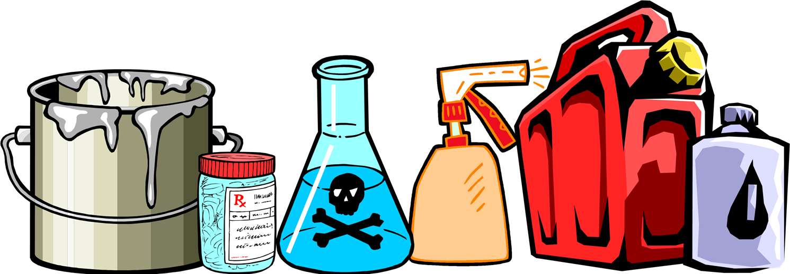
Chemical Hazards
Using Chemicals Requires safe Procedures as well as safe handling of object. When employees use objects in during their work, they should be aware of hazardous effect associated with them

Slide 4
Harmful Dusts/Mists/Fumes/Particulates
Employee get exposed to chemicals such as aerosolization of microorganisms which poses a health hazard.

Slide 5

Sharp Objects
Are there sharp objects which could cut or pierce the body? •G l ass Knife blades
•Sheet metal
•Nail guns
•Needles
•Splinters (wood)
•Burrs (metal)

Slide 6
Biohazards
Use of these chemicals may result to blood or body fluids infections

Slide 7
Administrative Controls
Reduction
Reducing the frequency of working in hazardous chemicals
Rotation
Employees can be rotated to reduce hazardous effect from chemicals

Slide 8
Engineering Controls
Employees can be eliminated from the hazard.
Using chemicals in control rooms
Guardrails
clearance distance
Using protective barriers and shields

Slide 9
HAZARDOUS SUGGETED CONTROLS
Obtain a Material Safety Data Sheet on the product in question from the supplier and review the information provided for health hazards and suggested controls

Slide 10
Summary
Chemical use in workplace can be harmful to employees. Precautions needs to be taken in order to prevent hazardous effects. Also, administrative and engineering controls should be employed.

