Slide 1
Literature Reviews and Library Research

Slide 2
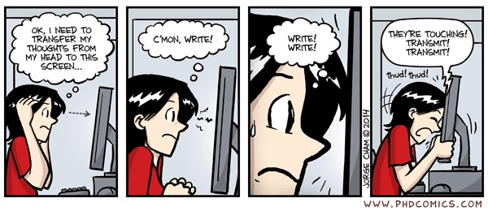
Overview
Aim of Literature Reviews and General Tips on construction
How to write a Literature Review in 5 steps
APPENDIX: Mini style and citation guide

Slide 3
The aim of a literature review: Major objectives
Fit your research into the context of existing scientific knowledge
Gain background knowledge on your research interests
Understand the nature of knowledge currently present in the field on your given topic

Slide 4
General Tips on Literature Reviews
Synthesize, don’t summarize
Don’t talk about one article after another like a list or treat this as a book report; you need to be able to synthesize what’s important about the research and create a cohesive, new whole.
Always frame research you are discussing in the context of your own research
Again, this is not a book report. The whole point of a literature review is to frame your research inside the world of existing research – How do these articles relate to/inform the question you are asking?
Use past tense when discussing research that has already been completed (anything from an article you are reading); future/present if you are talking about the project you are currently developing.

Slide 5
OVERVIEW: How to write a literature review
Source articles
Read articles
‘Process’ articles
Finalize thematic headings
Synthesize your literature review!

Slide 6
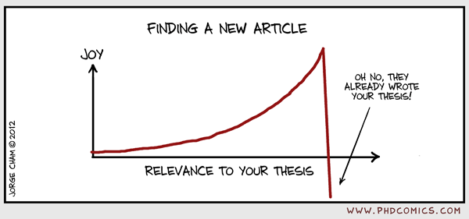
1) Sourcing articles – more on this Thursday
Effective navigation of library databases – some tips
Start big then work your way down based on the results you get
Browse databases by subject, or even browse specific
Snowball sample
Good articles can lead you to other ones – look at the works cited page for other relevant articles, or even additional work by the same author.

Slide 7
2) How to read a journal article like a pro
Start with the abstract
This is basically a summary of the article – should contain the purpose of the research, the methods used in the study, and the major findings. If the abstract isn’t helpful to your research, then probably best to move on.
Skim it
Scan the rest of the article, paying special attention to section headings (should give you the general ‘theme’ of that section) and tables/graphs.
Read it
You should only do a full read on articles that will fit your literature review. Try not to waste time on articles that don’t fit!
Review it
We’ll cover two options here, that I refer to as ‘processing’ your articles: #1 Annotated Bibliographies and #2 Summary Matrices

Slide 8
3) Option #1: Annotated Bibliographies
Start with proper ASA citation for your source.
Then, write a concise (should be around 150 words) annotation that summaries the central theme/scope and gives a quick overview of the methodology used. Include a sentence or two that encapsulates why this article is important to the research you want to conduct and any critical insights you may have.
NOTE: Annotated bibliographies are NOT simply a restatement of the article abstract. They are descriptive and critical; you should also be sure to highlight whatever elements of the article will be of most use to you in constructing your literature review.
Rinse and repeat for all articles, use summaries to identify areas of comparison/contrast between information in articles and construct synthesis.

Slide 9
EXAMPLE – Annotated Bibliography
Waite, L. J., F.K. Goldschneider, & C. Witsberger. 1986. “Nonfamily living and the erosion of traditional family orientations among young adults.” American Sociological Review. 51:541-554. The authors, researchers at the Rand Corporation and Brown University, use data from the National Longitudinal Surveys of Young Women and Young Men to test their hypothesis that nonfamily living by young adults alters their attitudes, values, plans, and expectations, moving them away from their belief in traditional sex roles. They find their hypothesis strongly supported in young females, while the effects were fewer in studies of young males. Increasing the time away from parents before marrying increased individualism, self-sufficiency, and changes in attitudes about families. In contrast, an earlier study by Williams cited below shows no significant gender differences in sex role attitudes as a result of nonfamily living.

Slide 10
3) Option #2: Summary Matrix
Complete summary chart for all articles.
Complete synthesis chart for all articles.
Use chart to create thematic synthesis, utilizing the themes outlined in your synthesis chart, integrating relevant information from summary chart as needed.
NOTE: I’ve added some additional reading materials regarding Summary Matrices to Canvas, you may want to check it out if you are interested in this option!

Slide 11
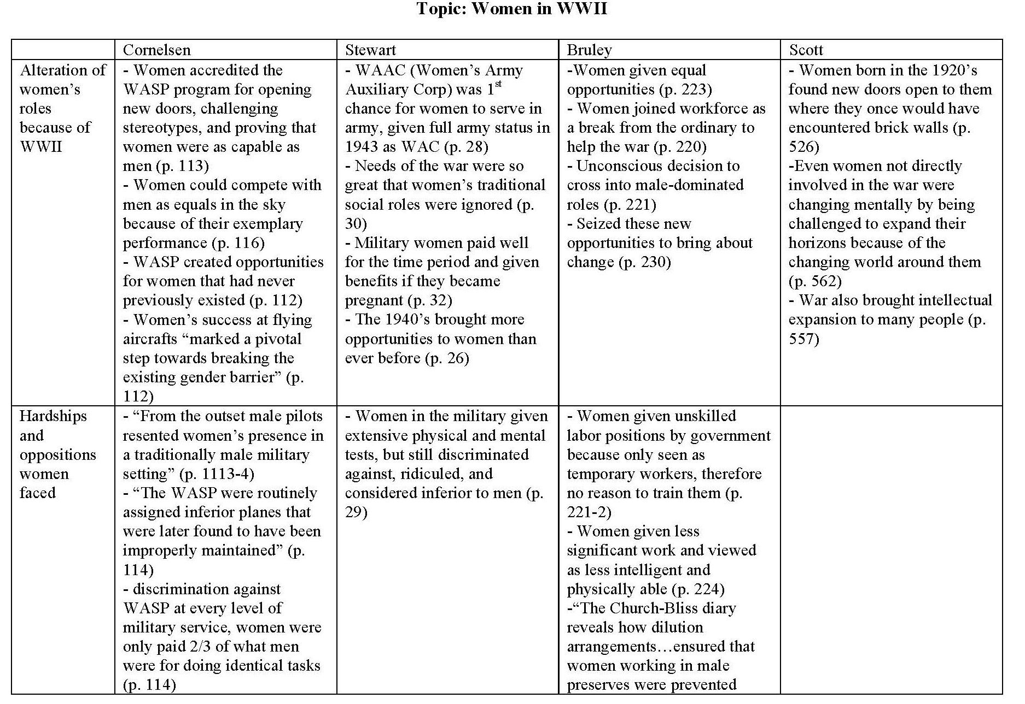
EXAMPLE – Synthesis Chart
Authors/citations go here
Themes go here

Slide 12
Putting it all together: How to write a literature review
Source articles
Search library databases thoroughly. Aim for recent articles (past 5-7 years) and conducted in the USA.
Read articles
Follow steps for reading journal articles like a pro – don’t waste your time on articles that don’t fit!
‘Process’ articles
For this literature review, I am requiring everyone to utilize either the Annotated Bibliography or Summary Matrix method. See Canvas for due dates – there are two, I’ve split this process up into two sittings. You’re welcome ☺
Finalize thematic headings
Your research question is a great place to start with your headings – others may arise as you read, so be flexible.
Synthesize your literature review!
Read everything before you start writing. It will make the synthesis process easier. Don’t forget to tie everything back to your specific research question!

Slide 13
Appendix: Style Guide and Citation Examples
Sourced from:
American Sociological Association. 2014. American Sociological Association Style Guide. 5th ed. Washington, DC: American Sociological Association.

Slide 14
Guidelines for academic writing
Use proper grammar and spelling, and adhere to all style conventions.
See guides like The Elements of Style for a good grammar guide, and ASA guidelines/ The Chicago Manual of Style for conventions.
Use active voice and keep tense consistent with what is going to happen/has already happened
Most importantly: don’t plagiarize

Slide 15
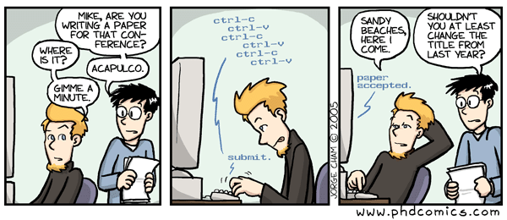
Tips on avoiding plagiarism
Intellectual theft
Representing someone else’s word OR thoughts/ideas as your own
The second piece of this can get tricky with literature reviews, so you must be vigilant!

Slide 16
Avoiding intellectual theft
Do not use another’s exact words without quotation marks and complete citations.
Do not edit or paraphrase another’s words and present the revised version as your own.
Do not present another’s ideas as your own, even if you use totally different words.

Slide 17
Examples of inline ASA citations
If the author’s name is in the text, follow it with the publication year in parentheses:
…Giddens (1991) argues that…
If the author’s name is not in the text, enclose the last name and publication year in parentheses:
… for validity and authenticity (Davis 2005).
Dual authors – use both names, three or more authors – use first author’s last name and et al.:
…(Danziger and Ratner 2010).
…(Mortimer et al. 2005).
Separate series of references with semicolons
…(Costa 2002; Finch and Crimmins 2004; Fogel 2004; Fogel and Costa 1997; Manton et al. 1997).

Slide 18
Examples of ASA Works Cited citations
Books
Author1 (last name inverted), Author2 (including full surname, last name is not inverted), and Author3. Year of publication. Name of Publication (italicized). Location of publisher, state or province postal code (or name of country if a foreign publisher): Publisher’s Name.
Edin, Kathryn, and Maria Kefalas. 2005. Promises I Can Keep: Why Poor Women Put Motherhood Before Marriage. Berkeley: University of California Pres.
Chapters in Books or Other Collected Works
Author1 (last name inverted), Author2 (including full surname, last name is not inverted), and Author3. Year of publication. “Title of Article/chapter.” Pp. (with page numbers, elided) in Name of Publication (italicized), edited by Editor1, Editor2, and Editor3 (editors’ initials only for first/middle names, names not inverted). Location of publisher, state or province postal code (or name of country if a foreign publisher): Publisher’s Name.
Montez, Jennifer K., and Mark D. Hayward. 2011. “Early Life Conditions and Later Life Mortality.” Pp. 187-206 in International Handbook of Adult Mortality, edited by R. G. Rogers and E. Crimmins. New York: Springer Publishers.

Slide 19
Examples of ASA Works Cited citations
Journal Articles
Author1 (last name inverted), Author2 (including full surname, last name is not inverted), and Author3. Year of publication. “Title of Article.” Name of Publication (italicized). Volume Number (Issue Number):page numbers of article.
Chang, Virginia W., and Diane S. Lauderdale. 2009. “Fundamental Cause Theory, Technological Innovation, and Health Disparities: The Case of Cholesterol in the Era of Statins.” Journal of Health and Social Behavior 50(3):245-60.

Slide 20
Works Cited formatting notes
Should be double spaced like the rest of your document
All works are organized alphabetically by authors last name
Use first and last name for all authors if indicated
For repeated authors or editors, give the author’s (or editor’s) full name in all subsequent references. Go earliest to latest, single author to multiple authors.
If you have multiple works by the same author in the same year, add letters to the end of the year in the reference (apply lettering scheme in alphabetical order)

