Slide 1

Stock Valuation and Analysis
MBA Finance 571
Week 2

Slide 2
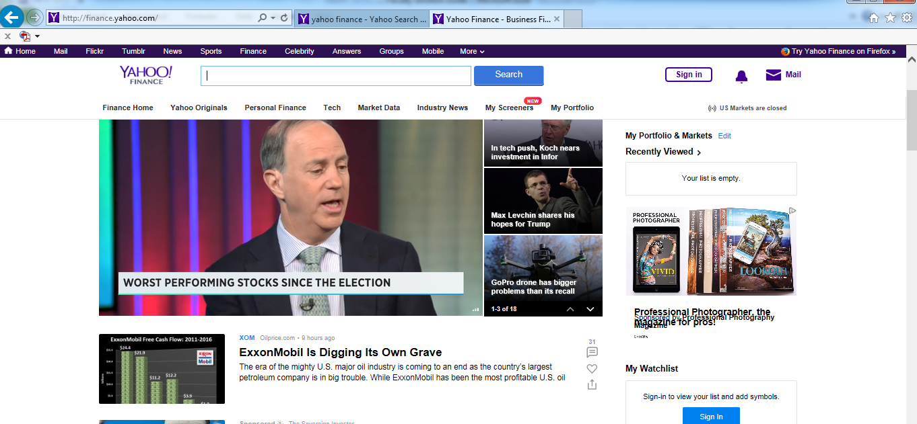
Stock Valuation and Analysis

Slide 3
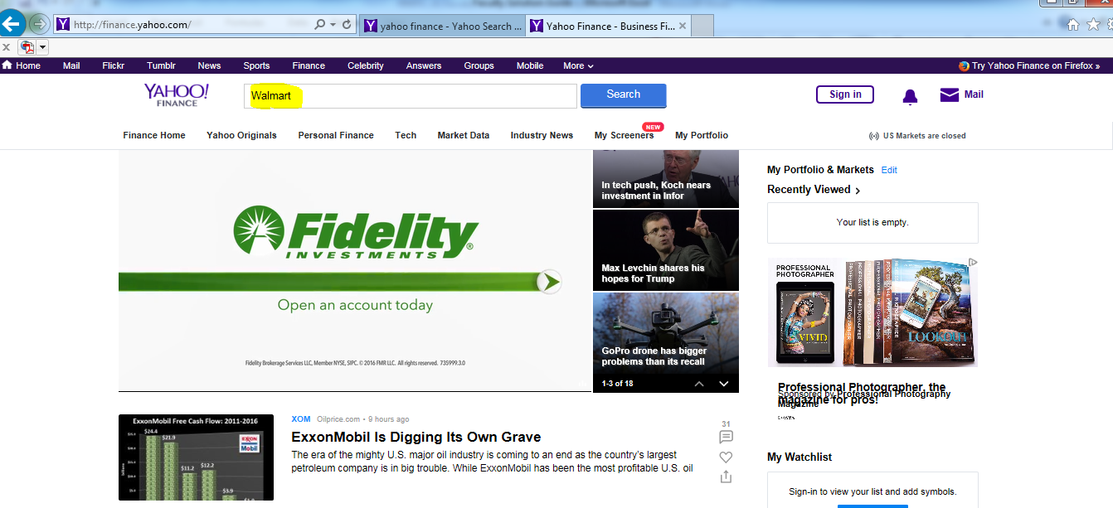
Stock Valuation and Analysis

Slide 4
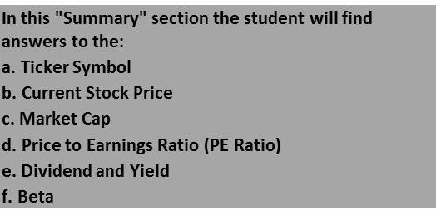
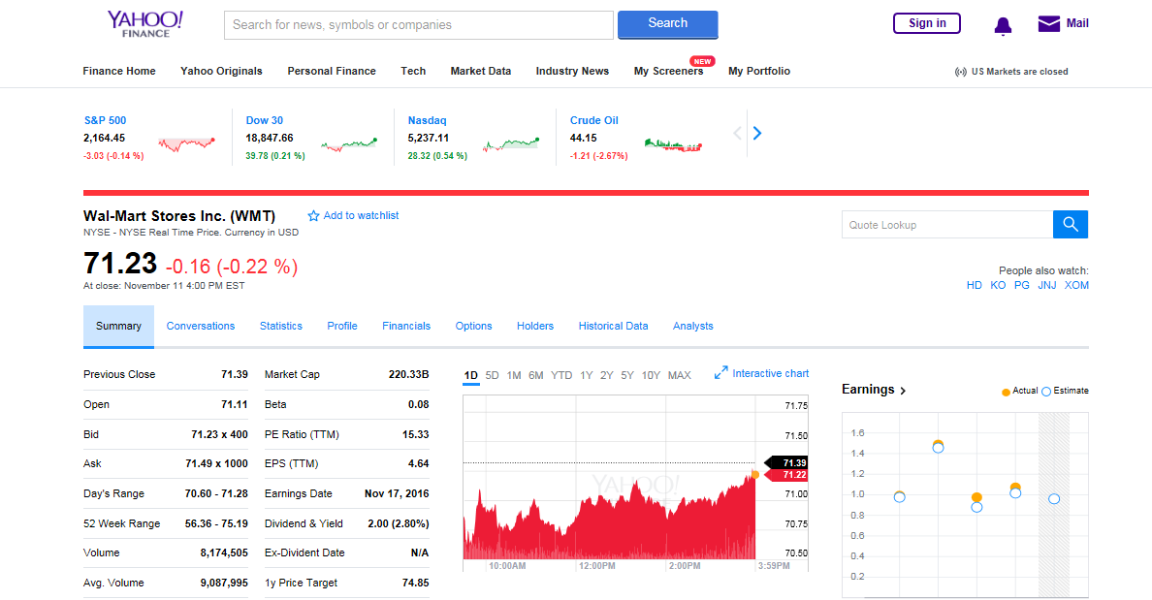
Stock Valuation and Analysis

Slide 5
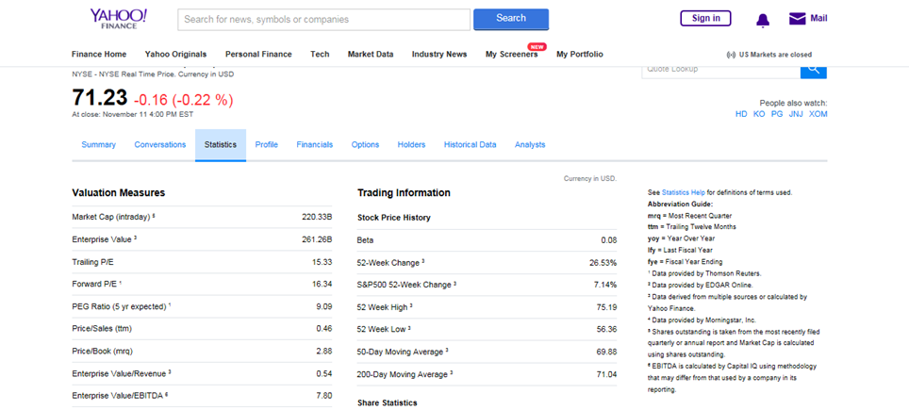
Stock Valuation and Analysis
5. The student will find answers for:
a. Enterprise Value
b. Stock Split (See the Dividend and Splits section towards the bottom)
c. 52 Week High
d. Book Value per Share (Bottom left)

Slide 6
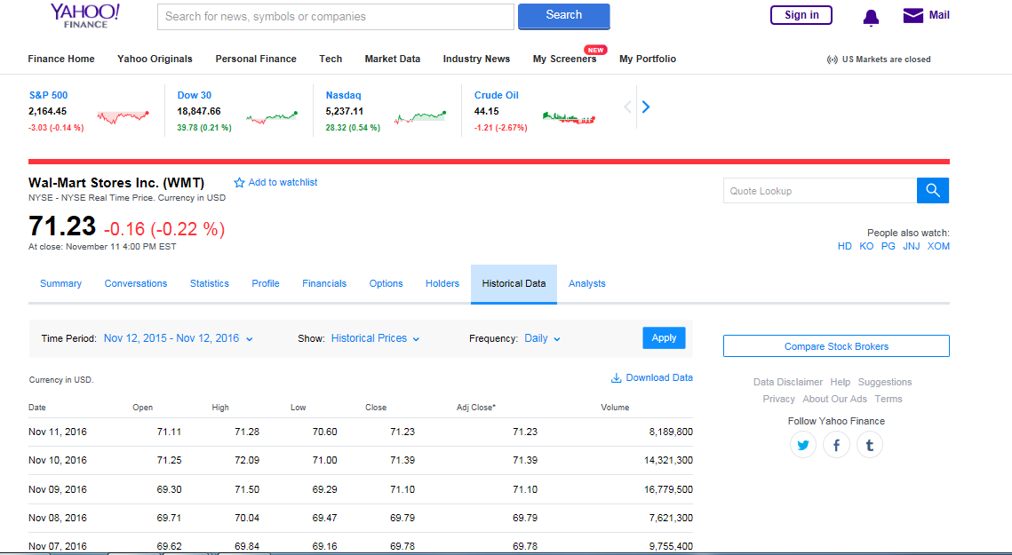
Stock Valuation and Analysis
a. Closing price for the last 5 days

Slide 7
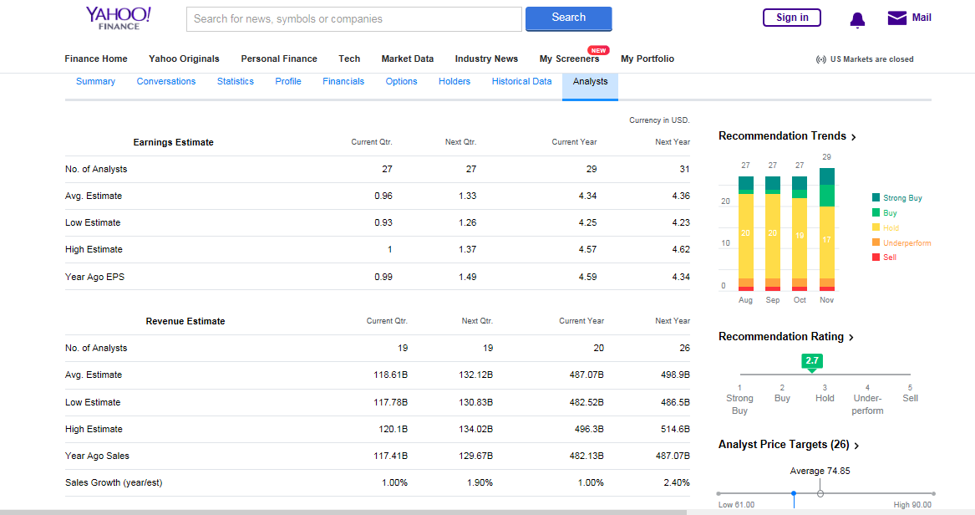
Stock Valuation and Analysis
Students will find answers to:
a. Recommendation Rating
b. Target Analyst Price
c. Average Revenue Estimate

Slide 8
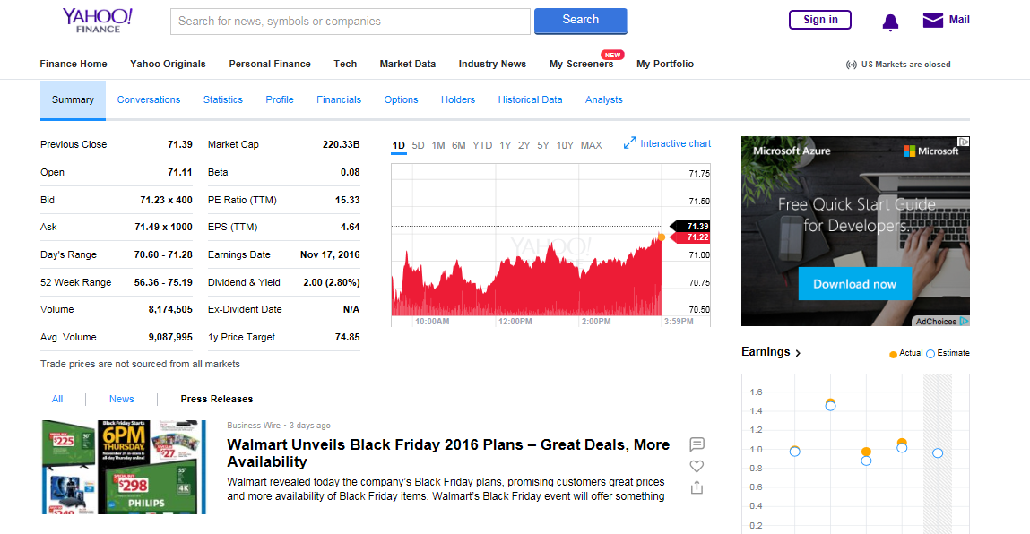
Stock Valuation and Analysis
a. Press Release and other news articles about the company.

Slide 9
Conclusion

