Slide 1
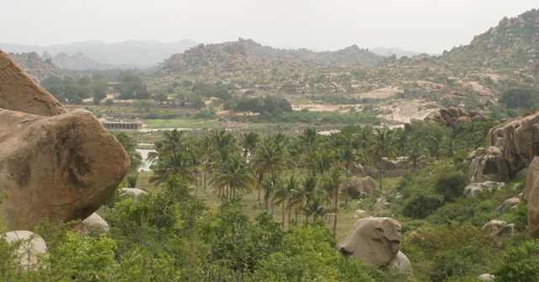
Mughal Expansion and Consolidation—17th Century

Slide 2
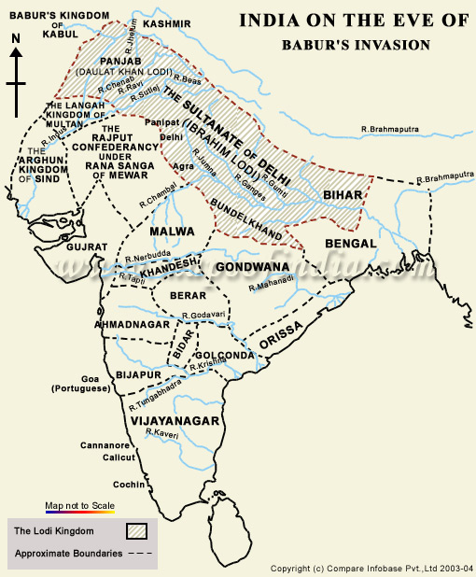

Slide 3
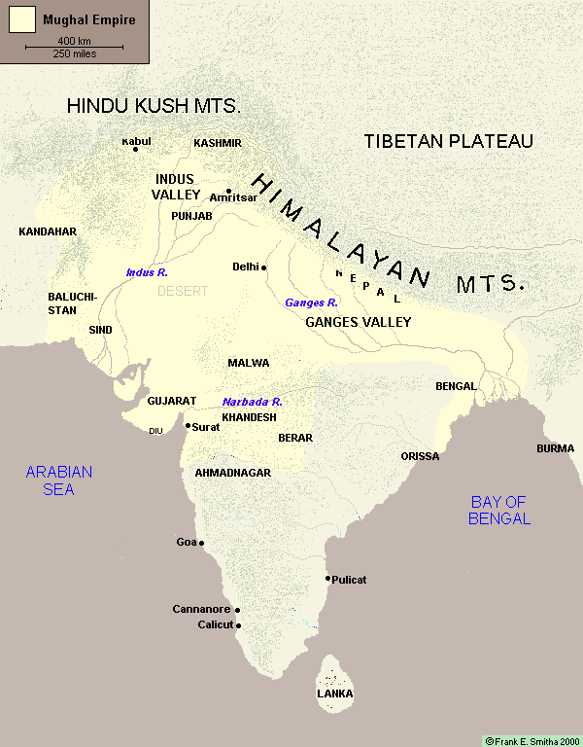

Slide 4
Consolidation after Akbar
Jahangir (1605-27), Shah Jahan(1628-58), and Aurangzeb (1658-1708) would continue to expand out—toward Deccan
Each area was surveyed and added to the mansabdari system (process slowed down under Aurangzeb)
Newly conquered ruling elite become mansabdars—following Akbar’s pattern
Economy continued to boom due to productive crops, growing trade

Slide 5
Who benefits from this system?
Khud Kasht peasants-enjoy greater share of profit from agriculture, become richer peasants
Merchants and traders
Those in Mansabdari system and those employed by the Mansabdars (soldiers, servants, craftsmen, clerks, bureaucrats)
Some nomadic tribes—banjaras, Afghans in horse trade

Slide 6
Who does not benefit?
Landless peasants, especially those with no craft or martial skills
Nomadic tribes w/o connections to trade or settled agriculture
Elite groups and zamindars who resist Mughal expansion
In the early part of the empire their numbers are far fewer, and there are “release valves”
  Expanding agriculture
  Expanding military frontier
  Local rivals of the elite groups who rebel

Slide 7
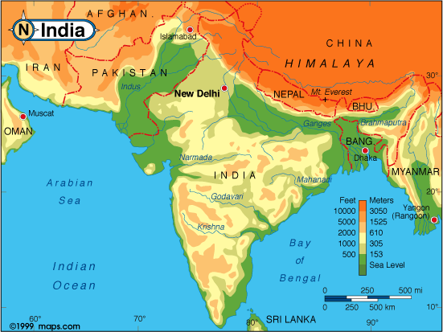
Nomadic
Tribes
Ind. Hill kingdoms
Swamps and
Forests
Forests

Slide 8
What are the limits of this expansion?
Geographical limits make Deccan the only logical point of expansion by the 1660s, also make this area hard to conquer
Economy works only as long as merchants and traders feel secure
Fine balance and supervisions needed to rule:
  taxing peasants-overburdening them
  employing as soldiers v. negative impact in agricultural zone of war front

Slide 9
Life in the Countryside
Most peasants were now part of a monetary economy—with its booms and busts (mostly booms in the 17th c)
Commodity production meant food stuffs were cheaper, goods produced for a commercial market, included food grains, textiles, and guns
Most local zamindars had links with the administration—however the category of “zor-talb” or rebellious peasants/zamindars did not go away. Why?

Slide 10
Areas of continuity--Cultural
Patronage of art and architecture in similar lines (see parallels b/w Humayun’s tomb and Taj Mahal)
Mughal art and architectural styles mix indigenous Indian elements with styles from Central Asia and the Middle East
Nobles and employees also patronize artists and craftsmen in towns and villages all over empire
A diverse cultural life emerges from the lavish spending in courts as well as from the support of merchant families—patronage support extended to peasants and craftsmen

Slide 11
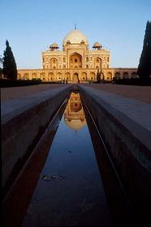
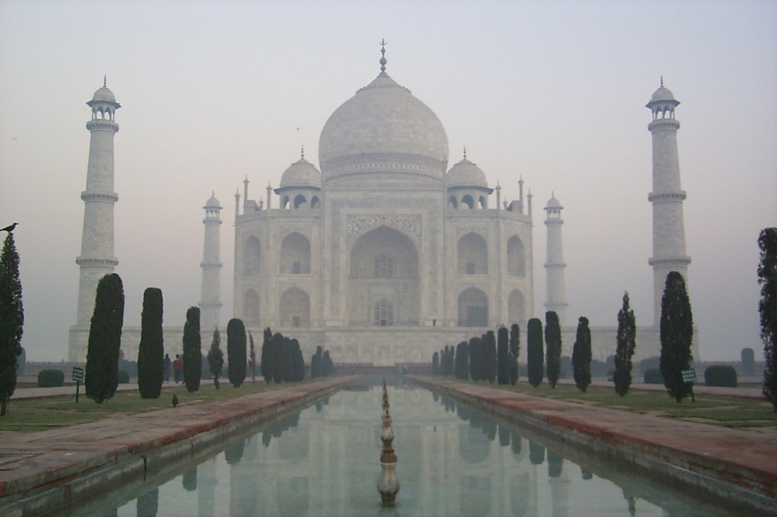
Akbar and Shah Jahan’s styles

Slide 12
Sites of non-elite cultural synthesis
Sufi and bhakti centers and modes of worship continued to expand
Growing production of texts, songs in vernacular languages, some signs of expanding literacy
Some signs of resistance to religious elite, moving away from orthodox patterns
New faiths connected with these trends—Dadu Panth, Sikhism

Slide 13
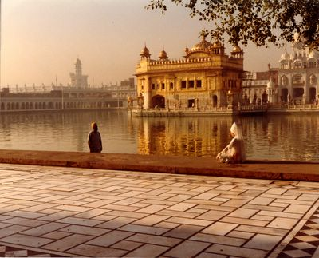
Early Sikhism and the context of Peasant/Merchant Prosperity
Founder Guru Nanak contemporary with Babur
Core Beliefs and practices
  Akal Purakh
  “nam, dan, snan”
  Langar and kirtan
  Rejects extremes
5th Guru, Arjan Dev strengthens core institutions
  Compiles Guru Granth Sahib
  Establishes the Harimandir (Golden Temple)

Slide 14
17th C. Developments
Large numbers of a peasant group, the Jats become Sikhs—Why?
  Community patters common to both
  Appeal of the lack of caste prejudice
  Gurus’ inclusion of popular songs, recruitment, and support of peasant groups
Gurus and early followers had been dominated by a merchant/bureaucratic caste called Khatris
During Jahangir’s era, relationship with Sikh Guru’s begins to change
  Execution of 5th Guru
  Imprisonment and release of 6th Guru

Slide 15
Signs of continuity and strength after Akbar’s death in 1605
Emp. Jahangir (1605-1627) not as involved in administration, but trends of strong imperial control and consolidation continue
stability of the bureaucracy of the empire even through these crisis—also of economy
No economic upheaval in South Asia even as New World silver floods markets throughout 17th century
Jahangir’s ministers and later Shah Jahan quickly learn the importance of balanced action

Slide 16
What does it mean in terms of policy?
For much of this period it is more profitable for smaller kingdoms and their ruling families to join the mansabdari system than fight the Mughals (until Aurangzeb)
For Mughals this means an incentive to continue with policy of inclusion rather than narrow theocratic or political aims
This also has repercussions for the peasants, literate groups in their territories who also see new opportunities (if not directly impacted by war)

Slide 17
Example—Rajput rulers of Amber
Recruited under Akbar, marry daughters to Mughals
Jahangir and Shah Jahan both have family connections
  Raja Jai Singh
  Employs many kinsmen and Rajasthan peasants
Amber

Slide 18
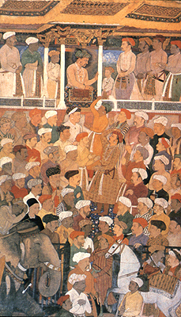

Slide 19
Lessons in PR?
Even emperors such as Jahangir realized the value of forming connections with varied groups
Patronage of sufis, but also Hindu and Jain groups
  Public visits with Jadrup
  Public works of charity—weighing ceremony, building of carvanserais, digging of wells and canals

Slide 20
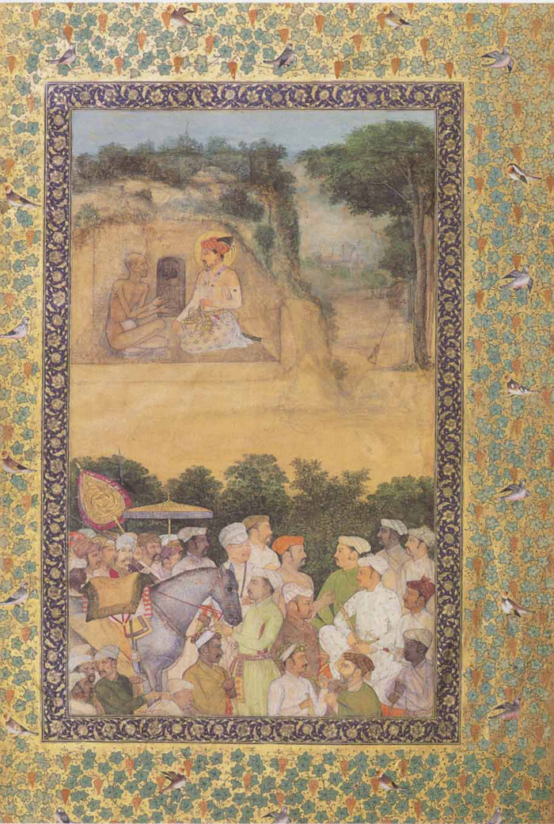

Slide 21
Some Problems
Problem of Succession
Old nobility or “Khanzads” often Central Asia, Persian, Rajput v. new nobility usually regional ethnic groups— ‘spurious Rajputs” or middle-level castes
Sulh-i kul policy not uniformly applied, sp. Under Jahangir
Upward mobility of peasants also a problem—why?

