Slide 1
Market Efficiency
Thomas J. Powell
Northcentral University

Slide 2



This is not an offering or the solicitation of an offer to purchase an interest in any investment vehicle. Any such offer or solicitation will only be made to qualified investors by means of an offering memorandum and only in those jurisdictions where permitted by law. The target returns set forth within all Resolute Capital Partners offerings may not be realized; actual results may differ materially from the stated goals. Prior to investing, investors must receive a prospectus, which contains important information regarding the investment objectives, risks, fees, and expenses of any funds and/or other investment opportunities. Past performance is no guarantee of future results. All investments involve risk, including the loss of principal. Securities are offered through WealthForge Securities, LLC member FINRA / SIPC.
Notes:
Introduction slide to show exerptise and disclosure regarding securities advisory services / offerings:
Thomas J. Powell
Banking / finance career began in silicon valley at Wells Fargo Bank in 1987
Resolute Capital Partners: Multi-billion dollar portfolio manager with focus in fintech, energy, cybersecurity, commercial lending
Finance major | MBA | Harvard University graduate and executive lecturer
Currently working towards PhD-BA in Financial Management at Northcentral University

Slide 3
Random walk vs predictable patterns
“”
Notes:
When it comes to investing, there is no shortage of theories on what makes the markets tick or what a particular market move means. The two largest factions on Wall Street are split along theoretical lines into adherents to an efficient market theory and those who believe the market can be beat. Although this is a fundamental split, many other theories attempt to explain and influence the market - and the actions of investors in the markets. In this article, we will look at some common (and uncommon) financial theories.
Efficient Market Hypothesis Very few people are neutral on efficient market hypothesis (EMH). You either believe in it and adhere to passive, broad market investing strategies, or you detest it and focus on picking stocks based on growth potential, undervalued assets and so on. The EMH states that the market price for shares incorporates all the known information about that stock. This means that the stock is accurately valued until a future event changes that valuation. Because the future is uncertain, an adherent to EMH is far better off owning a wide swath of stocks and profiting from the general rise of the market.
Opponents of EMH point to Warren Buffett and other investors who have consistently beat the market by finding irrational prices within the overall market.
Read more: 7 Controversial Investing Theories http://www.investopedia.com/articles/financial-theory/controversial-financial-theories.asp#ixzz4wSAwwnQp Follow us: Investopedia on Facebook

Slide 4
“”
Efficent Market Theory

Slide 5
“”
Weak Form
Semi-Strong Form
The Strong Form

Slide 6
“”
Technical Analyses vs Fundamental Analysis

Slide 7
“”
Evidence for and against EMH

Slide 8
“”
Role of expert – provide conclussions and recommendations considering market efficiencey debate

Slide 9
“”
What roles do financial stakeholders play in effecting the efficiency of the market

Slide 10
“”

Slide 11
“”

Slide 12

“”

Slide 13

“”

Slide 14

“”

Slide 15
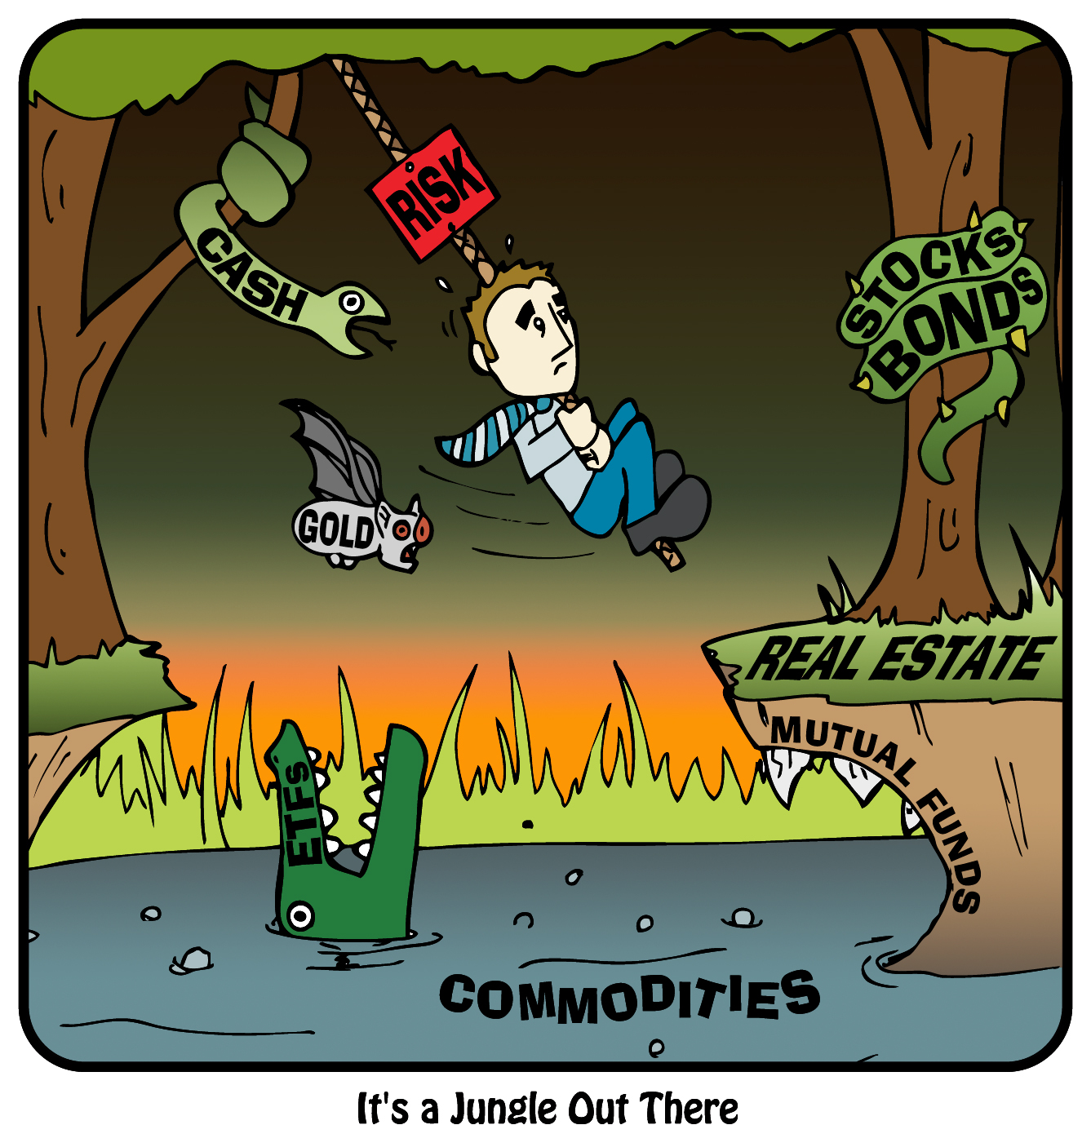
“”

Slide 16
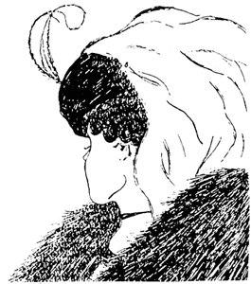
“”

Slide 17

“”

Slide 18

“”

Slide 19

“”

Slide 20
References
Ang, A., Goetzmann, W. & Schefer, S. (2011). Review of the Efficient Market Theory and Evidence: Implications for Active Investment Management. Evolution of Active Management of the Norwegian Government Pension Fund- Global.
Bailey, S. (2014). Scholar-Practitioner Leadership: A Conceptual Foundation. International Journal Of Progressive Education, 10(3), 47-59.
Bitvai, Z. & Cohn, T. (2013). Day Trading Profit Maximization with Multi-Task Learning and technical Analysis. Mach Learn (101) 187-209.
Bodie, Z., Kane, A., & Marcus, A. J. (2013). Investments New York, NY McGraw-Hill-Irwin 9780077641986
Bradley, D., Gokkaya, S., Liu, X. & Xie, F. (2017). Are All Analysts Created Equal? Industry Expertise and Monitoring Effectiveness of Financial Analysts. Journal of Accounting and Economics (63) 179-206.
Da, Z. & Ernst, S. (2010). Relative Valuation and Analyst Target Price Forecast. Journal of Financial Markets 14, 161-192.
De Grauwe, P. & Macchiarelli, C. (2015). Animal Spirits and Credit Cycles. Journal of Economic Dynamics & Control (59) 95-117.
Dodler, D., Thaler, R., & Van Den Assem, M. (2012). Split of Steal? Cooperative Behavior When the Stakes Are Large. Management Science (58:1), 2-20.
Fama, E., Fisher, L., Jensen, M. & Roll, R. (1969). The Adjustment of Stock Prices to New Information. International Economic Review (10:1).
Gauthier-Villars, D. & Leubsdorf, B. (2017). Nobel Prize in Economics Awarded to American Richard Thaler. Wall Street Journal.
Henderson, D. (2014). Libertarianism Paternalism: Leviathan in Sheep's Clothing? Springer Science + Business Media. Soc (51) 268-273.
Kaface. Is Efficient-Market Theory Becoming More Efficient? The Economist, Quants and the Quirks.
Lakonishok, J., Shleifer, A. & Vishny, R. (1992). The Structure and Performance of the Money Management Industry. Brookings Papers: Microeconomics.
North, D. (2012). Risk Analysis, Vol. 32, No. 7.
Padilla, A. (2009). Review of Richard H. Thaler and Cass R. Sunstein: Nudge: Improving decisions about health, wealth, and happiness. Rev Austrian Econ (22) 425-429.
Pasquale, F. (2015). Law's Acceleration of Finance: Redefining the Problem of High-Frequency Trading. Cardozo Law Review. Vol. 36:2085.
Powell, T. (2009). Standing In The Rain: Understanding, Surviving and Thriving in the Worst Financial Strom Since the Great Depression.
Thaler, R. & Tucker, W. (2013). Smarter Information, Smarter Consumers. Changes in Technology and Disclosure Rules Will Help Shoppers Make Better Decisions. Harvard Business Review.
Yadav, Y. (2015). How Algorithmic Trading Undermines Efficiency in Capital Markets. Vanderbilt Law Review Vol. 68:6:1607.

