Slide 1
Human Ecology of Disease
GEOG 280
12 January 2017
Notes:
Announcement: We know that some people have been having trouble getting the Drexler book (it is backordered on Amazon), so we are planning to push back the readings a bit (instead of reading it over three weeks, read it over two weeks—first half by Jan. 24th, second half by Jan. 31st) and there will likely be an online article or two assigned for next week, so keep an eye on the canvas site.

Slide 2
What is human ecology of disease?

Slide 3
What is human ecology of disease?
“concerned with the ways human behavior, in its cultural and socioeconomic contexts, interacts with environmental conditions to produce or prevent disease among susceptible people” -Meade & Emch 2010
Notes:
It is a conceptual framework for understanding the underlying causes of a disease.
Not only about the root causes for a disease, but also what causes its uneven geographic distribution and the variation in disease experience across space
Transcends scale—can be used to look at disease at any scale—What is scale?

Slide 4
Scale
The size/level of detail at which a phenomenon is considered
Ex. Body, Classroom, Community, City, State, Nation, Globe

Slide 5
What is human ecology of disease?
“concerned with the ways human behavior, in its cultural and socioeconomic contexts, interacts with environmental conditions to produce or prevent disease among susceptible people” -Meade & Emch 2010
Notes:
It is a conceptual framework for understanding the underlying causes of a disease.
Not only about the root causes for a disease, but also what causes its uneven geographic distribution and the variation in disease experience across space
Transcends scale—can be used to look at disease at any scale
So, what are the three factors or corners of the triangle of human ecology (also called the triangle of disease ecology)?

Slide 6
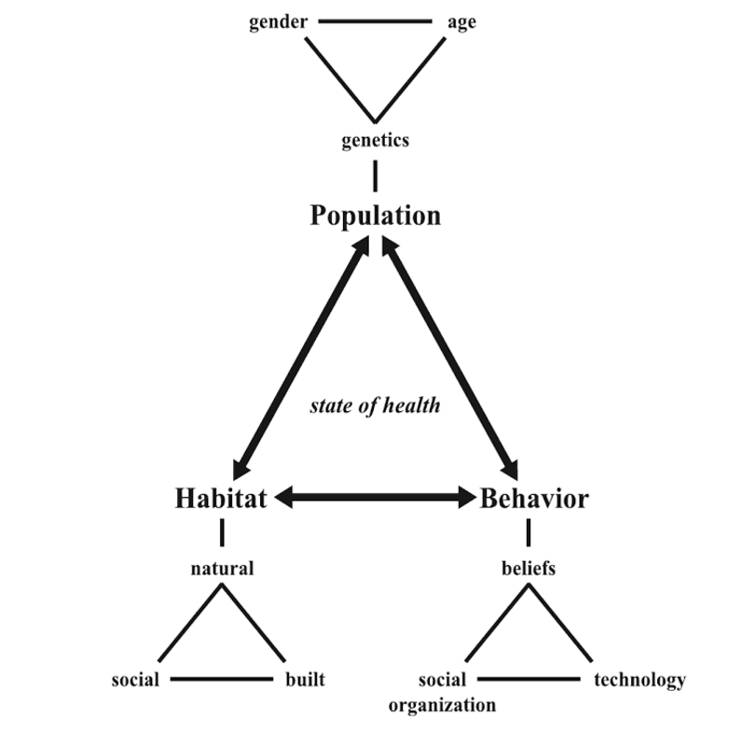

Slide 7
Humans as biological organisms

Slide 8
Humans as biological organisms
The environments in
in which we live

Slide 9
Humans as biological organisms
The environments in which we live
The observable aspects of culture
Notes:
Behavior isn’t just about how one individual comports themselves, but about how society structures human interaction.

Slide 10
Notes:
What are some of the factors we might consider? Examples of each?
Genetic susceptibility/resistance (ex. any time a family history puts you at risk, there is likely some genetic susceptibility)
Nutritional status (ex. The body is better able to fend off pathogens when nutrition is high—hookworm is very dangerous for children who are malnourished, but usually not for adults with healthy diets)
Immunological status (ex. families in the US—and even neighbors, friends—would often intentionally expose their kids to chicken pox if one kid gets it so that they deal with it all at once and then never again)
Physiological status (the chemical/electrical systems of the body—Ex. When the body is under stress—cortisol hormone is high—the body is less able to fend off pathogens)
Age and sex structure (ex. a top heavy population pyramid—a population with a lot of old people compared with the rest of the population—is usually more susceptible to disease)

Slide 11
Notes:
What are some of the factors we might consider? Examples of each?
Built environment: types of houses, pets, windows, central air/heating, how towns are laid out, etc. (ex. If no windows or mosquito nets, people may be at risk for Malaria)
Social environment: Groups, relations, societies. How is society organized? (Ex. Research suggests people at the bottom of the social hierarchy more at risk for disease)
Natural environment: Temperature, vegetation, mosquito breeding grounds, etc. (why don’t we have malaria in Seattle—too cold, mosquitoes not here year round, etc.)

Slide 12
Notes:
What are some of the factors we might consider? Examples of each?
Beliefs
Discourse (how we talk about things and the communal/societal meaning behind what we say—some discourses become normalized/mainstream and are generally considered fact; ex. Think about probiotics—prior to their rise in the early 2000s, there was little understanding of the importance of healthy bacteria—all bacteria was believed to be bad and killed)
Perceptions (what we think; in the 1990s there was a perception that only gay people had HIV which lead to a huge increase in the number of people contracting the disease from heterosexual sex)
Ideals (what we value; ex. in parts of the US, drug use is frowned upon, but within particular social circles, it is a barrier to entry)
Norms (what we define as normal; ex. shaking hands in the US is normal, so we do it even though it often increases our risk of contracting disease)
Economic constraints (ex. Low income people are more likely to live near hazardous waste sites)
Mobility (Our ability to move around means that we are exposed to more things through travel, but also that we may not live in the place our parents’ lived and thus may not have generational knowledge about health in that particular context. Ex. If I grew up keeping my windows open in the summer and I move to a malarial zone, unless I use a bed net, I am increasing my risk of contracting malaria)
Roles in society (ex. If tradition is that women gather water at the river, they are going to be more at risk for diseases that are geographically clustered around running water, for example, river blindness)
Cultural practices (ex. In China, tea is drunken because water often needs to be boiled to protect from disease)
Technological interventions (ex. Pacemakers and other medical technologies, but also non-medical technologies (ex. Sponges in the kitchen can spread disease; dishwashers that reach a particular temperature serve to limit the spread of disease))
Education (ex. In general, the more people know about disease risk factors, the more they can protect themselves)
Politics (ex. Access to contraception)

Slide 13
Notes:
What are some of the connections between the three corners of the triangle?
Examples:
-gender roles: population (gender breakdown) and behavior (societal roles)
-environmental degradation: habitat (natural/built environment) and behavior (where people want to live, what people want to use land for) and population (population growth often contributes)
-epigenetics: there is growing attention that the environments in which we live effect our genes (habitat and population)
There are many, many others!

Slide 14
Notes:
Lets think about the disease in the film Contagion. How would we fit it into this model?
(whiteboard)

Slide 15
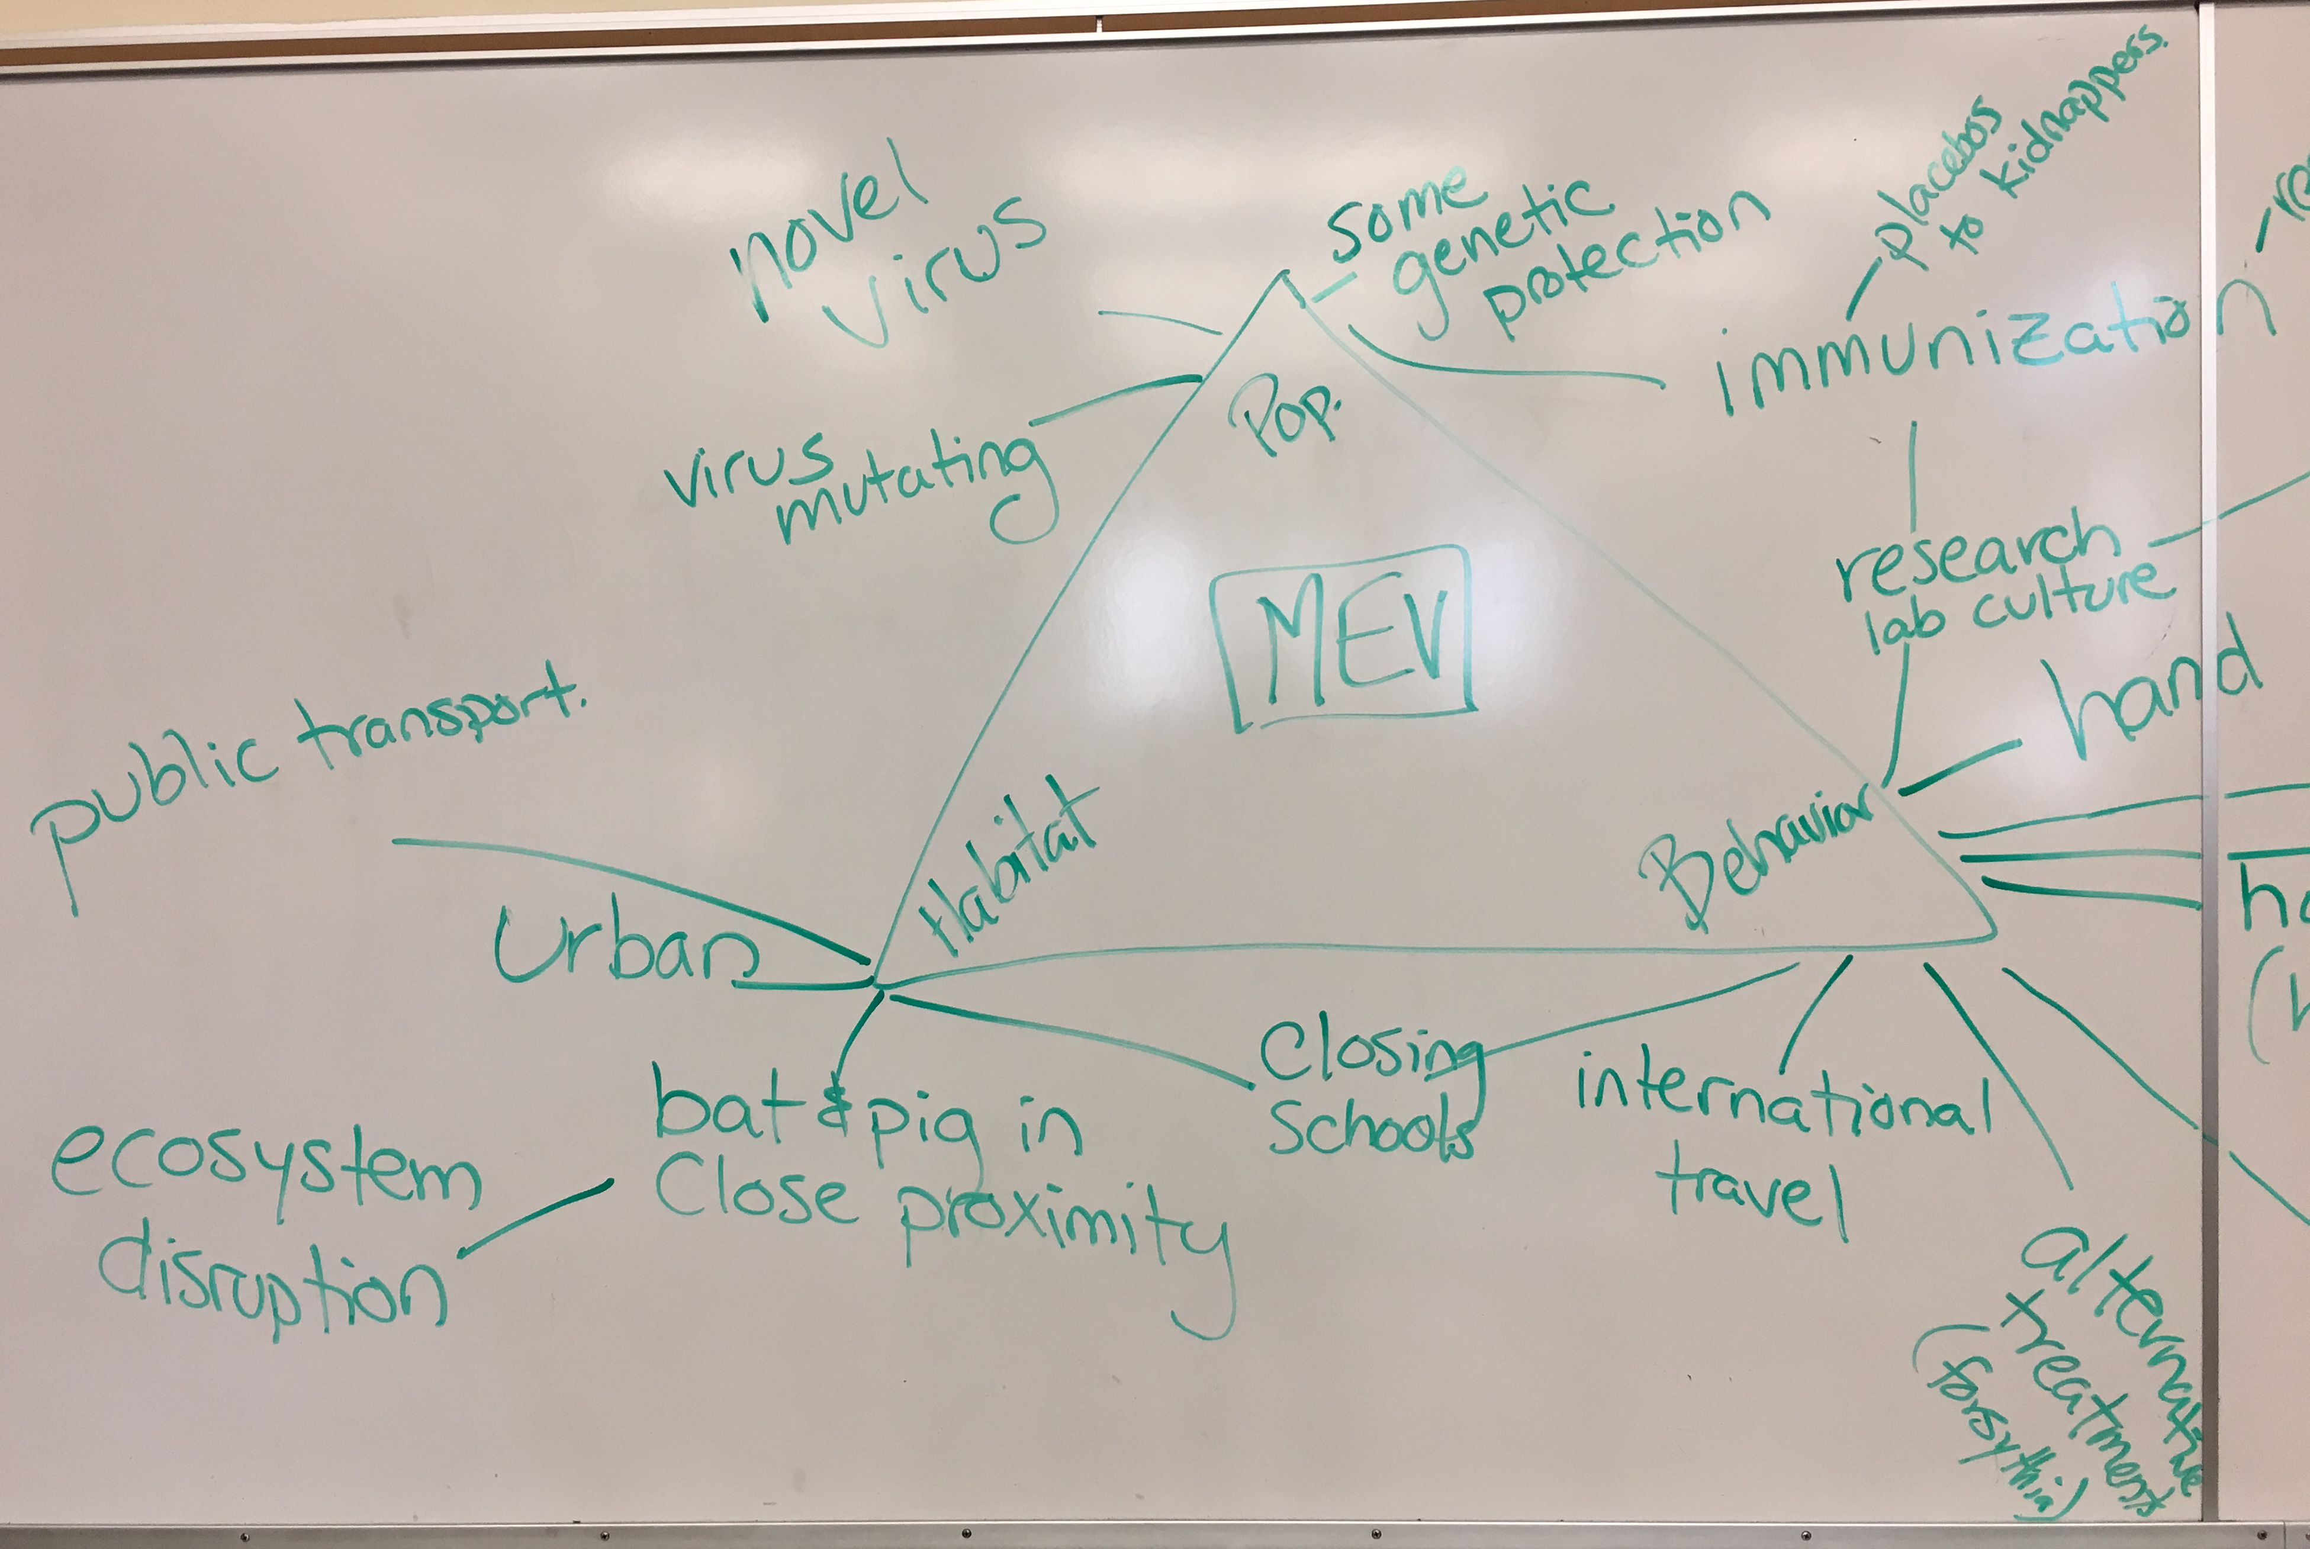
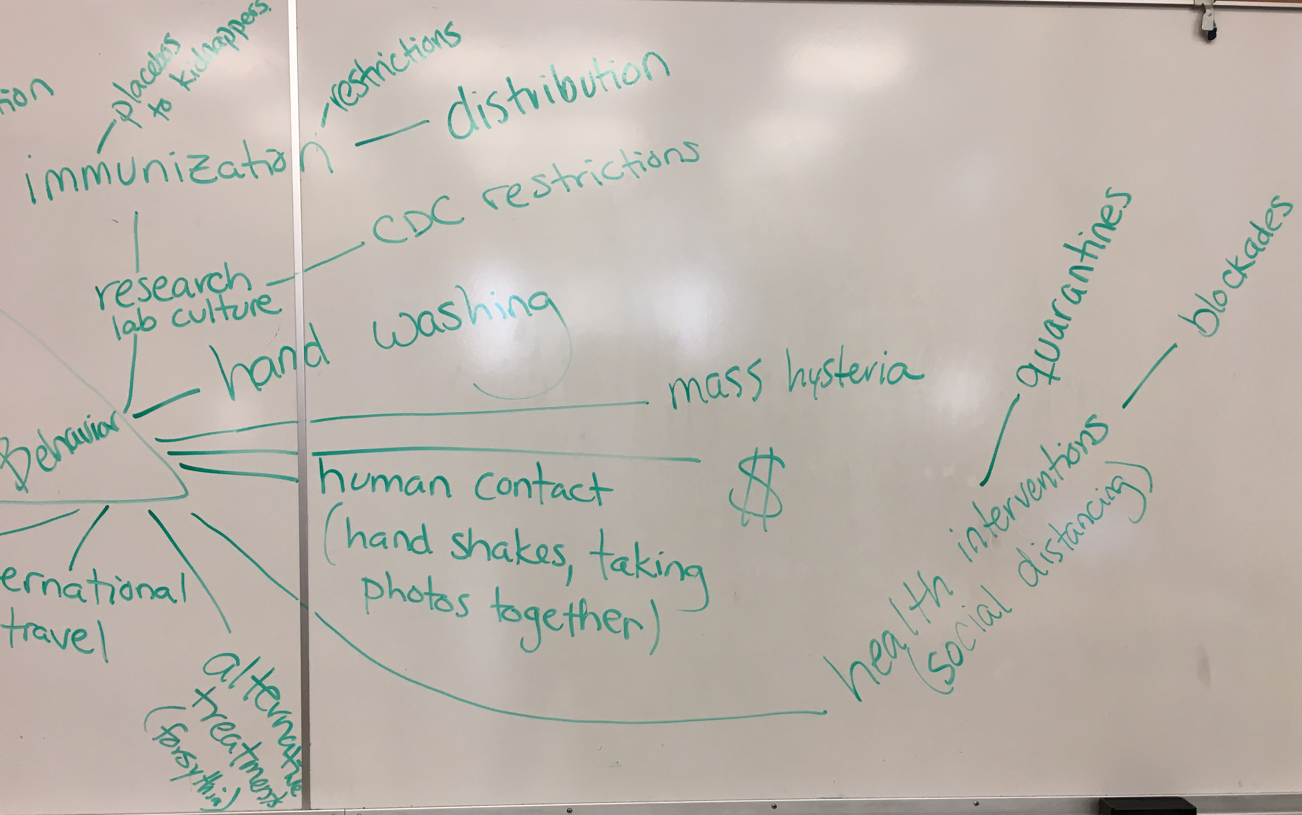
Notes:
Photo added after lecture of white board depiction of the class modeling MEV (the disease from Contagion) using a disease ecology framework.

Slide 16
Critiques of the human ecology of disease framework?
Focuses particularly on infectious disease
Notes:
Growing research considering apparently non-infectious diseases (why apparently? Because we often don’t know; many examples of diseases we thought were non-communicable, but actually were caused by infectious agents—Examples?: HPV causing cervical cancer) from a disease ecology model. Non-infectious diseases are also the product of population, habitat and behavior (ex. Heart disease—genetic predispositions, diet (dependent on habitat and behavior), exercise (dependent on habitat and behavior), etc.).

Slide 17
Critiques of the human ecology of disease framework?
Focuses particularly on infectious disease
Doesn't focus enough on underlying power relations or politics
Notes:
Early critiques suggest that politics/power not considered—you probably saw the term political ecology of disease in Dr. Mayer’s article—political ecology of disease was a response to this critique that emphasized the political sources, conditions and ramifications of environmental change and the linkages between power/politics/culture and the environment, in particular stressing the fact that the environmental conditions that produce/enable disease are often human-made or human-mediated. Power and politics are now relatively well encompassed in disease ecology in part because of the writing of Dr. Mayer.

Slide 18
Questions?
Notes:
This is essentially what you will be doing in Assignment 1—mapping out the disease ecology of a disease of your choice, so start thinking about what disease interests you.

