Slide 1
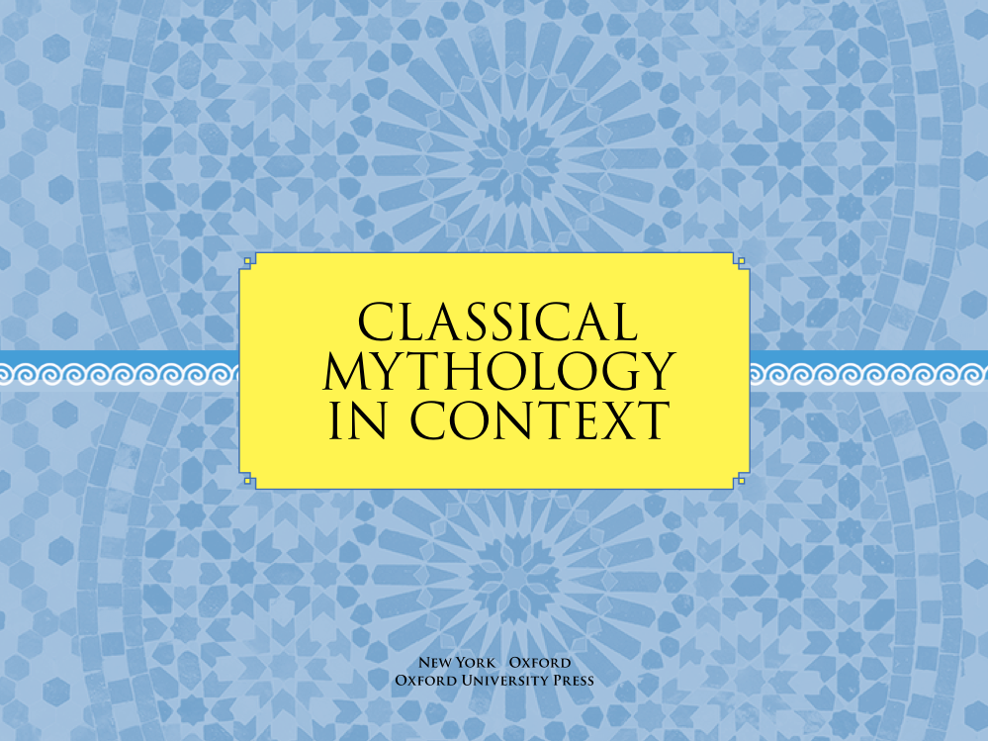
Chapter 2

Slide 2

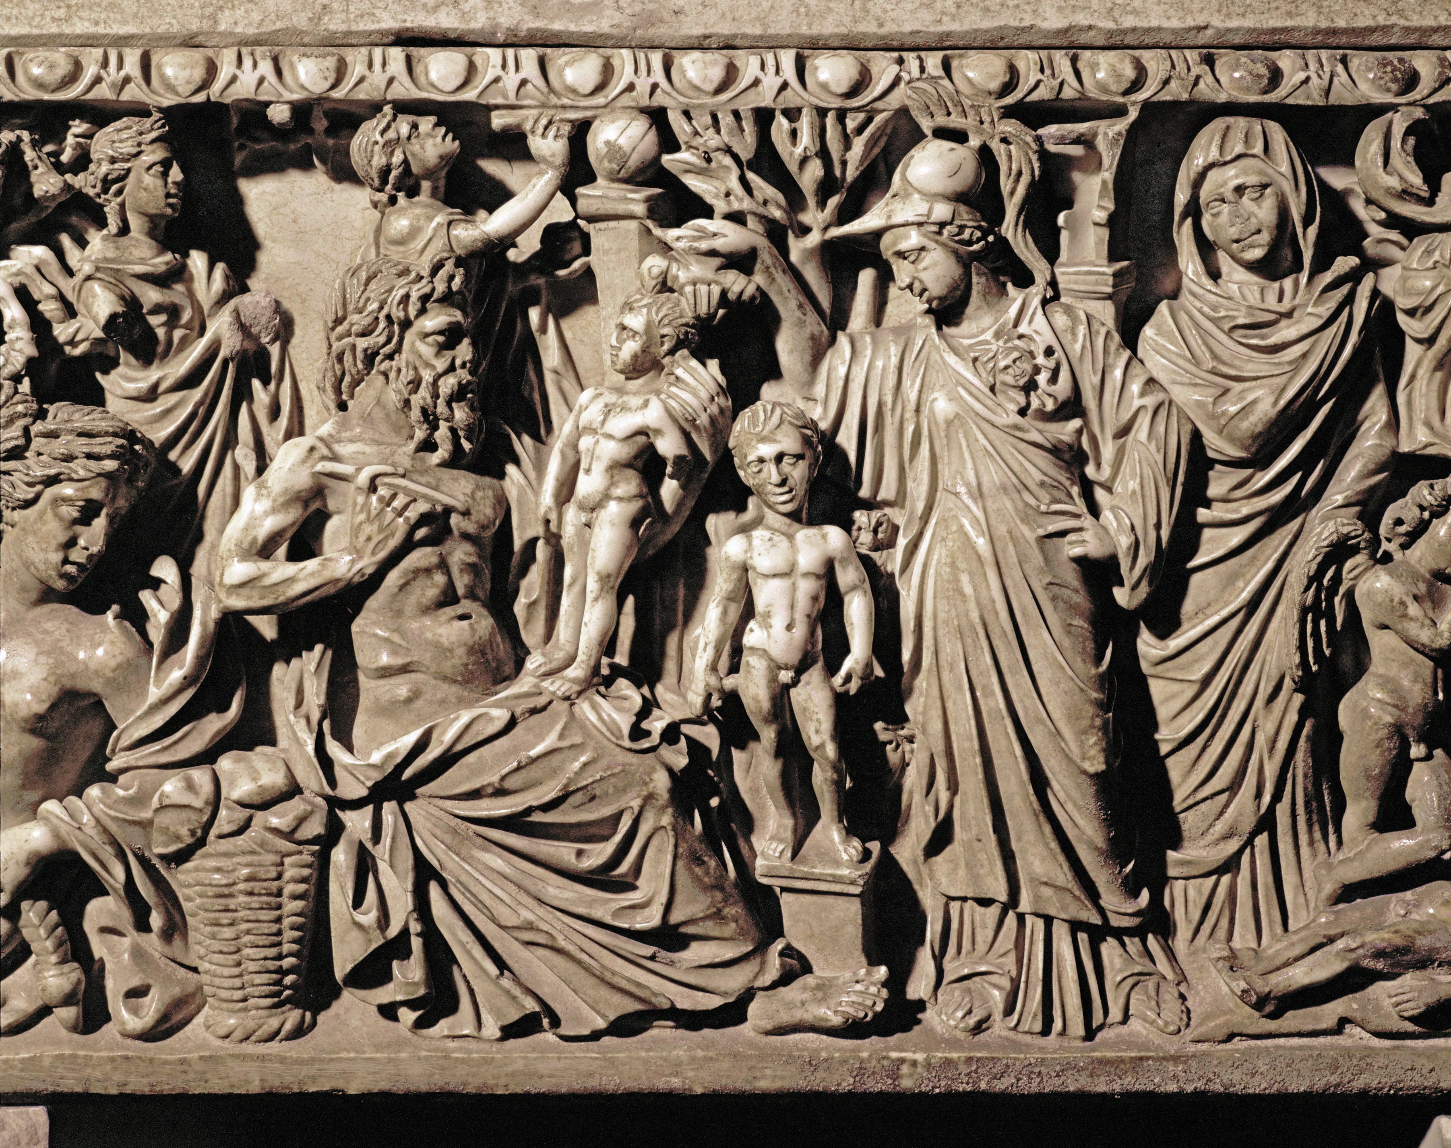
Creation Stories
Reflect understanding of how the world works
Set ethical, social, and religious patterns for a society
Provide explanations of the order of a society
2.1 Prometheus (seated) molds human beings out of clay and water. Marble sarcophagus. Third century ce. Museum Capitoline, Rome, Italy. Erich Lessing / Art Resource, NY, ART74681.

Slide 3
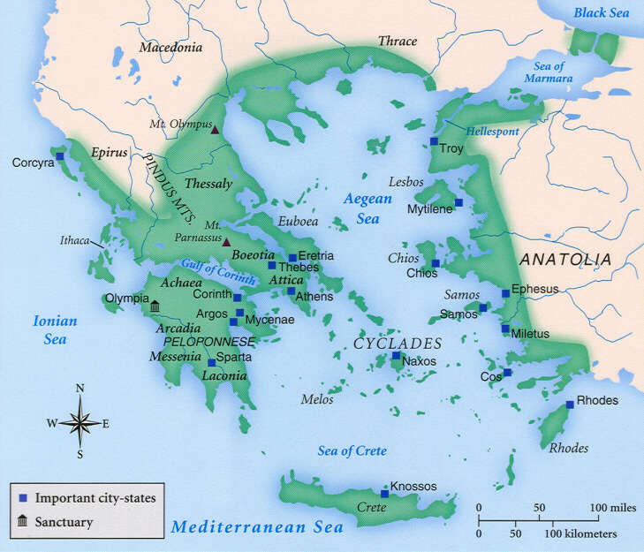
Hesiod’s Theogony ( Theos (GODS) AND GONOS (OFFSPRING)
A Theogony is a collection of stories about the nature of the cosmos and represents the fundamental vision or worldview of a particular people or culture.
All societies old enough to have created a cosmogony create a story to support and transmit their views.
Purpose:
to explain the origins of the universe (creation myth)
Account of the genealogy of the Greek pantheon
Origins of the social structure
Explain the relationships between humans, deities, nature and the cosmos
As sacred stories they recreate a primordial age before written history and provide a narrative context for religious rituals and beliefs.
Hesiod b. ca 700 BCE in Boeotia.

Slide 4
Ancient Poets and The Muses
The Muses were invoked at the beginning of poems and hymns
Homer begins the Iliad with a nod to the muses and credits them throughout his epics.
Hesiod creates their domain, definition and credits them for his inspiration for Theogony
Their early entry into the pantheon of Olympus supports their importance.

Slide 5
Gaia or Gaea
1. From Chaos comes Night and Erebus
2. One of the Protogenos (primeval divinity) of earth as a primal element that emerged at the dawn of creation, along with air, sea and sky.
2. Gaia (GE) The great mother of all: the gods are descended from her union with Uranus (the sky), Pontos (the sea) and Gigantes from her mating with Tartarus (hell pit) and mortal creatures come from her earthly flesh.

Slide 6
Uranus and Gaia – Titans, Cyclopes and Hecatonchires
Titans: They give birth to twelve sons and six daughters. He locked them in Gaia’s belly. Gaia suffered immense pain and asker her all her Titan sons to rebel.
Four of them (the sentinels) and their brother at the center castrated Uranus. His blood fell producing the avenging Erinyes( Furies) and the Gigantes.
Uranus prophesized that the fall of the Titans would happen like his. Pattern is repeated in generational conflict among succeeding generations of deities. (Cronus – Rhea)
Cyclopes (Brontes Thunder, Steropes Lightening and Arges Bright
Hecatonchires: Cottus, Briareus, and Gyes (hundred arms and hands)

Slide 7
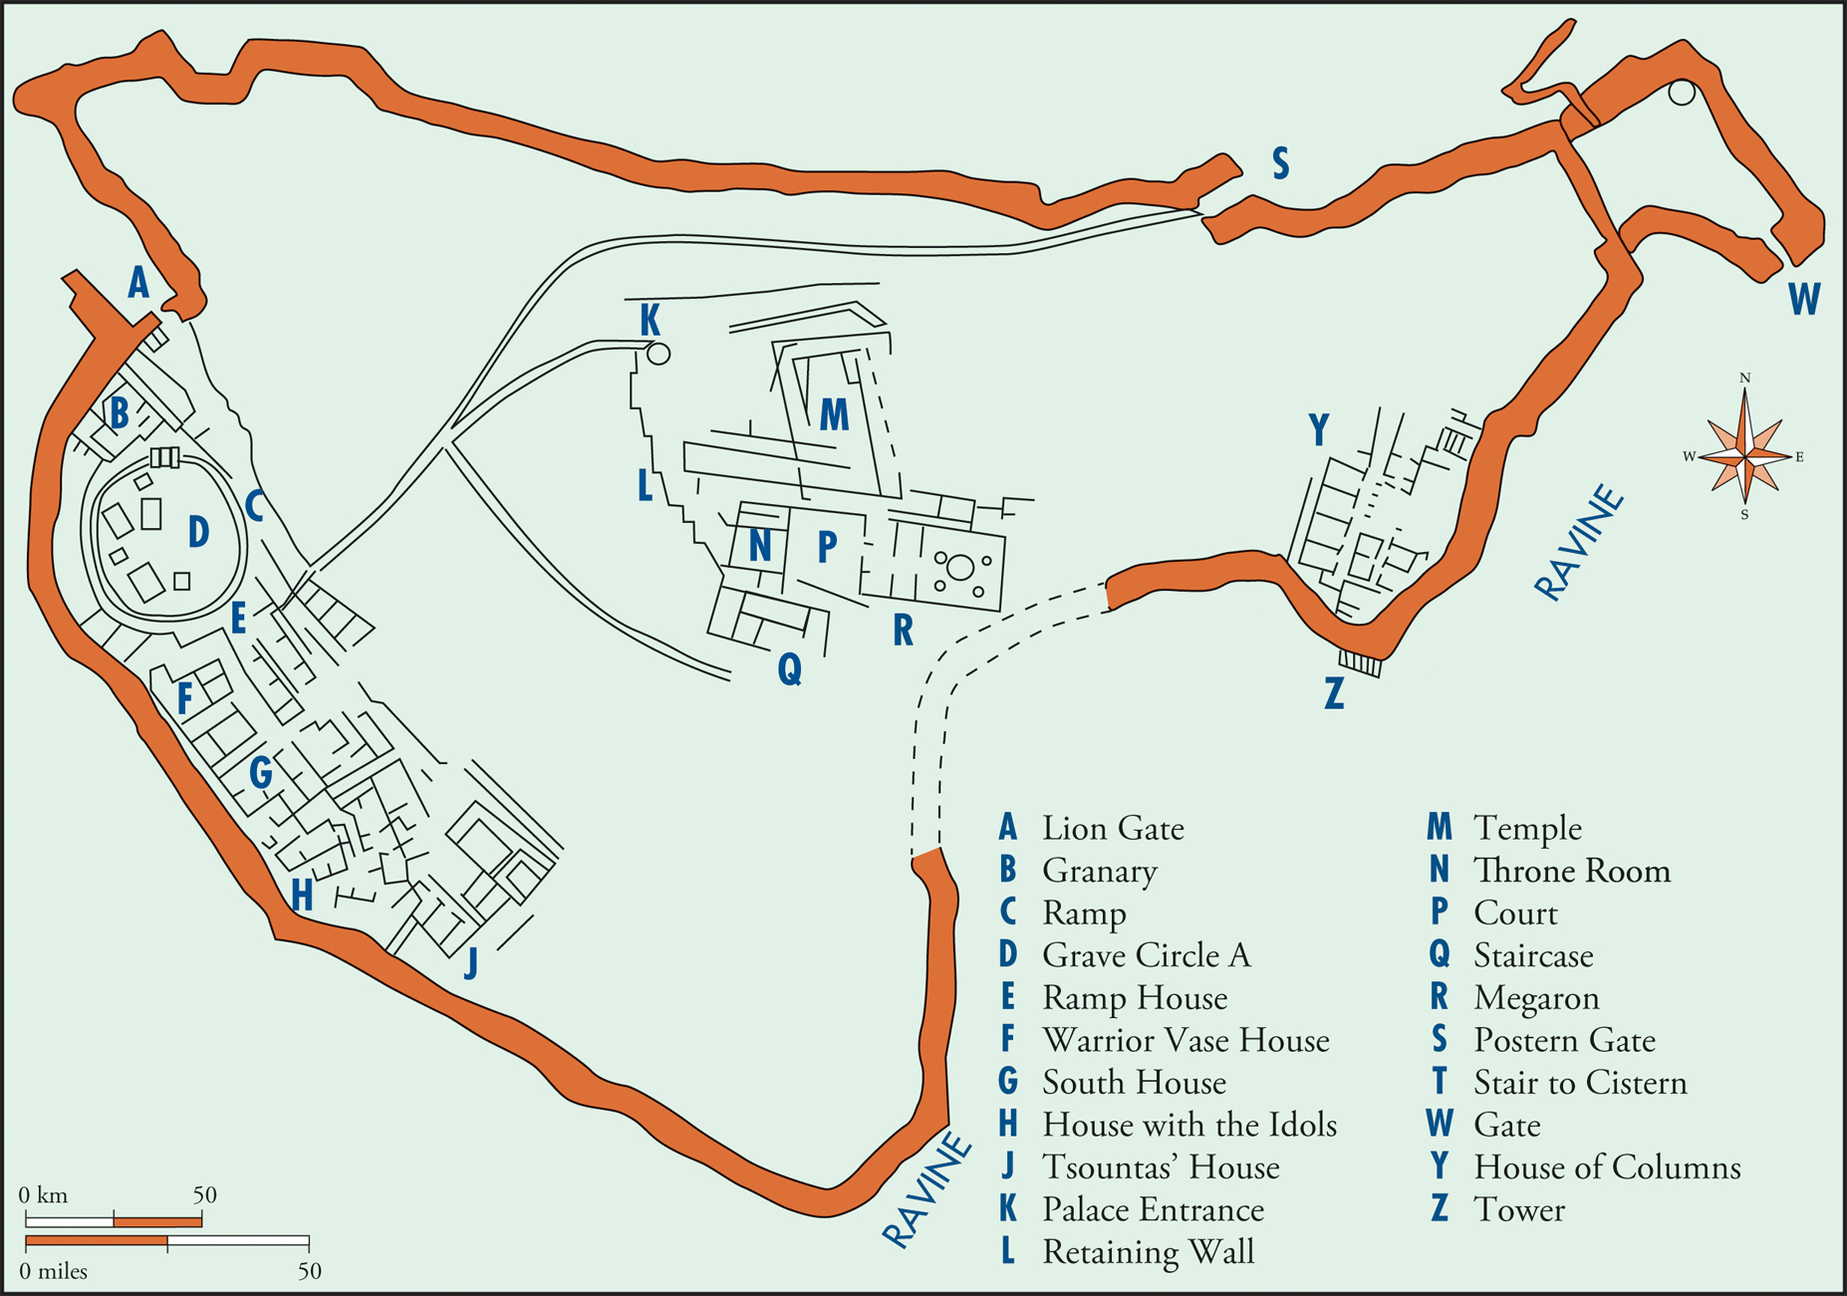
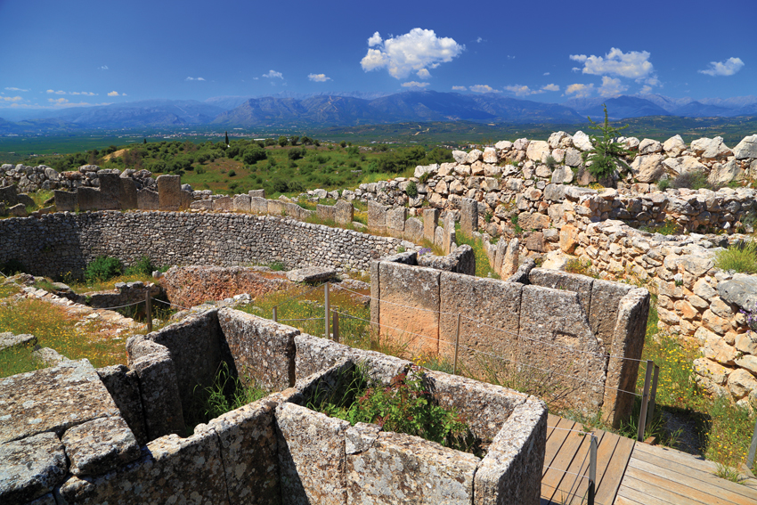
The Late Bronze Age: Mycenae
Mycenae was an important Bronze Age settlement in Greece
It was a fortified settlement, probably the home of the king (wanax), located on a hilltop
b
a
2.3a Plan of Mycenae’s Citadel.
2.3b Ruins of Mycenae today. © Florin Stana/Shutterstock 194965928.

Slide 8
The Iron Age: Ascra
The Iron Age is named after its use of iron for tools and weapons
Few records remain from this period
Hesiod’s Works and Days was composed at the end of this period
Takes place in Ascra, on Mount Helicon in Boetia
Hesiod’s description of Ascra is backed up by the archeological record
Kings have lost central authority
Most residents are small, independent farmers

Slide 9
The Archaic Period and Panhellenism
Hellenic identity developed during the Archaic Period
Maintained by Panhellenic sanctuaries and festivals
Oral performances of works by Homer and Hesiod developed a shared understanding of gods and goddesses
Led to a gradual homogenization of belief and worship
Local variations on the traits and worship of gods remained

Slide 10
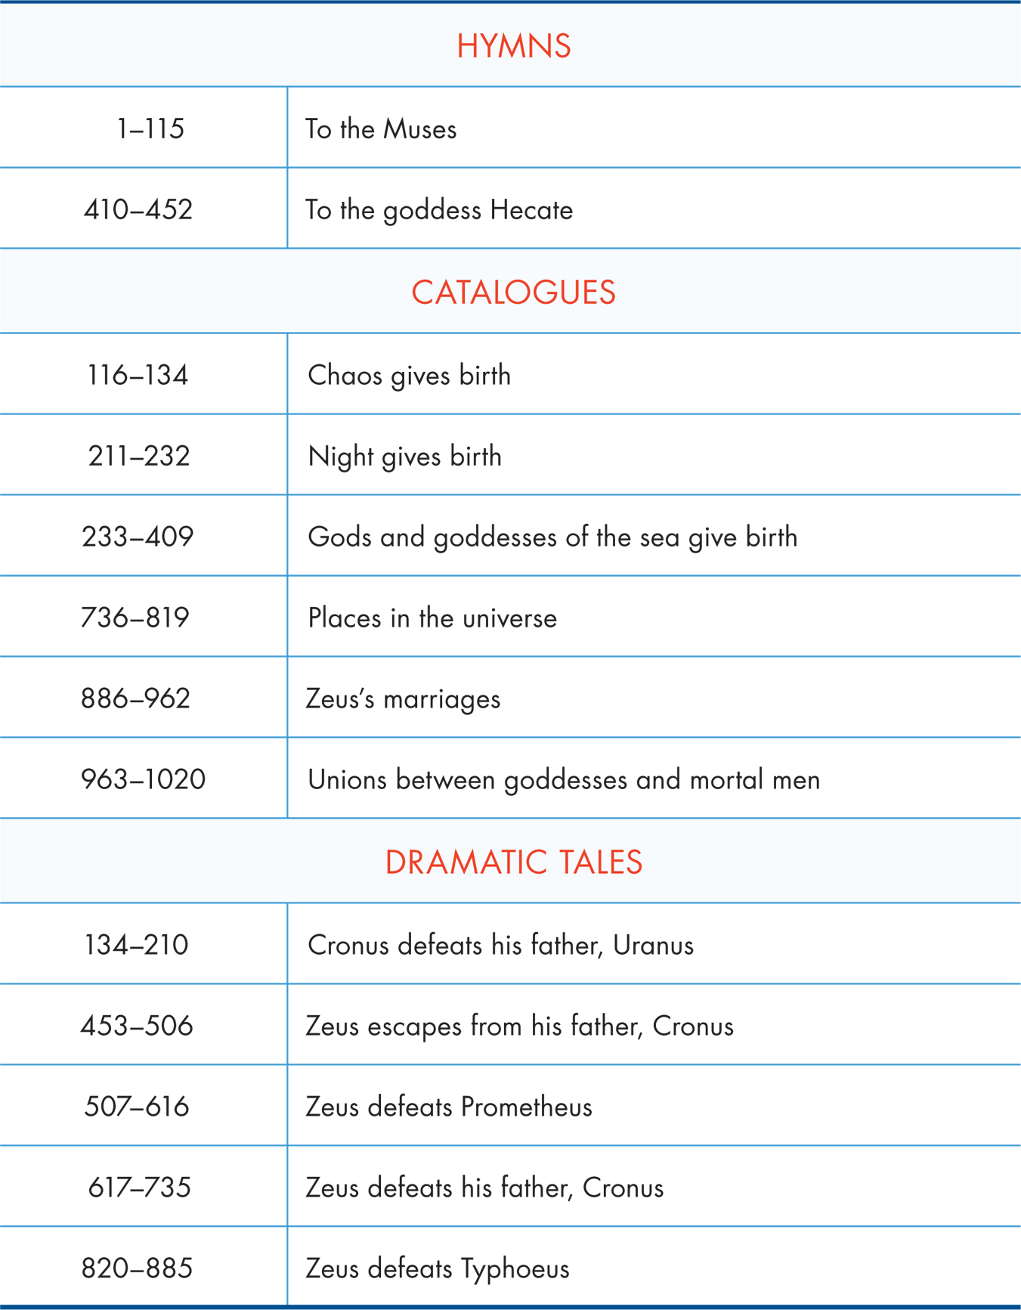
The Theogony
Hesiod was instrumental in shaping Panhellenic ideas of the gods
Theogony was a collection of oral poems
Hymns
Catalogues
Dramatic Tales
Described the Greek understanding of the creation of the universe
Table 2.1

Slide 11
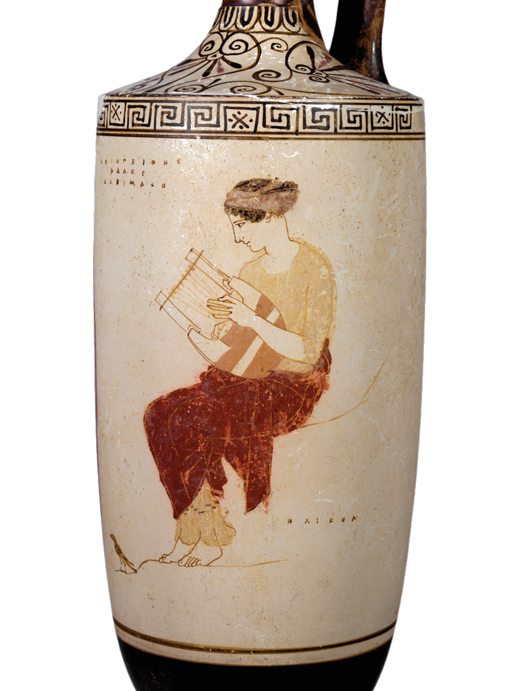
Hymns
Meant to be recited aloud
Primary purpose is prayer to and praise of the gods
Hesiod’s hymn to the Muses praises them for inspiring his poetry
Hymn to Hecate presents her as a protective goddess
2.7 A Muse plays a lyre atop Mount Helicon. Attic red figure (white ground), Lekythos. Achilles Painter, c. 445 bce. Staatliche Antikensammlungen und Glypothek München, Photograph by Renate Kühling, S80 Beazley Archive Number: 213977.

Slide 12
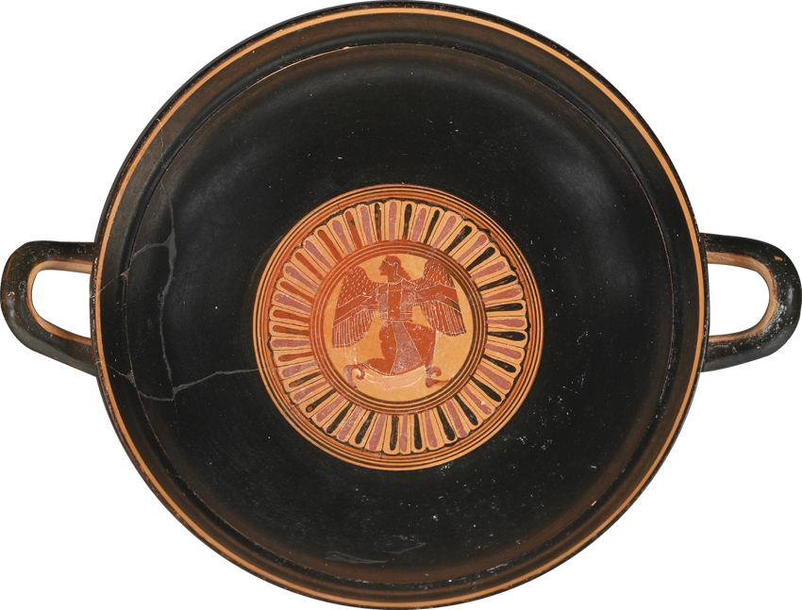
Catalogues
Genealogies of the gods
Designed to be recited aloud
Describes creation as a genealogy of the earliest gods
Presents two methods of procreation: spontaneous and within marriage
2.8 Strife (Eris). Interior of a black figure cup. Nikosthenes, c. 540–530 bce. The J. Paul Getty Museum, Villa Collection, Malibu, California, 86.AE.169.

Slide 13
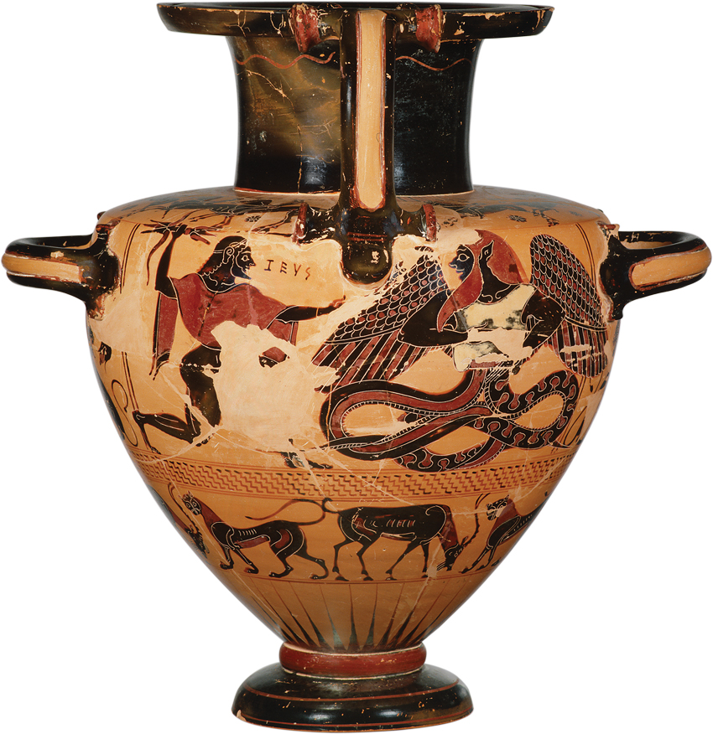
Dramatic Tales
The dramatic tales describe how Zeus came to rule creation
He imprisons chaotic gods
Institutes marriage to control female reproduction
Creates order and justice
2.9 Zeus defeats Typhoeus. Chalcidian black-figure hydria, c. 540 bce. Staatliche Antikensammlungen und Glypothek München. Photograph by Renate Kühling, 596.

Slide 14
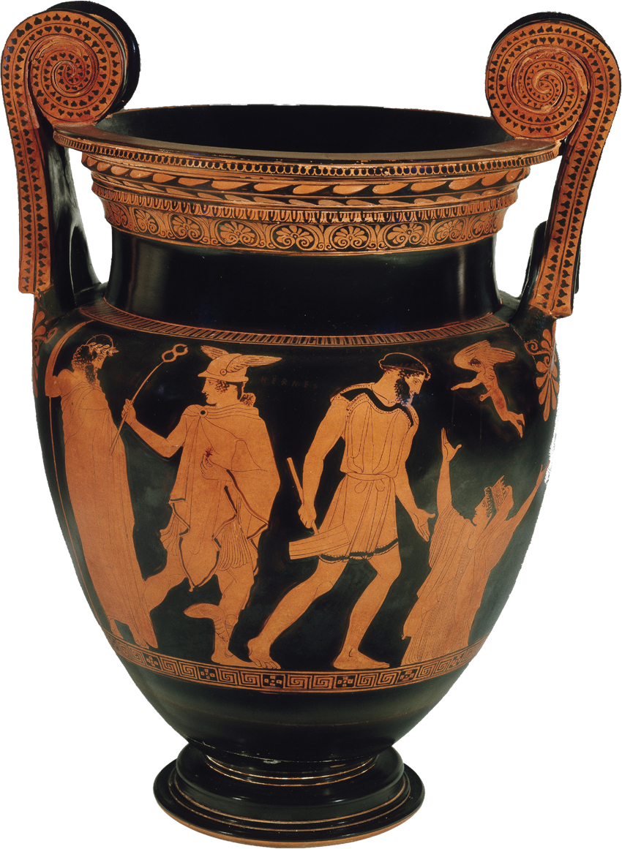
Prometheus and Pandora
Addresses both the institution of marriage and the ideal of order in society
Prometheus steals fire to benefit humanity, his creation
Zeus punishes them by sending them Pandora
Beautiful but deceitful; represented women
2.10 The creation of Pandora with Epimetheus, Hermes, and Zeus. Red-figure krater. Fifth century bce. Ashmolean Museum / The Art Archive at Art Resource, NY, AA566705.

Slide 15
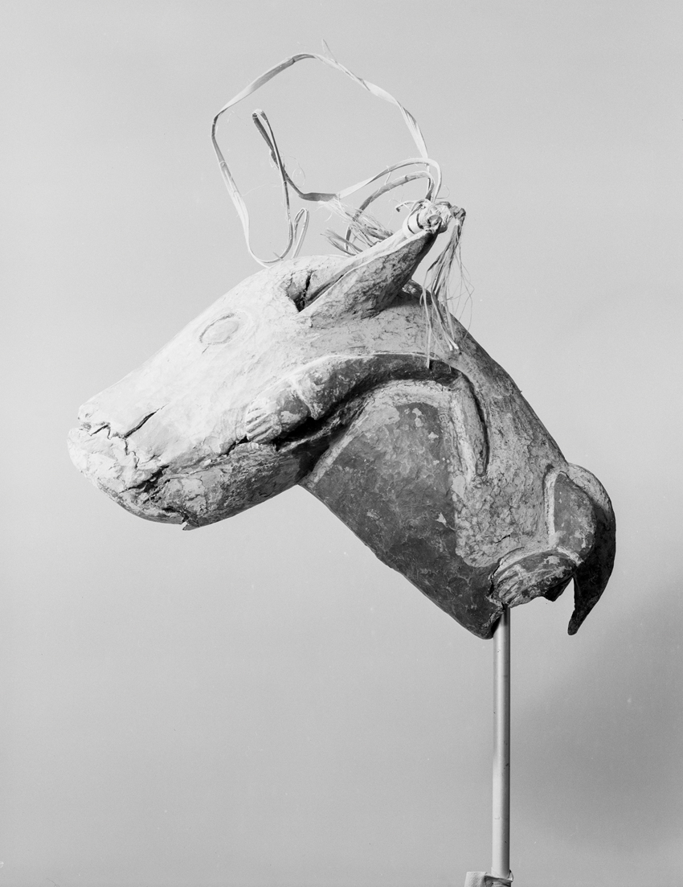
The Social World Shapes Myth
Bronislaw Malinowski placed myths within social context
Only social context can explain the function of a myth for its society
Myths can be ‘charters’: practical guides about how to behave for the people who hear them
2.11 Pig figure. Wood, paint, and fiber. Early to mid-twentieth century. Papua New Guinea, Prince Alexander Mountains, Middle Sepik River. Image copyright © The Metropolitan Museum of Art. Image source: Art Resource, NY, ART500336.

Slide 16
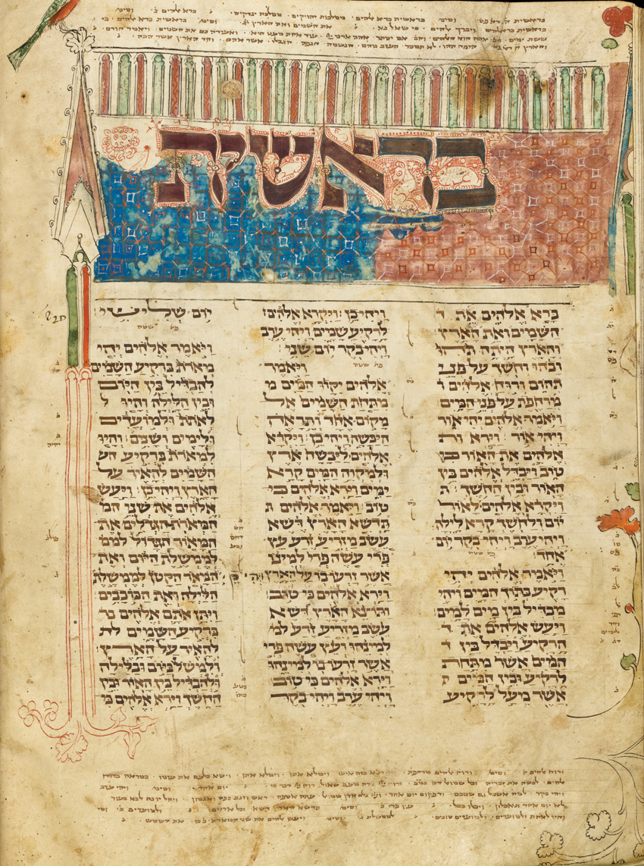
Creation Stories from the Levant
Enuma Elish, the Babylonian creation story, may have influenced Greek oral poetry
Depicts the Gods as fighting the forces of chaos
Genesis is distinguished by the Hebrew’s monotheistic beliefs and focus on the creation of humanity
It also emphasizes the creation of order
2.12 Illuminated medieval manuscript of Genesis 1 from the Hebrew Bible. The Xanten Bible. Germany, thirteenth to fourteenth century ce. Spencer Collection. The New York Public Library / Art Resource, NY, ART497620.

Slide 17
The Twelve Olympians: Zeus, Hera, and Their Children
Zeus’ Establishment as Supreme God
Zeus—sky
Poseidon — sea
Hades — underworld
Pantheon of Gods
Zeus (Jupiter)
Hera (Juno)
Poseidon (Neptune)
Hades (Pluto)
Hestia (Vesta)
Hephaestus (Vulcan)
Ares (Mars)
Apollo
Artemis (Diana)
Demeter (Ceres)
Aphrodite (Venus)
Athena (Minerva)
Hermes (Mercury)
Dionysus (Bacchus)
Canonical twelve (with removal of Hades and Hestia)
Hestia, Goddess of the Hearth and Its Fire
A goddess of chastity
Hearth/sacred fire
Hestia (“hearth”)
Family⇨tribe ⇨city ⇨state
Transmission of fire
First-born of Cronus and Rhea

Slide 18
The Twelve Olympians
Zeus
Amorous nature
Image of father, husband, and lover
Justice and virtue
Moral order of the universe
The cloud-gatherer
“Bright”
Thunder/lightening
Aegis/eagle/oak
Tales of Zeus’ subordination
Zeus and Hera
Hieros Gamos
Hera: consort and queen
Stern, vengeful
Women/marriage/childbirth
Peacock
Sanctuary of Zeus at Olympia
Elis
Olympic Games, 776 B. C.
Connection with Heracles
Pelops and Hippodamia
Temple of Zeus
West pediment: Lapiths and Centaurs
Ixion impregnates the nephele (“cloud”) that Zeus had fashioned to resemble his wife, Hera
Ixion’s punishment on the wheel
Nephele gives birth to Centaurus, the father of the race of centaurs
Chiron: wise, gentle tutor to heroes
Violent and lustful nature typical of centaurs
Lapiths, a Thessalian tribe
Pirithoüs, Lapith chieftain and a son of Ixion
Wedding of Pirithoüs and Hippodamia

Slide 19
The Twelve Olympians
East pediment: race of Pelops and Oenomaüs
Metopes: Twelve Labors of Heracles
Cult image of Zeus carved by Pheidias
Oracles at Olympia and Dodona
Whispering oaks of Dodona
Priestess and tripod
Oracles and prophets
Trophonius
Melampus
Amphiaraüs
Tiresias
Children of Zeus and Hera
Eileithyia, goddess of childbirth
Hebe: cupbearer to gods
Ganymede
Hephaestus, divine artisan
God of fire and forge
Lame
Return of Hephaestus
Consort of Aphrodite
Her adultery with Ares
Ares, god of war
Cult partner: Aphrodite
Thrace
Eros
Brutality of war

Slide 20
The Twelve Olympians
Other Children of Zeus
The Nine Muses
Mnemosyne (“memory”)
Patrons of literature and the arts
Pieria/Mt. Helicon
“Reminders”
Calliope (epic)
Clio (history or lyre playing)
Euterpe (lyric or tragedy and flute playing)
Melpomene (tragedy or lyre playing)
Terpsichore (choral dancing or flute playing)
Erato (love poetry or hymns to gods and lyre playing)
Polyhymnia (sacred music or dancing)
Urania (astronomy)
Thalia (comedy)
The Three Fates
Children of Zeus and Themis
Moirai (Greek) or Parcae (Latin)
Clotho (“spinner”)
Lachesis (“apportioner”)
Atropos (“inflexible”)
Luck or Fortune (Tyche)
Necessity (Ananke)

