Slide 1
Marketing Analytics –
Marketing Mix
Dr Arne Floh
Room 12MS03
Phone: 01483689185
a.floh@surrey.ac.uk
Skype: arnefloh

Slide 2
Outline
Resource allocation for marketing mix:
Advertising
Pricing
Personal selling

Slide 3
ADVERTISING

Slide 4
Advertising Budgeting in Practice
Affordable method
Percent of sales
Competitive parity method
Objective/task method
Model-based /Response Model approach

Slide 5
Sales Response to Advertising
Shape: S-shape? Linear? Decreasing returns? Saturation point? Threshold?
Dynamics: Growth and decline equal? Delay/carryover effects? Hysteresis?
Interaction: Advertise in strong (or weak markets)?

Slide 6
Advertising
Advertising interacts with other mix elements:
Personal selling (especially for industrial products)
Branding (advertise the brand/company?)
Price (does it increase or decrease price elasticity?)
Distribution (how to match distribution coverage with advertising coverage?)

Slide 7
What do we know about advertising response?
Sales respond dynamically upward and downward, respectively, to increases and decreases of advertising and frequently do so at different rates.
Steady-state response can be concave or S-shaped and will often have positive sales at zero advertising.
Competitive advertising affects sales.
The dollar effectiveness of advertising can change over time as the result of changes in media, copy, and other factors.
Products sometimes respond to increased advertising with a sales increase that falls off even as advertising is held constant

Slide 8
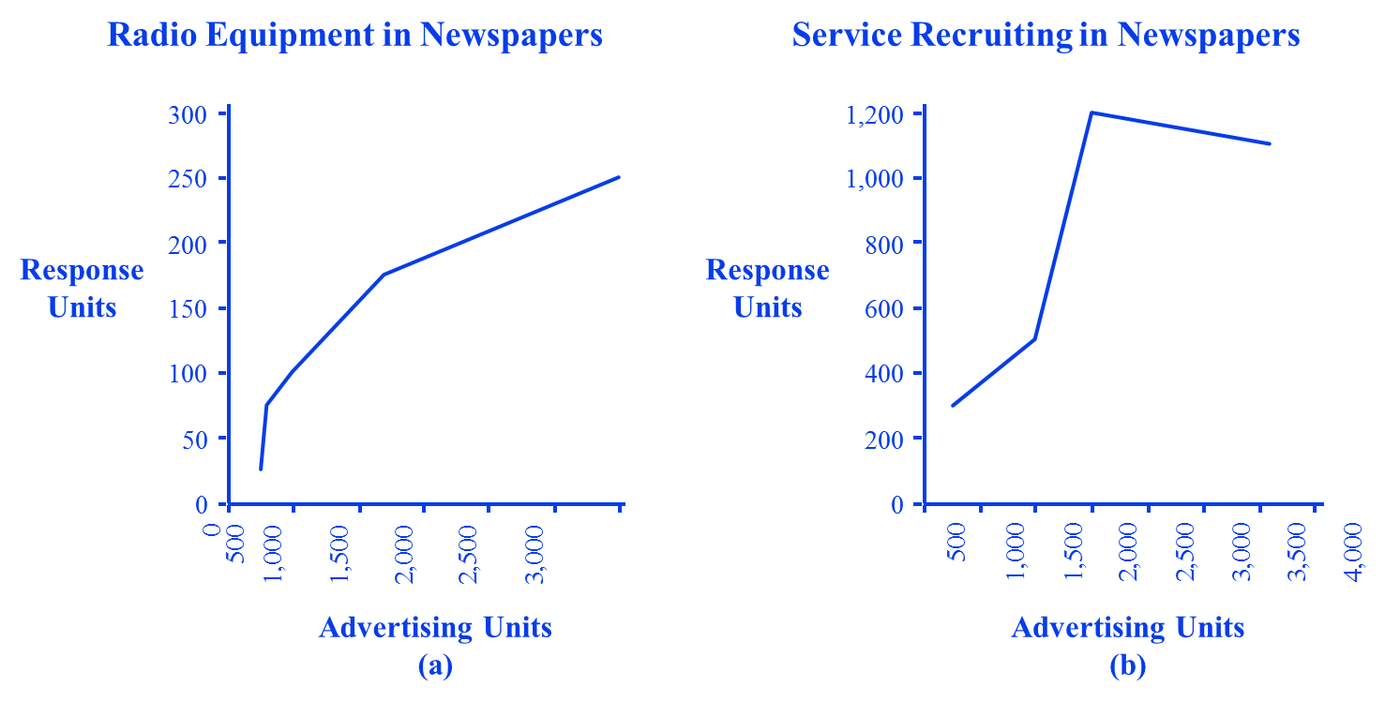
Response Shape Example

Slide 9
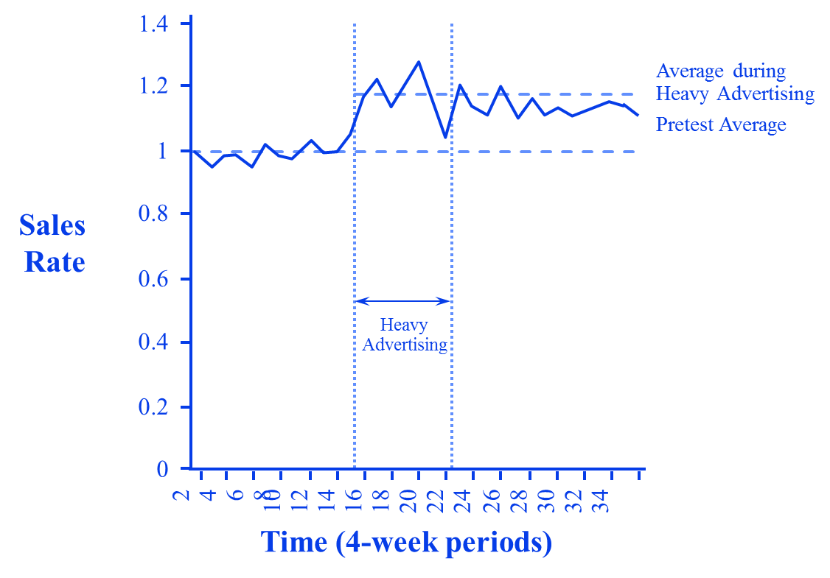
Hysteresis Example over time

Slide 10
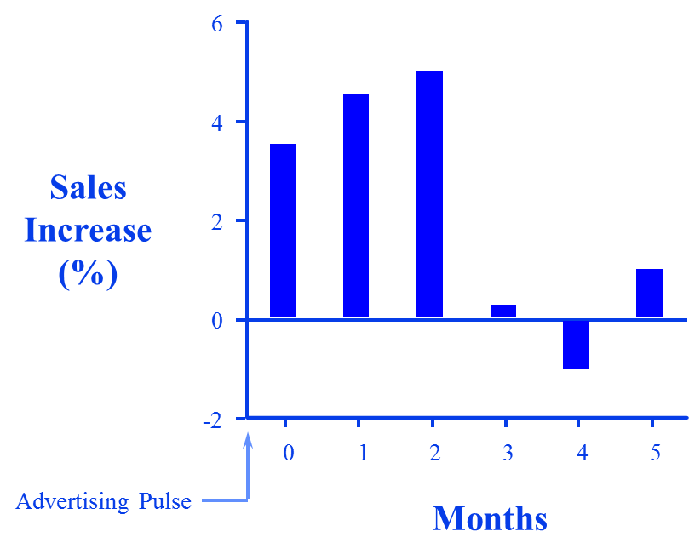
The Timing of Advertising Response

Slide 11
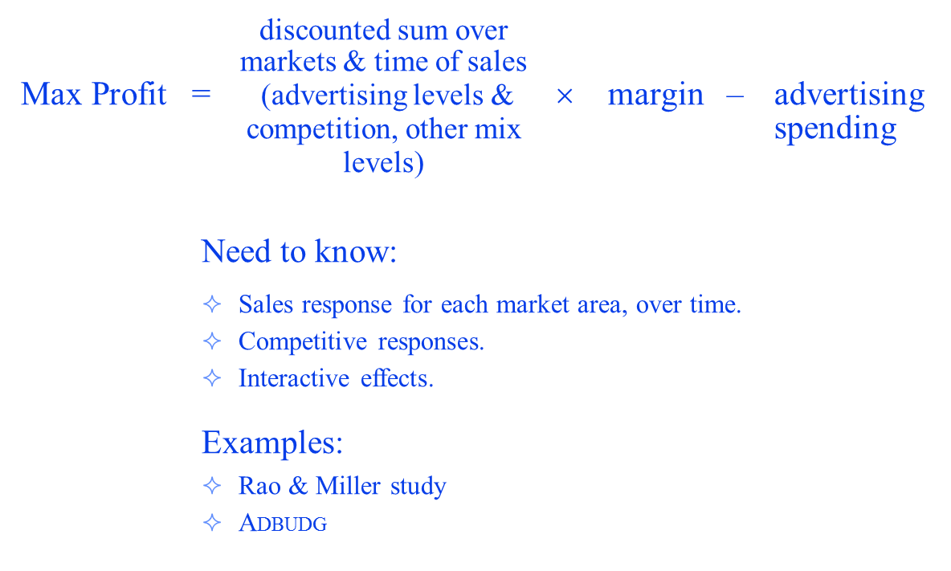
Response Model: Theoretical Idea

Slide 12
Rao and Miller Study
Idea:
Use natural variations in changes in advertising versus changes in sales across markets to develop a response function.
Use response function to optimize advertising spending.

Slide 13
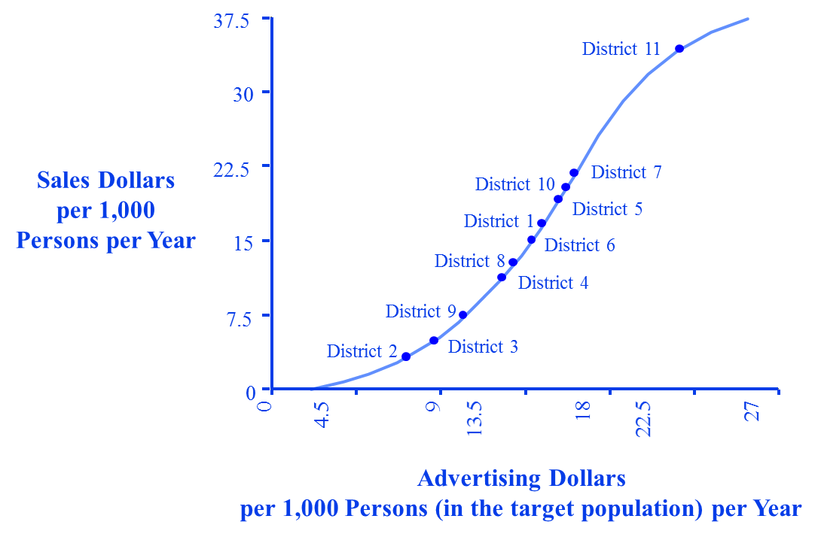
Advertising Response Function (for a specific brand)

Slide 14

Market response model for advertising:
Adbug Model
X^{c}
d + X^{c}
Y = b + (a–b)
S-shaped and concave; saturation effect.
b: Minimum sales with zero effort
a: Maximum (saturation-level sales)
c, d: Response parameters
$$Sales response$$
$$=$$
$$min+\left(max−min\right)∗\frac{{adv}^{c}}{(d+{adv}^{c})}$$
Notes:
13
12

Slide 15
ADBUDG Response Model Assumptions
If advertising is cut to zero, brand share will decrease, but there is a floor (min), on how much share will fall from its initial value by the end of the period. (minimum market share)
If advertising is increased a great deal, say to something that could be called saturation, brand share will increase but there is a ceiling (max), on how much can be achieved by the end of one period. (saturation, maximum market share)
There is some advertising rate that will maintain initial share.
An estimate can be made by data analysis (i.e., regression analysis) or managerial judgment of the effect on share by the end of one period of a xx% increase in advertising over the maintenance rate.

Slide 16

Response Function
Market share response
Max
Current
Sales
Min
50% Current Effort
150% Current Effort
Current Effort (maintenance advertising)
Advertising effort
$$Market share response=$$
$$min+\left(max−min\right)∗{adv}^{c}/(d+{adv}^{c})$$
Notes:
5

Slide 17
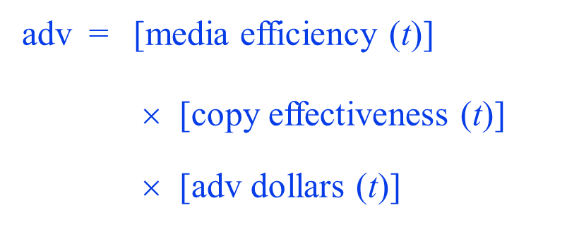
Effective Advertising

Slide 18
Adding Time Delays/Carryover
In the absence of advertising, share would eventually decay to some long-run minimum value (possibly zero)
The decay in one time period will be a constant fraction of the gap between current share and the long-run minimum, that is, decay is exponential
Long run min = lowest share possible in the long run
Persistence = fraction of the difference between
“long run min” and amount of share
retained with zero advertising

Slide 19
The Full Model
Share_{t} = Long Run Minimum (LRM)
+ Persistence × (Share_{t–1} – LRM)
+ Share Response

Slide 20
Pricing

Slide 21
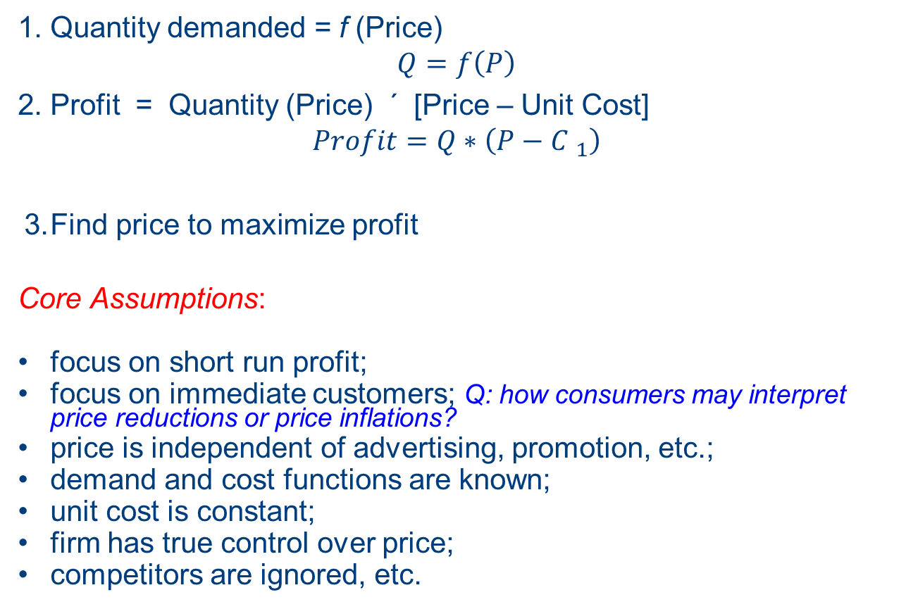
Classical Price Theory
1. Quantity demanded = f (Price)
$$Q=f\left(P\right)$$
2. Profit = Quantity (Price) ´ [Price – Unit Cost]
$$Profit=Q∗\left(P−{C }_{1}\right)$$
3. Find price to maximize profit
Core Assumptions:
focus on short run profit;
focus on immediate customers; Q: how consumers may interpret price reductions or price inflations?
price is independent of advertising, promotion, etc.;
demand and cost functions are known;
unit cost is constant;
firm has true control over price;
competitors are ignored, etc.

Slide 22
Pricing in Practice
Cost-Oriented Pricing (e.g., learning curve analysis)
When costs are constant and demand is inelastic
Competitor-Oriented Pricing (e.g., competitive bidding)
Competitors influence prices through their actions in the marketplace. When only a few dominant players and low differentiation.
Demand-Oriented Pricing (e.g. elasticity analysis)
Customers influence prices through their influence on demand.
- we need to estimate the relationship between price and demand

Slide 23
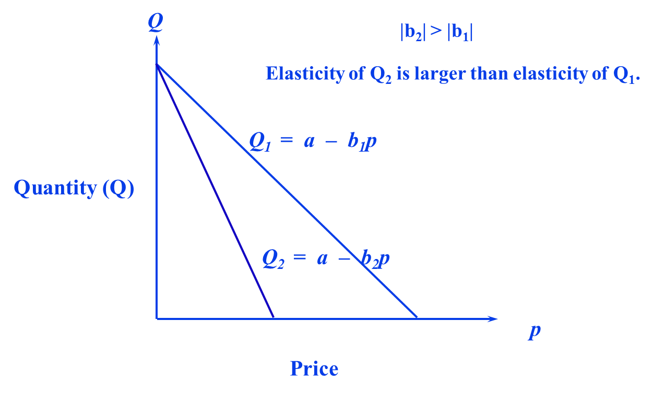


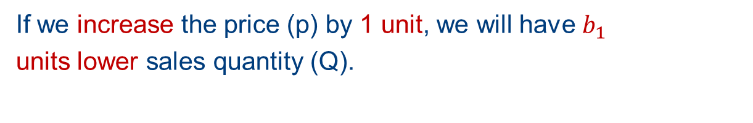
Demand-Price-Functions (linear models)
$$a$$
$$Profit=Q∗\left(P−{C }_{1}\right)$$
If we increase the price (p) by 1 unit, we will have $b_{1}$
units lower sales quantity (Q).

Slide 24
Demand-Price-Functions (linear models)
$$a$$
$$Profit=Q∗\left(P−{C }_{1}\right)$$
If we increase the price (p) by 1 unit, we will have $b_{1}$
units lower sales quantity (Q).

Slide 25
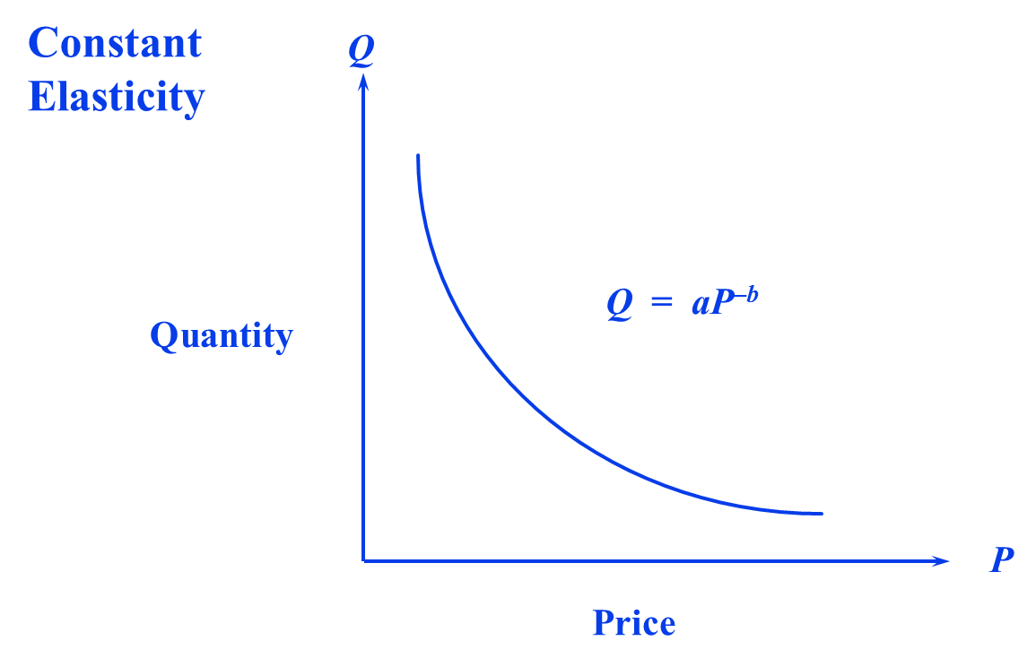
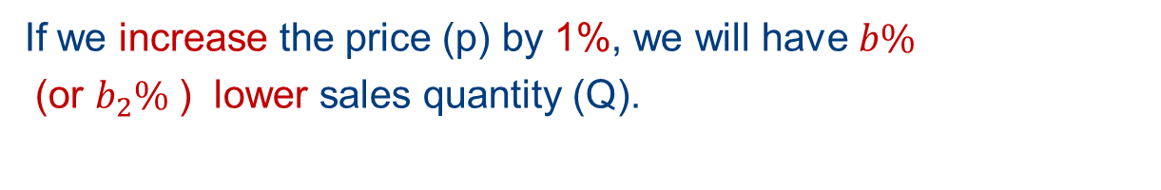
Demand-Price-Functions (non-linear, e.g., Fractional Model)
$$Profit=Q∗\left(P−{C }_{1}\right)$$
If we increase the price (p) by 1%, we will have $b\%$
(or $b_{2}\%$ ) lower sales quantity (Q).

Slide 26
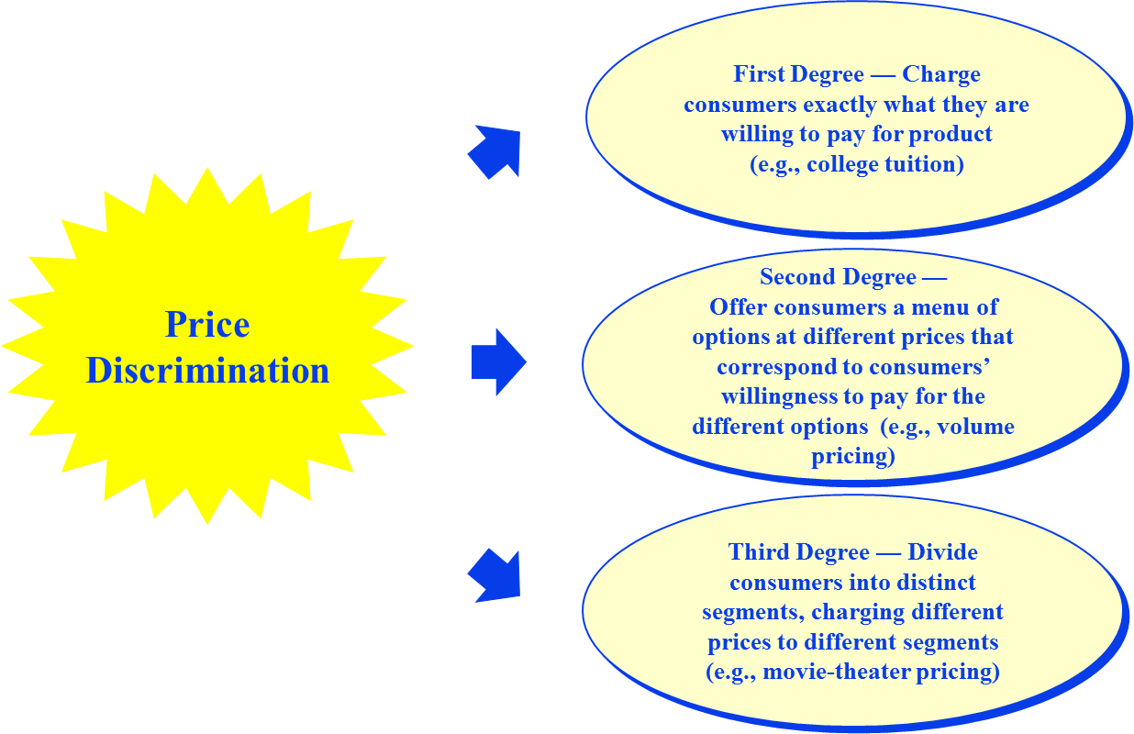
Differential Pricing

Slide 27
Demand-Price-Functions (linear models)
$$a$$
Not all customers have the same sales-price relationship
In their mind

Slide 28
Differential pricing
$$a$$
Customers in different segments: they may have different
Sales response curves for prices

Slide 29
Challenges for Differential Pricing
Identify reservation price for different customers
Targeting different customers and create barriers so that they are offered with different prices: is the barrier legal? Do customers feel unfair?
Prevent arbitrage

Slide 30
Bases for Differential Pricing
Geographic
Temporal (time of making reservation)
Non-linear (Quantity discounts)
Age, income
Profession
Membership

Slide 31
Revenue Management
Revenue management is the art and science of selling the right product to the right customer for the right price at the right time.
High fixed cost industries
Service industry (here, we focus on hotels and airlines)
Alternative approaches (temporal price discrimination in the airline/hotel industry)
  Time-of-day pricing
  Time when purchased
  Day of the week pricing
  Seasonal pricing

Slide 32
Revenue Management
Estimate demand for each class of service.
Demand arrives over time—so update demand function/remaining supply.
Allocate remaining space to:
  maximize expected profitability
  meet other criteria
subject to situation specific constraints.

Slide 33
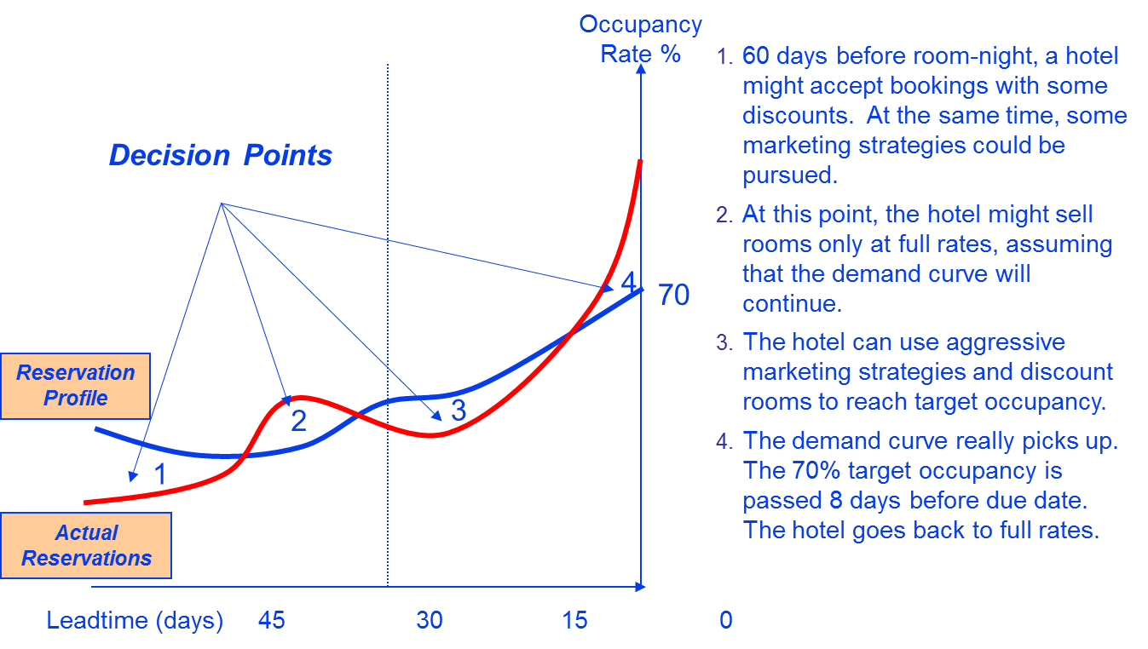
Revenue Management Example

Slide 34
Revenue Management in Practice
Major US domestic carriers:
  Operate 5000 flights per day
  Serve over 10,000 markets
  Offer over 4,000,000 fares
Schedules change twice each week
On a typical day, a major carrier will change 100,000 fares
Airlines offer their products for sale more than one year in advance
The total number of products requiring definition and control is approximately 500,000,000 (various possible routes)
This number is increasing due to the proliferation of distribution channels and customer-specific controls

Slide 35
Benefits of Revenue Management
Use price management, rather than cost cutting to balance supply and demand.
Price according to what the market will bear.
Use differential pricing to reach different segments of customers.
Save the “best product” for the most valuable customers.
Make decisions based on real-time market information.
More fully exploit available resources.
Revenue management is a way to bring discipline into the organization’s decision making process.

Slide 36
Sales resource allocation

Slide 37
Marketing/Sales Budgeting and
Resource Allocation (Current Practice)
Budgeting
  % of sales / average cost of a sales person
  Forecasted sales / average revenue generated by one sales person
  Market response model

Slide 38
How to Estimate the Response Function?
Estimate from Historical data
  Data available?
  Is there sufficient variability in the data to allow for reliable estimation?
Conduct Experiments
  Difficult to execute in offline settings.
  A bit easier in online settings
Elicit Managerial Judgment
  Quick.
  Builds consensus.
  Encourages systematic thinking.

Slide 39
The Judgemental Approach Asks Each Person
What would sales of this account be if . . .
. . . you don’t visit the account? X₀
. . . you visit the account the same as
last period? X₁
. . . you visit the account 50% more
than last period? X₂
. . . you visit the account as frequently
as possible? X₃

Slide 40
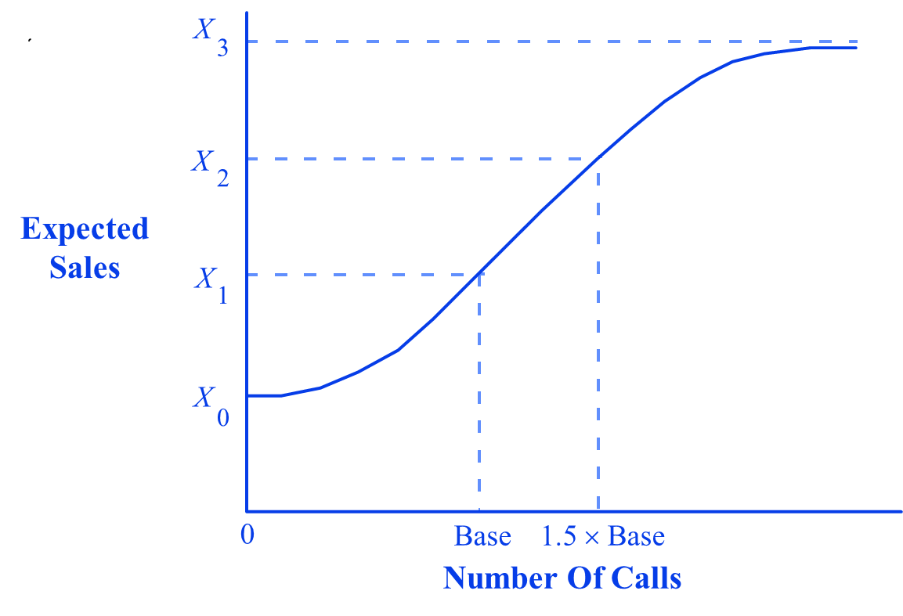
This Yields a Response Function

Slide 41
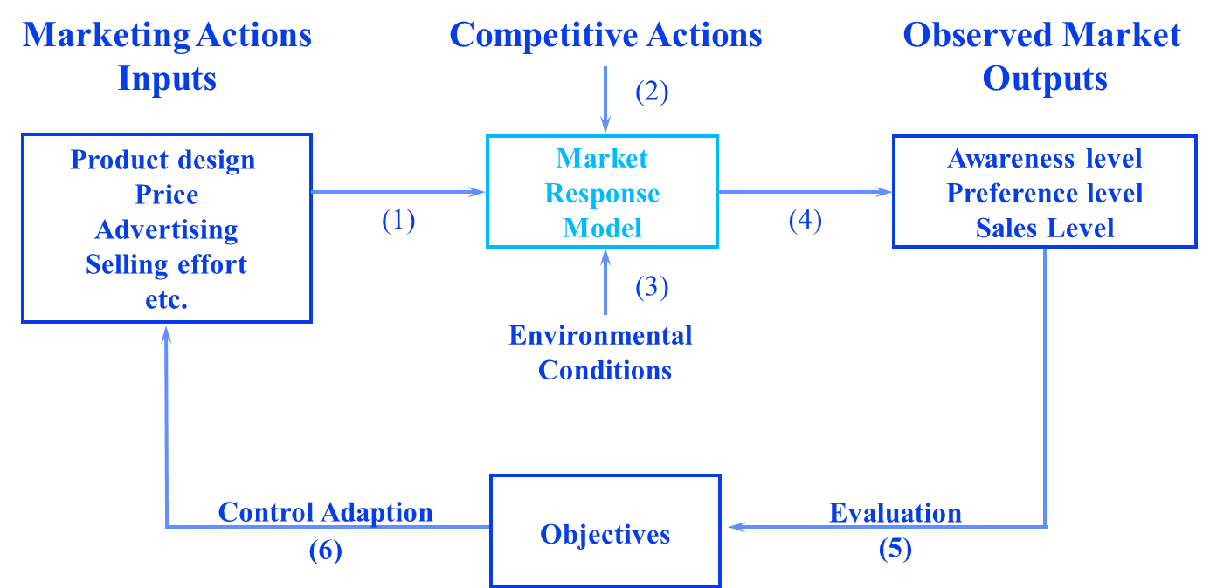
Resource Allocation Using a Response Model System

