Slide 1
Marketing Analytics –
Forecasting
Dr Arne Floh
Room 12MS03
Phone: 01483689185
a.floh@surrey.ac.uk
Skype: arnefloh

Slide 2
What is forecasting and why we need it in Marketing Analytics?
Sales/demand forecasts are used for…
Marketing strategic planning (long range planning)
e.g., what is the potential of the market size?
what would be the sales for new product?
what would be the sales if we drop our price / launch a promotional campaign?
what would be the sales for our existing products if we do not launch any extra marketing campaign?
Negotiation with chain members
Resource planning, production capacity

Slide 3

Moving Average (MA)
  The forecast in the future depends on the actual value of previous time periods.
  $${F }_{t}=A_{t−1}$$
  $${\text{F} }_{t}=\frac{A_{t−1}+A_{t−2}}{2}$$
  $${\text{F} }_{t}=\frac{A_{t−1}+A_{t−2}+A_{t−3}}{3}$$
The naïve method ->
MA(t,1)
MA(t,2)
MA(t,3)

Slide 4
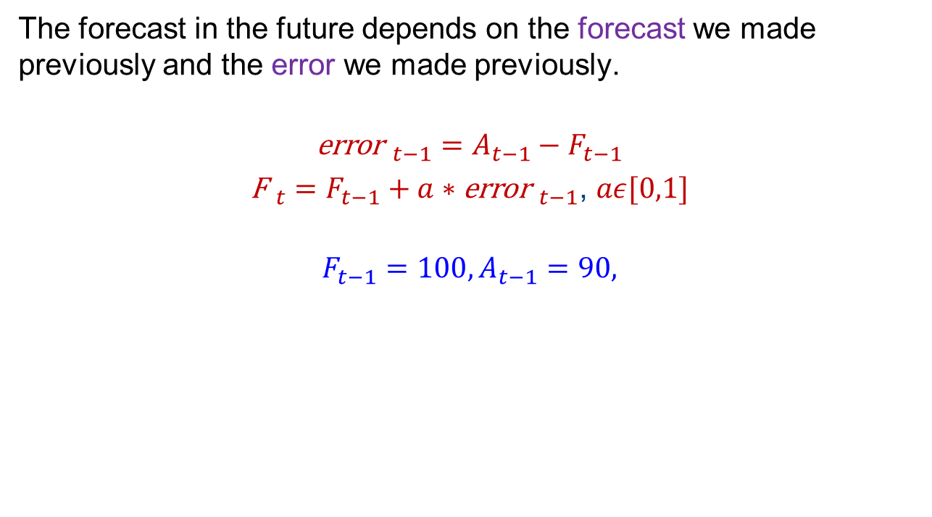
Simple Exponential Smoothing (SES)
The forecast in the future depends on the forecast we made previously and the error we made previously.
$${\text{error} }_{t−1}=A_{t−1}−F_{t−1}$$
${\text{F} }_{t}=F_{t−1}+a∗{\text{error} }_{t−1}$, $aε[0,1]$
$$F_{t−1}=100, A_{t−1}=90,$$

Slide 5
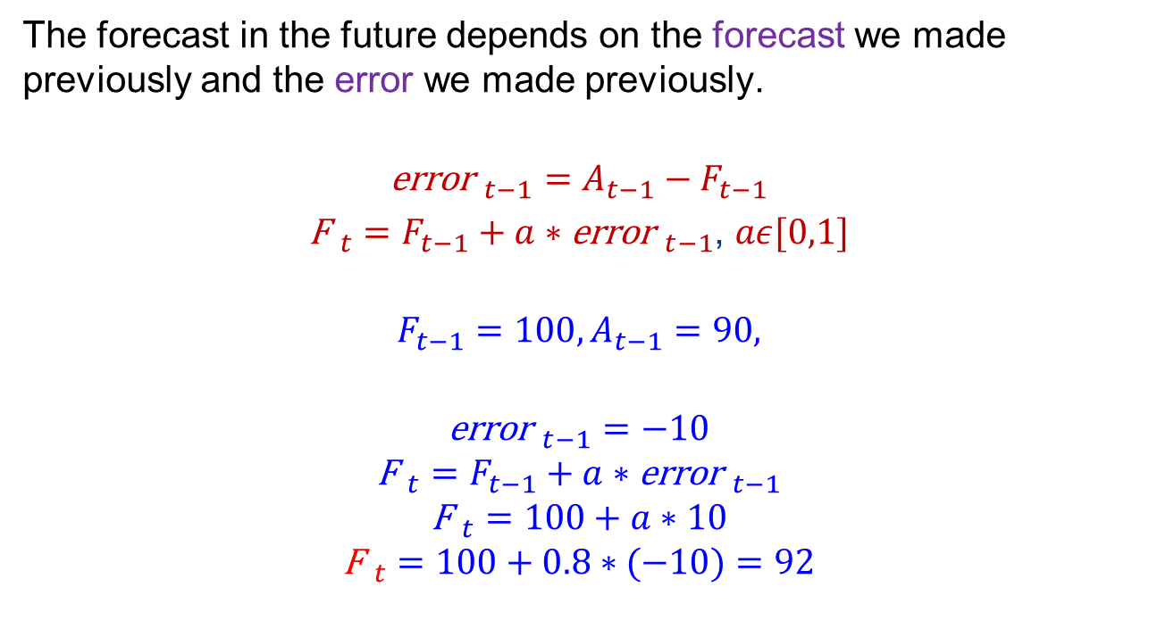
Simple Exponential Smoothing (SES)
The forecast in the future depends on the forecast we made previously and the error we made previously.
$${\text{error} }_{t−1}=A_{t−1}−F_{t−1}$$
${\text{F} }_{t}=F_{t−1}+a∗{\text{error} }_{t−1}$, $aε[0,1]$
$$F_{t−1}=100, A_{t−1}=90,$$
$${\text{error} }_{t−1}=−10$$
$${\text{F} }_{t}=F_{t−1}+a∗{\text{error} }_{t−1}$$
$${\text{F} }_{t}=100+a∗10$$
$${\text{F} }_{t}=100+0.8∗(−10)=92$$

Slide 6

Regression as a forecasting model
The forecast in the future depends on the relationship between the product sales and the spending on advertising.
We could predict the product sales based on planned advertising spending.
Sales= a+ b*advertising+ error
Written as
$$y_{i}=a+bx_{i}+e_{i}$$
$$y_{i}=100+20∗x_{i}$$
$y_{i}=$120, when $x_{i}=1$

Slide 7
Session overview
An overview of forecasting techniques
The Bass Model
Case Study
The Assessor Model
Review Questions

Slide 8
Forecasting Methods
Judgmental | Market and Survey Analysis | Time Series | Causal Analyses
Salesforce composite Jury of executive opinion Delphi methods Scenario analysis | Buyer intentions Product tests Chain ratio method | Naïve methods Moving averages Exponential smoothing Box-Jenkins method Decompositional methods | Regression analysis Econometric models Input-output analysis MARMA Neural networks

Slide 9
Intent-to-Buy Scale Used for Generating Some Inputs to Chain Ratio
1. Definitely would buy
2. Probably would buy
3. May or may not buy
(May be excluded from the scale)
4. Probably would not buy
5. Definitely would not buy

Slide 10
Forecasting Methods
Judgmental | Market and Survey Analysis | Time Series | Causal Analyses
Salesforce composite Jury of executive opinion Delphi methods Scenario analysis | Buyer intentions Product tests Chain ratio method | Naïve methods Moving averages Exponential smoothing Box-Jenkins method Decompositional methods | Regression analysis Econometric models Input-output analysis MARMA Neural networks

Slide 11
Methods for Forecasting New Product Sales
Early stages of development
  Chain ratio method
  Judgmental methods
  Scenario analysis
  Diffusion model e.g., Bass model
Later stages of development
  Pre-test market methods e.g., ASSESOR
  Test-market methods
Notes:
28
28
5
2
2

Slide 12
Forecasting Based on “Newness” of Products
Repositioning
Pre-test market model
Breakthroughs—Major Product Modifications
Bass model/Conjoint
Hi
New to World
Line Extensions
Simple pre-test market models
“Me Too” Products
Conjoint/Pre-test market models
Lo
Lo
Hi
New to Company
Notes:
3
3
2
2

Slide 13
New Product Forecasting Models
That We Consider
Forecasting the pattern of new product adoptions (Bass Model)
Forecasting market share for new products in established categories (Assessor pre-test market model)
Forecasting using conjoint analysis
Notes:
2
2
1
1

Slide 14
Overview of “Stage-Gate” New Product Development Process
Opportunity Identification
Market definition
Idea generation
Reposition
Harvest
Life-Cycle Management
Market response analysis & fine tuning the marketing mix; Competitor monitoring & defense
Innovation at maturity
Go
No
Design
Identifying customer needs Sales forecasting
Product positioning Engineering
Marketing mix assessment Segmentation
Go
No
Introduction
Launch planning
Tracking the launch
Go
No
Testing
Advertising & product testing
Pretest & prelaunch forecasting
Test marketing
Go
No
Notes:
5
5

Slide 15
The Bass model

Slide 16
The Bass Diffusion Model of
New Product Adoption
The model attempts to answer the question:
When will customers adopt a new product or technology?
Why is it important to address this question?
Helps in planning major investments (e.g., building a factory) with respect to the product.
Notes:
29
29
23
5
5

Slide 17
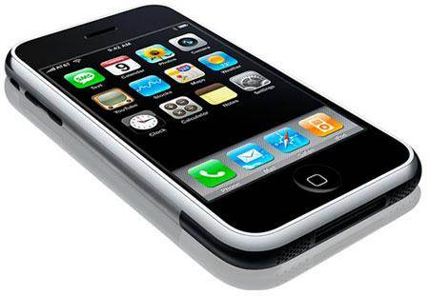
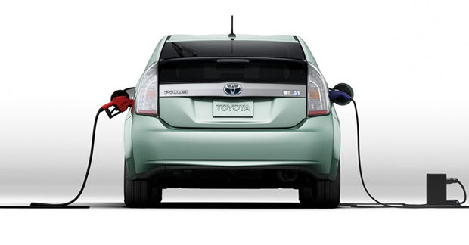
Bass model
Examples:
iphone 1, Electronic cars etc.
No closely competing alternatives.
No previous sales information
No previous market response info
Q: how many iphone 1 can we sell in the next 3 years?

Slide 18




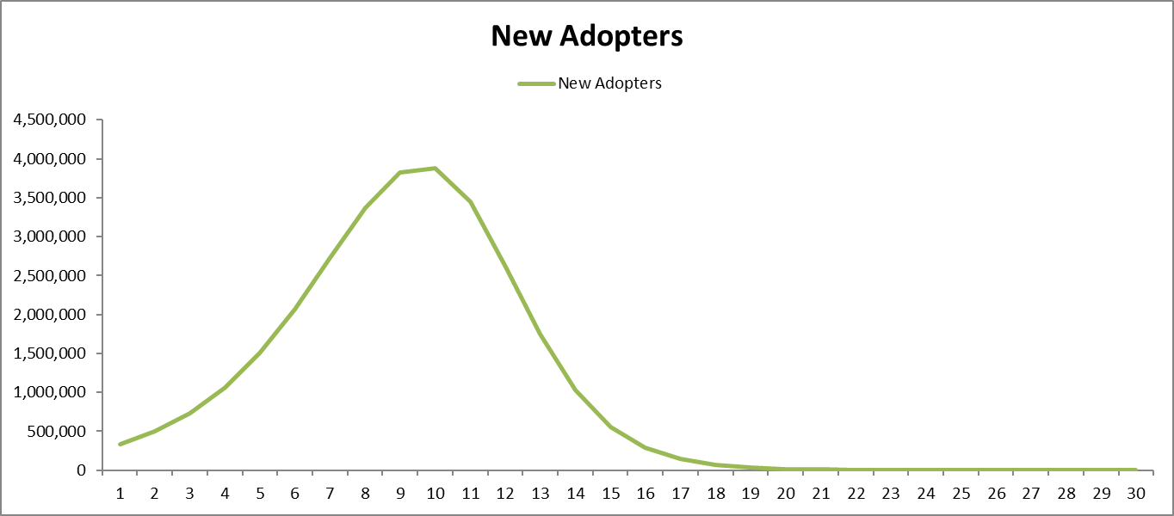
Observed product sales over time

Slide 19
So, how Bass model works?
All adopters= innovators + imitators
Innovators: driven by external factors and have long term purchase intentions. Usually a small percentage of population in the target segment.
Imitators: people who follow innovators, driven by internal (to society) factors , e.g., word-of-mouth effect (interaction between the people who purchased the product).

Slide 20
How do we estimate the number of
Innovators over time
p * Remaining Potential
Products purchased
by innovators
each month
Innovators: Adoptions due to external influence
Time

Slide 21
How do we estimate the number of
Imitators over time
q * Adopter Proportion * Remaining Potential
Products purchased
by imitators
each month
Time

Slide 22
Graphical Representation of The Bass Model
(Cell Phone Adoption)
Imitators: Adoptions due
to word-of-mouth effect
Products purchased
by innovators/imitators
each month
Innovators: Adoptions due to external influence
Time

Slide 23
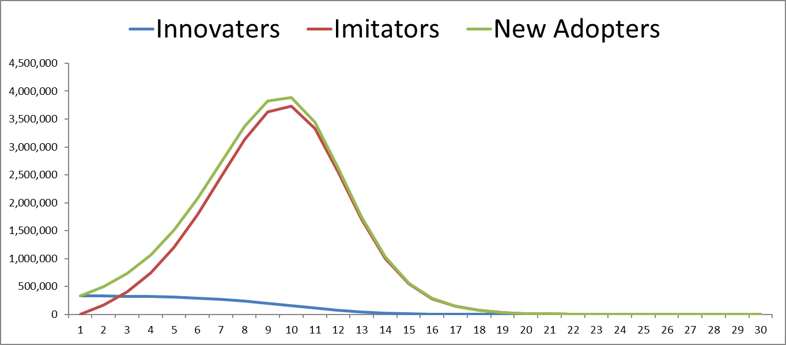
Observed product sales (new adopters) over time=
Innovators + imitators

Slide 24
Bass model
For each time period (e.g., each month/year),
All adopters= innovators + imitators
n_{t} = p * Remaining Potential + q * Adopter Proportion * Remaining Potential
Innovation Imitation
Effect Effect
n_{t} = number of adopters at time t (Sales)
p = “coefficient of innovation” (External influence)
q = “coefficient of imitation” (“internal” to the society in which the diffusion spreads)
The original question has been split into two questions:
Innovators and imitators
Notes:
33
33

Slide 25

Bass model
All adopters= innovators + imitators
n_{t} = p * Remaining Potential + q * Adopter Proportion * Remaining Potential
Innovation Imitation
Effect Effect
$\overline{N}$total population (of the target segment)
$N_{t}$cumulative adopters until time t, $N_{t}=n_{0}+n_{2}+…n_{t−1}$
$\overline{N}−N_{t}$remaining potential
$\frac{N_{t}}{\overline{N}}$adopter proportion
Notes:
33
33

Slide 26

Representation as an Equation
All adopters= innovators + imitators
N(t) : Cumulative number of adopters until time t.
n_{t} = n umber of adopters at time t (Sales)
p = “coefficient of innovation” (External influence)
q = “coefficient of imitation” (“internal” to the society in which the diffusion spreads)
= Eventual number of adopters
# Adopters = n₀ + n₁ + • • • + n_{t–1}
Remaining = Total Potential – # Adopters
Potential
we only need to know p, q, and $\overline{N}$
Notes:
Skip this slide for non-technical classes

Slide 27
Assumptions of the Basic Bass Model
Diffusion process is binary (consumer either adopts, or waits to adopt).
Constant maximum potential number of buyers .
Eventually, all will adopt the product.
No repeat purchase, or replacement purchase.
The impact of word-of-mouth is independent of adoption time.
Innovation is independent of substitutes.
The marketing strategies supporting an innovation are not explicitly included.
Uniform influence or complete mixing. That is, everyone in the population knows everyone else, or is at least able to communicate with, or observe everyone else.
Notes:
30
30
24
6
6
While this list seems pretty formidable, many of these assumptions can be dropped or relaxed with small changes to the model.

Slide 28
Estimating the Parameters p and q of the
Bass Model
Estimation using the data of analogous products (e.g., Nokia)
  Select analogous products based on the similarity in environmental context, market structure, buyer behavior, marketing-mix strategies of the firm, and innovation characteristics.
  Regression
  Specialized nonlinear estimation
Estimation using the data of the same products (e.g., iphone 1) from analogous markets
  The same product in different markets (UK market versus China market)

Slide 29
Parameters of the Bass Model in Several Product Categories
Innovation Imitation
Product/ parameter parameter
Technology (p) (q)
B&W TV 0.065 0.335
Color TV 0.021 0.583
Room Air conditioner 0.010 0.454
Clothes dryers 0.073 0.389
Ultrasound Imaging 0.003 0.506
CD Player 0.028 0.368
Cellular telephones 0.005 0.506
Steam iron 0.036 0.318
Oxygen Steel Furnace (US) 0.001 0.456
Microwave Oven 0.018 0.337
Hybrid corn 0.000 0.798
Home PC 0.003 0.253
A study by Van den Bulte and Stremersch (2004) suggests an average value of 0.03 for p and an average value of 0.42 for q, The average was
taken across a couple of hundred categories.
Notes:
34
34
31
11
11

Slide 30
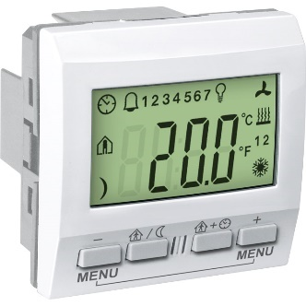
Forecasting Using the Bass Model—Room Temperature Control Unit
Cumulative
Quarter Sales Sales
Market Size = 16,000
(At Start Price) 0 0 0
1 160 160
Innovation Rate = 0.01 4 425 1,118
(Parameter p) 8 1,234 4,678
12 1,646 11,166
Imitation Rate = 0.41 16 555 15,106
(Parameter q) 20 78 15,890
24 9 15,987
Initial Price = $400 28 1 15,999
32 0 16,000
Final Price = $400 36 0 16,000
Example computations
Sales in Quarter 1 = 0.01 ´ 16,000 + (0.41–0.01) ´ 0 – (0.41/16,000) ´ (0)² = 160
Sales in Quarter 2 = 0.01 ´ 16,000 + (0.40) ´ 160 – (0.41/16,000) ´ (160)² = 223.35
Notes:
40
40

Slide 31
Factors Affecting the Rate of Diffusion e.g., what determines the value of p and q
Product-related
High relative advantage over existing products
High degree of compatibility with existing approaches
Low complexity
Can be tried on a limited basis ( trialability)
Benefits are observable (observability)
Market-related
Type of innovation adoption decision (e.g., does it involve switching from familiar way of doing things?)
Communication channels used
Nature of “links” among market participants (e.g., WOM effective?)
Nature and effect of promotional efforts
Source: Everett Rogers
Notes:
41
41
33
13
13

Slide 32
Some Extensions to the Basic Bass Model
Varying market potential
  As a function of product price, reduction in uncertainty in product performance, and growth in population, and increases in retail outlets.
Incorporating marketing variables e.g., price changes diffusion process
Incorporating repeat purchases
Multi-stage diffusion process
  Awareness → Interest → Adoption → Word of mouth
Incorporating Network Structure e.g., not everyone in the population knows everyone else, e.g., KOL

Slide 33
Example Application of Bass Model
DirecTV (History and Technology)
1984 FCC grants GM Hughes approval to construct a Direct Broadcast Satellite system (DBS)
High K_{u} Band frequency
Early 1990’s technological breakthrough in digital compression. Result: Affordable product and non-obtrusive dish and equipment
Changed economics of DTH broadcasting
1991 DIRECTV founded
A new broadcasting system which are affordable.

Slide 34
DirecTV
Data Collection Method
CATI (Computer-Assisted Telephone Interview) data collection - nationally representative sample of TV viewers.
15-minute phone interview. “Eligibles” assigned to one of two monadic concept-price cells (“Intent to Buy”).
Respondents mailed a color brochure that described DIRECTV/RCA branded Direct Broadcast System concept.
Phone callback interview (22 minutes)-Key inputs: Stated Intentions (Probability of Acquire and Perceived value and Affordability).

Slide 35

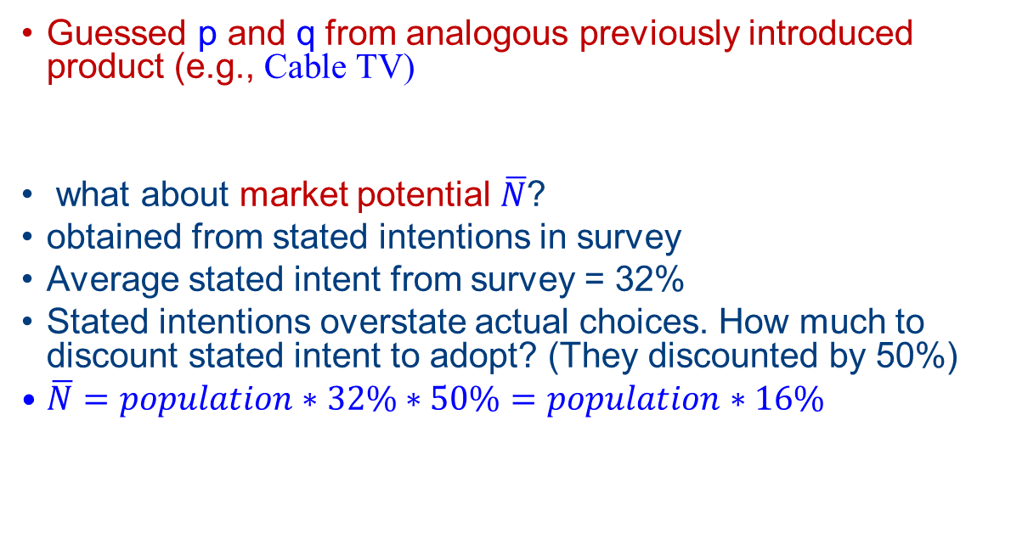
Obtaining p, q, and$\overline{N}$
Guessed p and q from analogous previously introduced product (e.g., Cable TV)
what about market potential $\overline{N}$?
obtained from stated intentions in survey
Average stated intent from survey = 32%
Stated intentions overstate actual choices. How much to discount stated intent to adopt? (They discounted by 50%)
$\overline{N}=population∗32\%∗50\%=population∗16\%$

Slide 36
Adjusting Stated Intentions to Get Actual Purchase Behavior
Probability of Purchase (within six months)
Increases with Stated Intention
Some Who Say
They Will, Don’t
Some Who Say
They Won’t, Do!

Slide 37
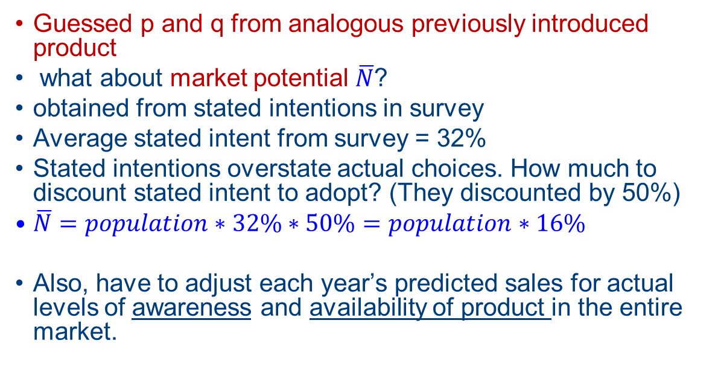
Obtaining p, q, and$\overline{N}$
Guessed p and q from analogous previously introduced product
what about market potential $\overline{N}$?
obtained from stated intentions in survey
Average stated intent from survey = 32%
Stated intentions overstate actual choices. How much to discount stated intent to adopt? (They discounted by 50%)
$\overline{N}=population∗32\%∗50\%=population∗16\%$
Also, have to adjust each year’s predicted sales for actual levels of awareness and availability of product in the entire market.

Slide 38
Multi-Year Forecast and Actual
9.4 Million TV homes forecast for June 99; Actual = 9.9 Million
Forecast based on p and q of Cable TV (other alternative considered was Color TV) and maximum penetration set to 16% of population (half that in the stated intent survey).

Slide 39
Multi-Year Forecast-Actual Graph
92 Forecast Was Not Updated
Notes:
The forecast turned out to be remarkably accurate.

Slide 40
Using Scenario Analysis for Calibrating the Bass Model
Structure a scenario as a flowing narrative, not as a set of numerical parameters. Include verbal descriptions such as “rapid experience effects,” “FCC adoption of digital standard,” etc. Ideally, each scenario should also include how the situation described in the scenario will be reached from the present position.
Construct several scenarios that capture the richness and range of the “possibilities” relevant to a decision situation. Describe all the scenarios in the same manner, i.e., one is not more “vivid” than another. Focus your further analyses on scenarios that are internally consistent and plausible. Develop forecasts and strategies that are compatible with the scenarios. The strategies include:
  Robust actions that are resilient across scenarios (e.g., hedging, concurrent pursuit of multiple options, etc.)
  Contingent actions that postpone major commitments to the future.
  e.g., For each scenario, what would be the p, q, and market size?

Slide 41
Steps in Scenario Planning
(Example for Zenith HDTV)
Identify the major stakeholders.
Summarize the core trends that are relevant (technological, economic, social, etc.) within the time frame of interest.
Articulate the main uncertainties (e.g., TV studio adoption of new filming methods).
Construct an initial set of scenarios.
Assess the consistency and plausibility of the scenarios.
Create “themes” (i.e., a story with a name) that combine some trends into meaningful composites (e.g., a Japanese domination of hardware and American domination of software).
Identify areas where you need more research (e.g., consumer acceptance) and seek additional information.
Associate the final set of scenarios with potential product analogs for diffusion model, select p and q, and generate the forecasts.
Evaluate strategic and tactical choices that will help you realize the forecasts in the most cost effective manner.

Slide 42
Assessor model

Slide 43
How ASSESSOR works
ASSESSOR: forecasting system
forecast the market share of new product
before the product is introduced into the market
after the product has been developed
a consumer shopping opportunity in a simulated store (typically set up in a testing facility within a shopping mall) where customers choose the new product when it is displayed along with the competing products.
Information obtained via surveys

Slide 44
Overview of ASSESSOR Modeling Procedure
Management Input
(Positioning Strategy)
(Marketing Plan)
Consumer Research Input
(Laboratory Measures)
(Post-Usage Measures)
Preference
Model
Trial &
Repeat Model
Reconcile
Outputs
Draw &
Cannibalization
Estimates
Brand Share
Prediction
Unit Sales
Volume
Diagnostics

Slide 45
Overview of ASSESSOR Measurement Process
Design Procedure Measurement
O₁ Respondent screening and Criteria for target-group identification
recruitment (personal interview) (e.g., product-class usage)
O₂ Pre-measurement for established Composition of ‘relevant set’ of
brands (self-administrated established brands, attribute weights
questionnaire) and ratings, and preferences
X₁ Exposure to advertising for established
brands and new brands
[O₃] Measurement of reactions to the Optional, e.g. likability and
advertising materials (self- believability ratings of advertising
administered questionnaire) materials
X₂ Simulated shopping trip and exposure
to display of new and established brands
O₄ Purchase opportunity (choice recorded Brand(s) purchased
by research personnel)
X₃ Home use/consumption of new brand
O₅ Post-usage measurement (telephone) New-brand usage rate, satisfaction ratings, and repeat-purchase propensity;
O = Measurement; X = Advertising or product exposure

Slide 46
Predicted and Observed Market Shares for ASSESSOR
Deviation Deviation
Product Description Initial Adjusted Actual (Initial – (Adjusted –
Actual) Actual)
Deodorant 13.3 11.0 10.4 2.9 0.6
Antacid 9.6 10.0 10.5 –0.9 –0.5
Shampoo 3.0 3.0 3.2 –0.2 –0.2
Shampoo 1.8 1.8 1.9 –0.1 –0.1
Cleaner 12.0 12.0 12.5 –0.5 –0.5
Pet Food 17.0 21.0 22.0 –5.0 –1.0
Analgesic 3.0 3.0 2.0 1.0 1.0
Cereal 8.0 4.3 4.2 3.8 0.1
Shampoo 15.6 15.6 15.6 0.0 0.0
Juice Drink 4.9 4.9 5.0 –0.1 –0.1
Frozen Food 2.0 2.0 2.2 –0.2 –0.2
Cereal 9.0 7.9 7.2 1.8 0.7
Etc. ... ... ... ... ...
Average 7.9 7.5 7.3 0.6 0.2
Average Absolute Deviation — — — 1.5 0.6
Standard Deviation of Differences — — — 2.0 1.0

Slide 47
Recap
Judgmental methods and Chain ratio approach can be applied in a wide range of forecasting situations.
Bass diffusion model is useful for forecasting the adoptions of a new to the world product (e.g., a new technology or trend)
Pre-test market models are useful for forecasting products that have repeat purchase potential (e.g., consumer packaged goods).
Notes:
64
64
22
19

Slide 48
Review questions
Why is Sales Forecasting so important? Discuss the various methods of Sales Forecasting and use examples to illustrate your answers.
How can the process of product development be planned? How can the success during the various stages be tested?
How can the Bass Model be used for Marketing Decisions? Use theoretical frameworks and examples to illustrate your answer.

Slide 49
Lab session
The ‘case’ folder in Surreylearn
Go through the ‘week 6 lab session tasks.docx’ file
Explore the template for various forecasting methods including MA, SES, regression, and Bass model.

