Slide 1
Marketing Analytics –
Customer Value &
Customer Relationship Management
Dr Arne Floh
a.floh@surrey.ac.
Department of Marketing & Retail Management
Surrey Business School
UK
Dr Tao Huang
t.huang@surrey.ac.uk

Slide 2

A revision for the Response Curve
Sales Response
$$y_{i}=a+bx_{i}$$
Effort Level
Notes:
5

Slide 3
A revision for the Response Curve
Sales Response
X^{c}
d + X^{c}
Y = b + (a–b)
Effort Level
Notes:
5

Slide 4
Session overview
General Marketing Theories
Customer Value
Customer Satisfaction
Customer Loyalty
Word-of-Mouth
Customer Profitability

Slide 5
GENERAL MARKETING THEORIES

Slide 6
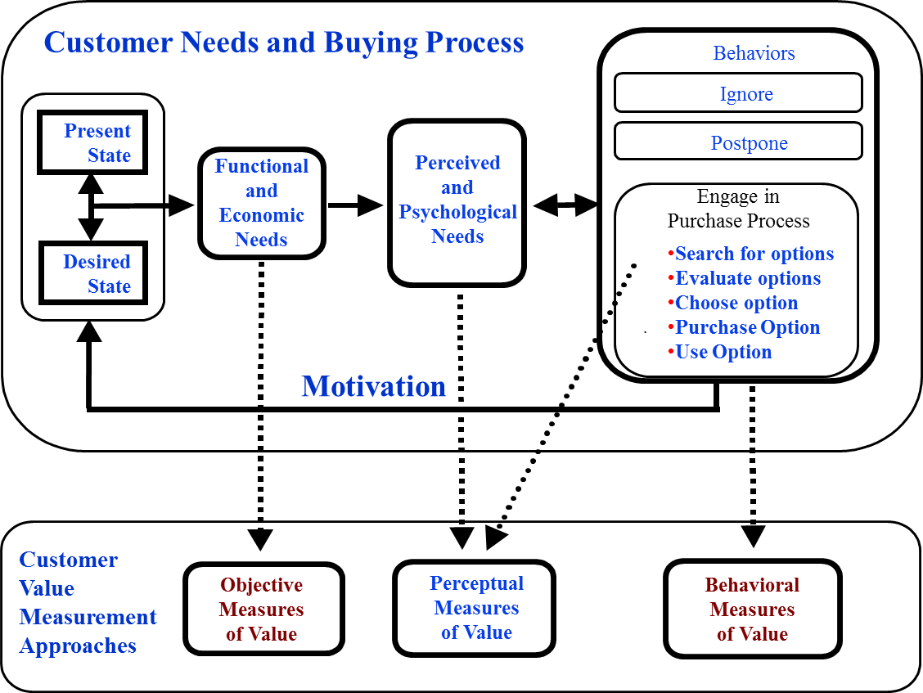
Value Chain I

Slide 7
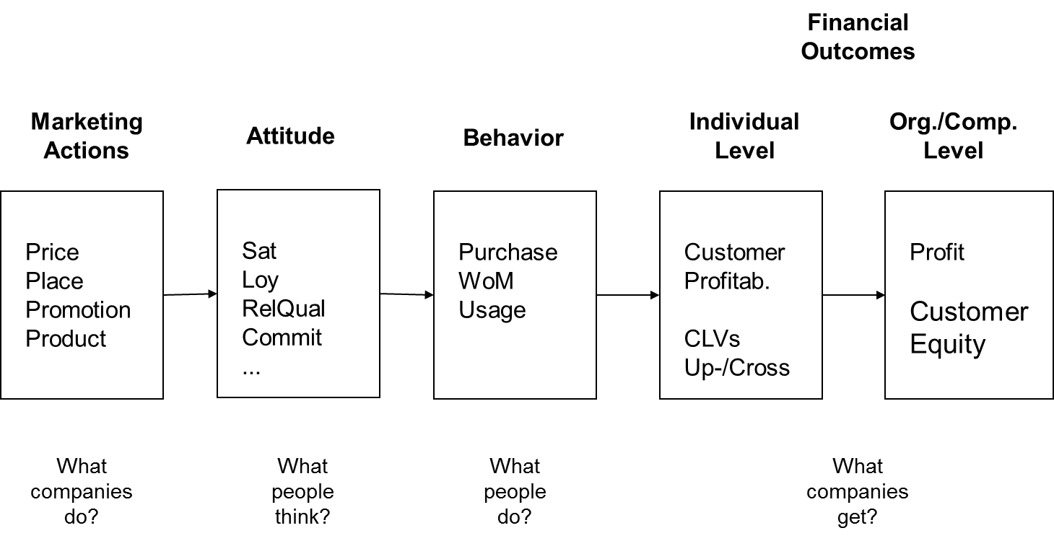
Value Chain II

Slide 8
CUSTOMER VALUE

Slide 9
Customer Value
The hypothetical price for a supplier's offering at which a particular customer would be at overall economic break-even relative to the best alternative available to that customer for performing a set of functions.

Slide 10
Perceived Customer Value
Ecological Value
  My car …
  … is environmentally friendly
  … pollutes the environment only marginally
  … is more environmentally friendly than other cars
Functional Value
  … is very reliable
  … provides good performance
  … has an acceptable standard of quality
Economic Value
  … offers value for money
  … is fairly priced
  … compared to the other cars, my car is economical

Slide 11
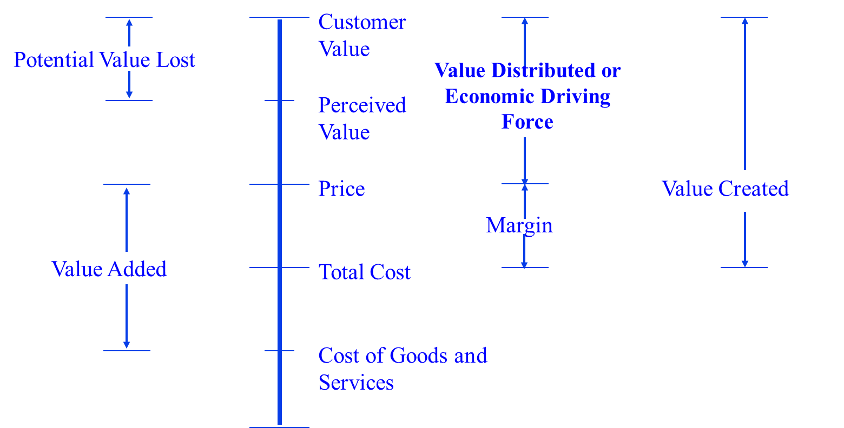
Cost, Price and Customer Value

Slide 12
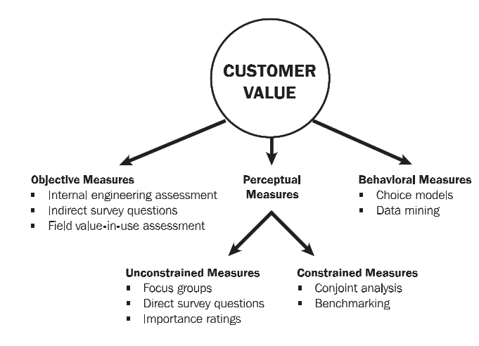
So, how do we measure customer value?

Slide 13
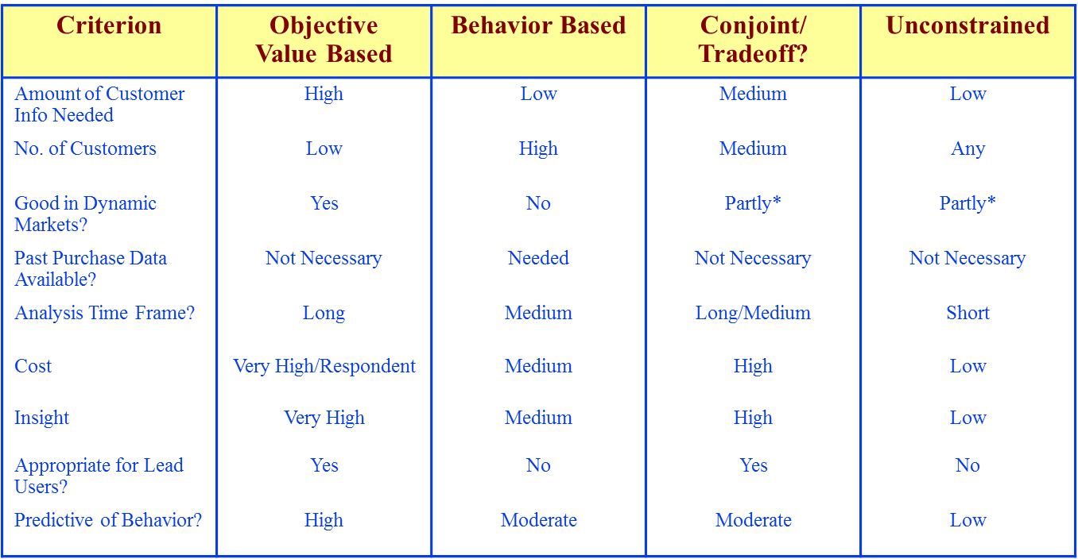
Customer Value Measurement

Slide 14
Customer Satisfaction

Slide 15
Customer Satisfaction
Definition
  The degree to which a consumer's expectations are fulfilled or surpassed by a product. The post-purchase evaluation of a consumer action by the ultimate consumer or the decision maker.
  Overall (longitudinal perspective) vs. episode view
Measurement of Customer Satisfaction
  Survey
  Mistery shopping
  Critical incident method
  (Analysing customer complaints)
  (Analysing customer defections)

Slide 16
Confirmation-Disconfirmation Paradigm
Expectations
Satisfaction
…
Performance
Satisfaction = Attribute Performance - Expectations
Source: Hansen (2008, p. 181)

Slide 17
National Customer Satisfaction Index
 | Base- line | 09 | 10 | 11 | 12 | 13 | Previous Year % Change | First Year % Change
Audi |  |  |  | 83 | 84 | 83 | -1.0 | 0.0
Nissan |  |  |  |  | 82 | 82 | 0.0 | 0.0
BMW | 80 | 78 | 78 | 81 | 82 | 82 | 0.0 | 3.0
Toyota | 80 | 83 | 80 | 82 | 83 | 82 | -1.0 | 3.0
All Others | 77 | 76 | 81 | 81 | 81 | 81 | 0.0 | 5.0
Car Manufacturers | 77 | 76 | 79 | 79 | 80 | 80 | 0.0 | 4.0
Volkswagen | 79 | 80 | 79 | 81 | 82 | 80 | -2.0 | 1.0
Peugeot | 73 | 73 | 77 | 77 | 77 | 78 | 1.0 | 7.0
Vauxhall | 75 | 75 | 75 | 77 | 77 | 78 | 1.0 | 4.0
Ford | 75 | 73 | 76 | 76 | 79 | 77 | -3.0 | 3.0
Renault | 73 | 72 | 80 | 74 | 76 | 75 | -1.0 | 3.0
http://ncsiuk.com/index.php

Slide 18
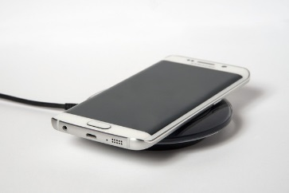
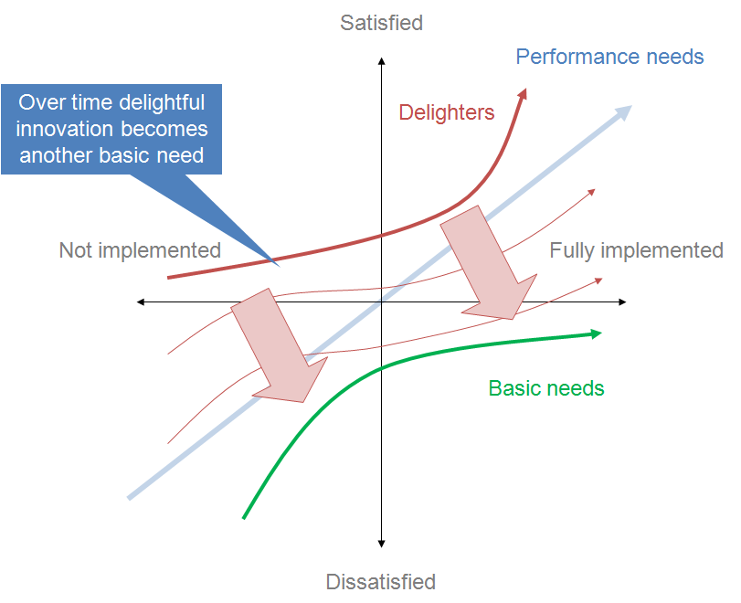
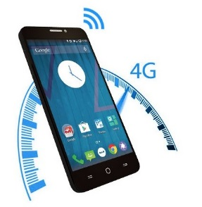
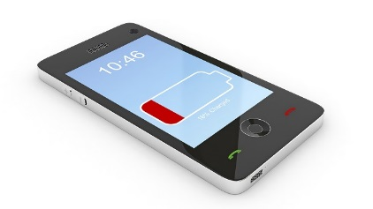
Kano Model

Slide 19
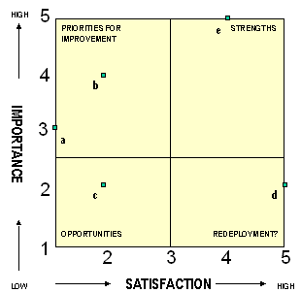
Importance-Performance-Matrix
Design/ ease of use
Security, reliability
Fragile

Slide 20
SERVQUAL
  An instrument initially designed to measure the quality of service by capturing consumers’ expectations and perceptions along five dimensions of service quality.
  measure a concept with multiple items → to check the uni- or multi-dimensionality of a concept. → to achieve sound validity & reliability
  determine the THEORETICAL & OPERATIONAL definitions of a concept to facilitate measurement.
  propose a rigorous process for scale development.

Slide 21
SERVQUAL
Reliability: Ability to perform the promised service dependably and accurately
Assurance: Knowledge and courtesy of employees and their ability to inspire trust and confidence
Tangibles: Physical facilities, equipment, and appearance of personnel
Empathy: Caring, individualized attention the firm provides its customers
Responsiveness: Willingness to help customers and provide prompt service

Slide 22
 | Sample expectations item
Reliability | If an excellent company promises to do something by a certain time, they do so
Assurance | The behaviour of employees in excellent banks will instill confidence in customers
Tangibles | Excellent telephone companies will have modern looking equipment
Empathy | Excellent banks will have operating hours convenient to customers
Responsiveness | Employees of excellent telephone companies will never be too busy to help a customer
 | Sample perceptions item
Reliability | The company provides it services at the promised time
Assurance | The behaviour of employees in the The bank instils confidence in you.
Tangibles | The company has modern looking equipment
Empathy | The bank has convenient operating hours
Responsiveness | The employees are never too busy to help you

Slide 23
SERVQUAL
SERVQUAL is a very “versatile” concept & has been adopted & adapted in various contexts such as:
  online shopping;
  mobile technology adoption;
  food consumption (e.g. dining out);
  sport consumption (e.g. sporting events);
  banking;
  tourist destination, &
  so forth.

Slide 24
SERVQUAL vs. SATISFACTION
Both concepts focus on the expectancy-disconfirmation process which seeks to explain post-purchase or post-adoption satisfaction as a function of expectations, perceived performance, and disconfirmation of beliefs.
Oliver (1997) attempted to differentiate these two concepts by proposing that:
  service quality = “a judgment of performance excellence” (p. 28) → functional or objective performance.
  satisfaction = “the consumer’s fulfilment response, the degree to which the level of fulfilment is peasant or unpleasant” (p. 28) → emotive outcome.
It’s absolutely critical to discern these two concepts via THEORETICAL & OPERATIONAL DEFINITIONS when both are measured in one study.

Slide 25
Customer LOYALTy

Slide 26
Customer Loyalty
Customer loyalty can be defined in two ways (Jacoby and Kyner, 1973):
Attitudinal: different feelings create an individual’s overall attachment to a product, service, or organization (Fornier, 1994) – the individual’s (purely cognitive) degree of loyalty.
Behavioural: continuing to purchase services from the same supplier, increasing the scale and or scope of a relationship, or the act of recommendation (Yi, 1990).

Slide 27
Zero Defection (quality management)
Reducing Defections 5% Boosts Profits 25% to 85%

Slide 28
Zero Defection (quality management)
Why Customers Are More Profitable over Time

Slide 29
Zero Defection
Why Customers Are More Profitable over Time

Slide 30
Measuring Customer Loyalty
Attitudinal Loyalty
  If XYZ were to raise the fees associated with my checking account or ATM use, I would still continue to be a customer of XYZ
  If a competing bank were to offer a better rate or discount on their service, I would switch
  In the near future, I intend to use more of the service offered by XYZ
  In the near future, I intend to buy XYZ again
Behavioural Loyalty
  Number of products/services used/bought
  Frequency of shopping
  Length of relationship
  Share

Slide 31
Word of mouth

Slide 32
Definitions
Word of mouth: The information imparted by a consumer or individual other than the sponsor. It is sharing information about a product, promotion, etc., between a consumer and a friend, colleague, or other acquaintance. For example, a consumer may tell a friend about a particularly good price he or she received on a product. Research has found that word-of-mouth communication about products is more likely to be negative than positive. (AMA Dictionary)
Online ratings are a quantitative summary of experiences, attitudes, and opinions, usually expressed as stars or points. (Mudambi & Schuff, 2010)
Online reviews are open-ended, user-generated text messages about a product or service. (Park & Kim, 2008)
(Perceived) valence intensity of an online review relates to the argument strength. It is extend to which the receiver of the message views the argument as valid, convincing and reinforcing its position. (Cheung et al., 2009)

Slide 33
Literature Review (Selected Studies)
Authors (Year) | Product | N | Results
Chevalier/Mayzlin (2006) | Book | 1,636 | Significant effect of average rating, number and length of review texts
Dellarocas et al. (2007) | Book | 55,156 | Significant effect of average rating and number of reviews
Park/Lee (2009) | Book | 440* | Significant effect of valence, negative review texts have a higher impact on purchase decisions
Park/Kim (2008) | Multimedia player | 222* | Significant effect of number of reviews on purchase intention
Sparks/Browning (2011) | Hotel | 554 | Significant effect of valence and order of reviews (negative reviews have a higher impact)

Slide 34
Taking a deeper look at online reviews:
An examination of the asymmetric effect of valence intensity on shopping behaviour
Arne Floh / Monika Koller / Alexander Zauner
Journal of Marketing Management, http://dx.doi.org/10.1080/0267257X.2013.776620
Acknowledgements: This research study has been financially supported by the Austrian Marshall Plan Foundation.

Slide 35
Results of Study II – Customer Sample (Book – Purchase Intention)
very likely
very unlikely
p = .000
p > .3

Slide 36
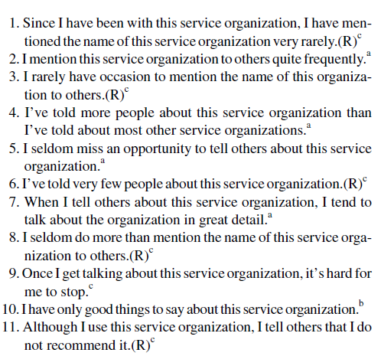
Measuring WoM

Slide 37
Measuring WoM II - Net Promoter Score
How likely is that you would recommend company XYZ to a friend or colleague?
1
2
3
4
5
6
7
8
9
10
very unlikely
very likely
9 - 10 promoters
7 - 8 passively satisfied
0 – 6 detractors
NPS = % of promoters - % of detractors
“Companies with world-class loyalty should receive net-promoter scores of 75 % to more than 80 %.”
Reichheld, F. (2003): The One Number You Need to Grow, Harvard Business Review, December 2003.

Slide 38
Customer Profitability

Slide 39
Measuring Customer Lifetime value
Customer Lifetime Value (CLV)
Total profit the company can expect to earn from an individual customer over the ongoing relationship with that customer.
At the heart of understanding CLV lies the recognition that a customer does not represent not a single transaction but a relationship that is far more valuable than any one-time exchange.
Wikipedia: https://en.wikipedia.org/wiki/Net_present_value

Slide 40


Measuring Customer Lifetime value
$${PV}_{t}=(R_{t}−C_{t}){d_{}^{t−1}}_{}$$
$$d=\frac{1}{(1+r) }$$
$$CLV={PV}_{1}+{PV}_{2}+…+{PV}_{t}$$
e.g., R- C= 100, n = 3, d= 15%
${PV}_{1}$= 100$\frac{1}{(1+0.15) }$=87
${PV}_{3}$= 100$\frac{1}{(1+0.15) }$$\frac{1}{(1+0.15) }$=76
${PV}_{3}$= 100$\frac{1}{(1+0.15) }$$\frac{1}{(1+0.15) }$$\frac{1}{(1+0.15) }$=67
$CLV={PV}_{1}+{PV}_{2}+{PV}_{3}=87+76+67=230$
Notes:
We are unsure if a customer would still retain, so we need to incorporate the likelihood for this to happen.

Slide 41
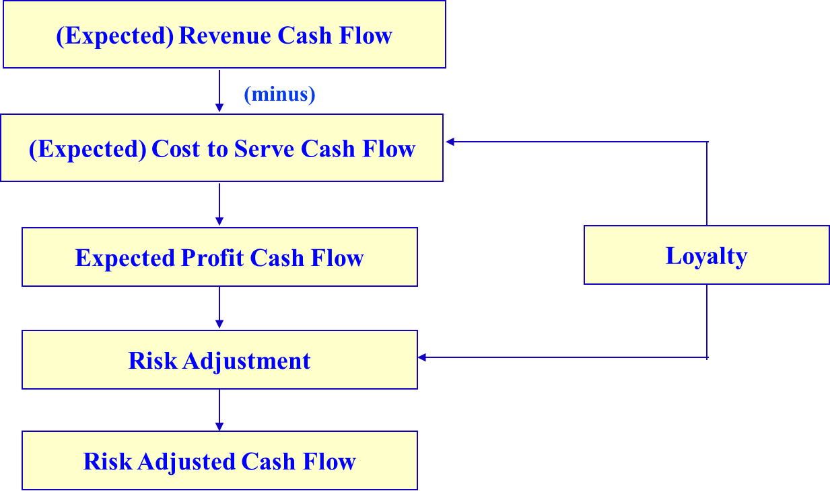
Measuring Customer Lifetime value
reduce
reduce

Slide 42
Measuring Customer Lifetime value
$${PV}_{t}=(R_{t}−C_{t}){d_{}^{t−1}}_{}$$
$$d=\frac{1}{(1+r) }$$
$$CLV={PV}_{1}+{PV}_{2}+…+{PV}_{t}$$
e.g., R- C= 100, n = 3, d= 15%
${PV}_{1}$= 100$\frac{1}{(1+0.15) }$=87
${PV}_{3}$= 100$\frac{1}{(1+0.15) }$$\frac{1}{(1+0.15) }$=76
${PV}_{3}$= 100$\frac{1}{(1+0.15) }$$\frac{1}{(1+0.15) }$$\frac{1}{(1+0.15) }$=67
$CLV={PV}_{1}+{PV}_{2}+{PV}_{3}=87+76+67=230$
Extension 1: We take into account the likelihood for the customer to keep buying from us, i.e., p

Slide 43
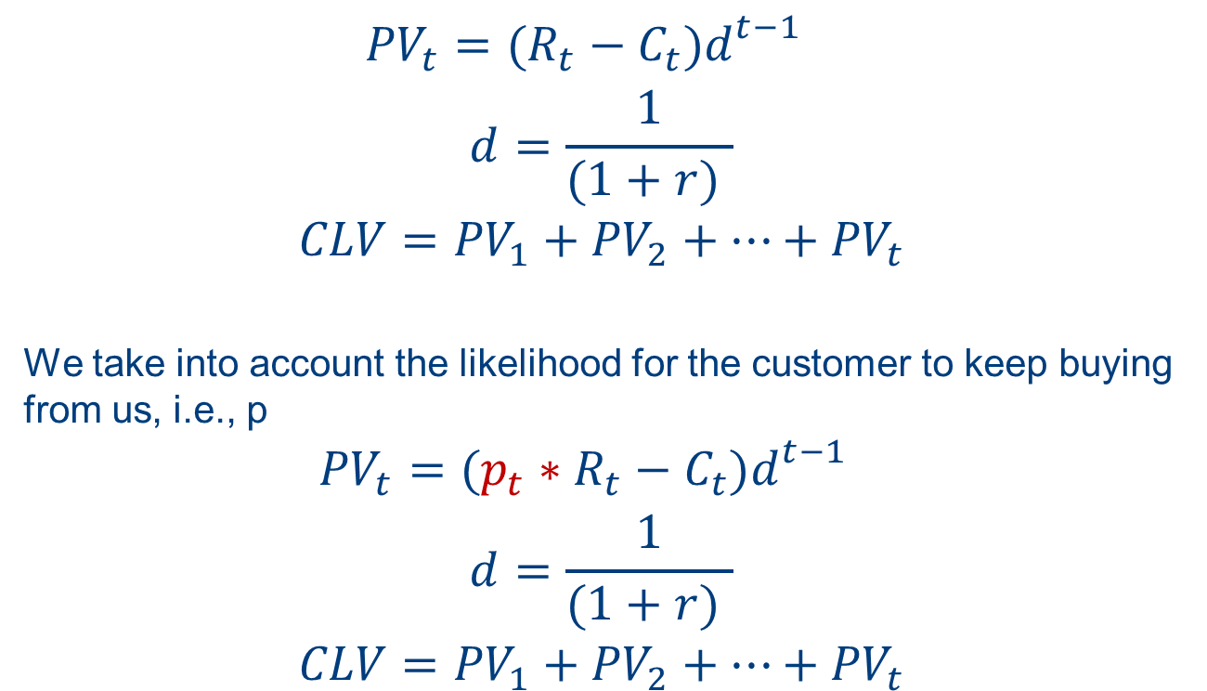
Measuring Customer Lifetime value
$${PV}_{t}=(R_{t}−C_{t}){d_{}^{t−1}}_{}$$
$$d=\frac{1}{(1+r) }$$
$$CLV={PV}_{1}+{PV}_{2}+…+{PV}_{t}$$
We take into account the likelihood for the customer to keep buying from us, i.e., p
$${PV}_{t}=(p_{t}∗R_{t}−C_{t}){d_{}^{t−1}}_{}$$
$$d=\frac{1}{(1+r) }$$
$$CLV={PV}_{1}+{PV}_{2}+…+{PV}_{t}$$

Slide 44


Measuring Customer Lifetime value
$${PV}_{t}=(p_{t}∗R_{t}−C_{t}){d_{}^{t−1}}_{}$$
$$d=\frac{1}{(1+r) }$$
$$CLV={PV}_{1}+{PV}_{2}+…+{PV}_{t}$$
e.g., R- C= 100, n = 3, d= 15%,$p_{1}=0.9$, $p_{3}=0.8,p_{3}=0.7$
${PV}_{1}$= 100$\frac{1}{(1+0.15) }$0.9=78
${PV}_{3}$= 100$\frac{1}{(1+0.15) }$$\frac{1}{(1+0.15) }$0.8=61
${PV}_{3}$= 100$\frac{1}{(1+0.15) }$$\frac{1}{(1+0.15) }$$\frac{1}{(1+0.15) }$0.7=47
$CLV={PV}_{1}+{PV}_{2}+{PV}_{3}=87+76+67=$186

Slide 45

Measuring Customer Lifetime value
$${PV}_{t}=(p_{t}∗R_{t}−C_{t}){d_{}^{t−1}}_{}$$
$$d=\frac{1}{(1+r) }$$
$$CLV={PV}_{1}+{PV}_{2}+…+{PV}_{t}$$
e.g., R- C= 100, n = 3, d= 15%,$p_{1}=0.9$, $p_{3}=0.8,p_{3}=0.7$
${PV}_{1}$= 100$\frac{1}{(1+0.15) }$0.9=78
${PV}_{3}$= 100$\frac{1}{(1+0.15) }$$\frac{1}{(1+0.15) }$0.8=61
${PV}_{3}$= 100$\frac{1}{(1+0.15) }$$\frac{1}{(1+0.15) }$$\frac{1}{(1+0.15) }$0.7=47
$CLV={PV}_{1}+{PV}_{2}+{PV}_{3}=87+76+67=$186
Extension 2: Segments? change of revenue and cost

Slide 46
Measuring Customer Lifetime value
Why Customers Are More Profitable over Time

Slide 47
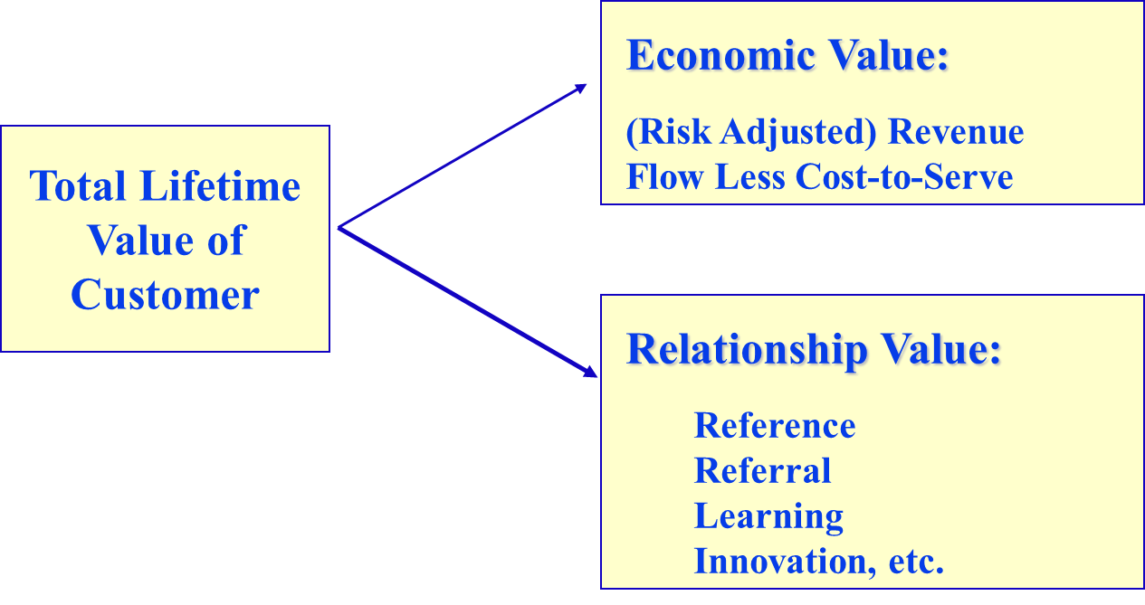
CLV III

Slide 48
Relationship Value
Indirect source of profit:
Reference Accounts (Give us prestige, high credibility, e.g., opinion leaders)
Referral Accounts (Give us high-quality leads, WOM)
Learning Accounts (Help us refine our offerings/beta testers)
Innovation Accounts (Help us to develop new offerings)

Slide 49
The Value of WoM, Customer Referral Value (CRV) and CLV
Average CRV after one year
AFFLUENTS 29% of customers CLV = $1,219 CRV = $64 | CHAMPIONS 21% of customers CLV = 370 CRV = $590
MISERS 21% of customers CLV = $130 CRV = $64 | ADVOCATES 29% of customers CLV = $180 CRV = $670
High
Average CLV after one year
(Telecom sample, see Kumar et al., 2007)
Low
Low
High

Slide 50
Review questions
What is the linkage between perceived customer value and customer lifetime value. Use theoretical frameworks and examples to illustrate your answer.
How can customer satisfaction be measured? How does it relate to SERVQUAL? Use examples to illustrate your answer.
How can loyalty be measured? How can these measures be linked to customer profitability?

