Slide 1
Marketing Analytics –
Conjoint Analysis
Dr Arne Floh
a.floh@surrey.ac.uk
Skype: arnefloh

Slide 2
NEW PRODUCt DEVElopement

Slide 3
Overview of New Product
Development Process
Opportunity Identification
Market definition
Idea generation
Reposition
Harvest
Life-Cycle Management
Market response analysis & fine tuning the marketing mix; Competitor monitoring & defense
Innovation at maturity
Go
No
Design
Identifying customer needs Sales forecasting
Product positioning Engineering
Marketing mix assessment Segmentation
Go
No
Introduction
Launch planning
Tracking the launch
Go
No
Testing
Advertising & product testing
Pretest & prelaunch forecasting
Test marketing
Go
No
Notes:
5
5

Slide 4
Value of Good Design
80% of a product’s manufacturing costs are incurred during the first 20% of its design (varies with product category).
Conjoint Analysis is a systematic approach for matching product design with the needs and wants of customers, especially in the early stages of the New Product Development process.

Slide 9
CONJOINT ANALYSIS

Slide 10
Conjoint Analysis
is a dependence technique used to understand how respondents develop preferences for products or services.
The dependent variable is a measure of respondent preference and can be metric or nonmetric (choice-based conjoint). The independent variables are dummy variables representing attributes of multiattribute products or services.
The researcher first constructs a set of real or hypothetical products by combining selected levels of each attribute (factor):
  In most situations, the researcher will need to create an experimental design.
  Some computer programs will create the design (Sawtooth Software, SPSS Conjoint).
These combinations or profiles are then presented to respondents, who provide their overall evaluations.

Slide 11
What Does Conjoint Analysis Do? (Measure Importance by Assessing Preferences)
The basic outputs of conjoint analysis are:
  A numerical assessment of the relative importance that customers attach to attributes of a product category
  The value (utility) provided to customers by each potential feature (attribute option) of an offering
  Identification of product designs that maximize market share or other indices.

Slide 12
In developing the conjoint task the researcher must answer four questions . . .
What are the important attributes that could affect preference?
How will respondents know the meaning of each factor?
What do the respondents actually evaluate?
How many profiles are evaluated?

Slide 13
Is calculated as shown below:
Is a decompositional technique:
  Conjoint decomposes stated overall preference to determine preferences for each attribute. That is, the researcher collects data on the overall preference for a stimulus and decomposes it to ratings for the individual attributes.
  In contrast, with compositional techniques the researcher collects ratings on many product characteristics and then compares the ratings to an overall preference rating to develop a predictive model.
Individual-, aggregate-, or segment-level models can be estimated.

Slide 14
Conjoint Analysis in Product Design
Conjoint Analysis can help answering the following questions:
Should we offer our business travelers more room space or a fax machine in their room?
Given a target cost for a product, should we enhance product reliability or its performance?
Should we use a steel or aluminum casing to increase customer preference for the new equipment?

Slide 15
Measuring Importance of Attributes
When choosing a restaurant, how important is…
Circle one
Not Very
Important Important
Decor 1 2 3 4 5 6 7 8 9
Location 1 2 3 4 5 6 7 8 9
Quality of food 1 2 3 4 5 6 7 8 9
Price 1 2 3 4 5 6 7 8 9

Slide 16
Measuring Importance of Attributes
Notes:
If

Slide 17
Conjoint Study Process
Stage 1—Designing the conjoint study:
Step 1.1: Select attributes relevant to the product or service category,
Step 1.2: Select levels for each attribute, and
Step 1.3: Develop the “product” bundles to be evaluated.
Stage 2—Obtaining data from a sample of respondents:
Step 2.1: Design a data-collection procedure, and
Step 2.2: Select a computation method for obtaining part-worth functions.
Stage 3—Evaluating product design options:
Step 3.1: Segment customers based on their part-worth functions,
Step 3.2: Design market simulations, and
Step 3.3: Select choice rule.

Slide 18
Measuring Importance By Measuring Utility
For single-attribute products, an underlying preference or utility scale can be constructed as follows:
  If a customer tells you she prefers Blue to Red, Red to Yellow, and Blue to Yellow (transitivity), then you can create an underlying numeric scale with the following “utiles” to represent customer preferences for the three colors: assign 3 to Blue, 2 to Red, and 1 to Yellow; or you could assign 10 to Blue, 9.95 to Red, and 1 to Yellow. From this can we say whether this customer would prefer Orange to Red?
Note: Preferences represent a higher-order construct than Utility, i.e., utility comes from preferences.
How do we come up with an underlying scale to represent customer preferences for multi-attributed products?

Slide 19
Methodological Issues
Selecting a measure of consumer preference:
      Rankings (requires transformation or specialized computer software)
      Ratings
      Choices
  Choosing a presentation method:
    Trade-off presentation – compares attributes two at a time.
    Full-profile presentation – most popular and most realistic.
      Factorial design
      Fractional factorial design
      Bridging design
    Pairwise presentation – a combination of other two methods.

Slide 20
Part-Worth I
 |  | Attribute B
 |  | 1 | 2
Attribute A | 1 | 2 | 1 | 1,5 | -2,0
 | 2 | 3 | 4 | 3,5 | 0,0
 | 3 | 6 | 5 | 5,5 | 2.0
 |  | 3,6667 | 3,3333 | 3,5
 |  | 0,1667 | - 0,1667
Part-Worth
= 3,5 β_{A1} = -2,000 β_{B1} = +0,1667
β_{A2} = -0,000 β_{B2} = -0,1667
β_{A3} = +2,000
Total Utility: y₁ = 3,5 + (-2,0) + 0,1667 = 1,667

Slide 21
Part-Worth II
Stimulus | p | y | p – y | (p-y)²
I | 2 | 1,6667 | 0,333 | 0,111
II | 1 | 1,3333 | -0,333 | 0,111
III | 3 | 3,6667 | -0,667 | 0,4444
IV | 4 | 3,3333 | 0,667 | 0,4444
V | 6 | 5,6667 | 0,333 | 0,1111
VI | 5 | 5,3333 | -0,333 | 0,1111
 | 21 | 21,0000 | 0,000 | 1,3333

Slide 22
EXAMPLE

Slide 23
Designing a Frozen Pizza
Attributes
Type of crust (3 types)
Type of cheese (3 types)
Price (3 levels)
Topping (4 varieties)
Amount of cheese (2 levels)
Crust
Topping
Type of cheese
Price
Amount of cheese
Pan
Thin
Thick
Pineapple
Veggie
Sausage
Pepperoni
Romano
Mixed cheese
Mozzarella
$9.99
$8.99
$7.99
2 Oz.
6 Oz.
A total of 216 (3x4x3x2x3) different pizzas can be developed from these options!
Notes:
This is another good example to use in the ME>XL software.

Slide 24
Designing a Frozen Pizza
Example Paired Comparison Data
Aloha Meat-Lover’s
Special treat
Crust Pan Thick
Topping Pineapple Pepperoni
Type of cheese Mozzarella Mixed cheese
Amount of cheese 2 Oz 6 Oz
Price $8.99 $9.99
Which do you prefer?
Which one would you buy?

Slide 25
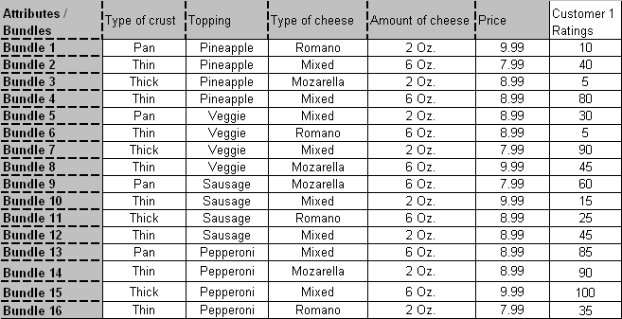
Designing a Frozen Pizza
Example Ratings Data

Slide 26
Conjoint Utility Computations
k
m
j
U(P) = S S a_{ij}x_{ij}
j=1
i=1
P: A particular product/concept of interest
U(P): The utility associated with product P
a_{ij}: Utility associated with the jth level (j = 1, 2, 3...k_{j}) on the ith attribute
k_{j}: Number of levels of attribute i
m: Number of attributes
x_{ij}: 1 if the jth level of the ith attribute is present in product P, 0 otherwise

Slide 27
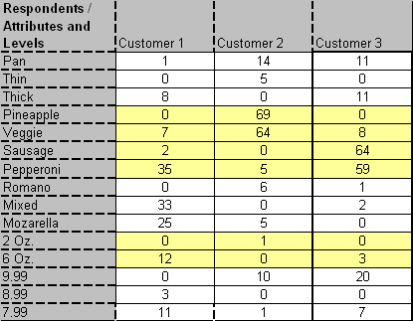
Part-Worth Computation:
(Designing a Frozen Pizza)
*Base product for customer 1: Thin pizza with pineapple, 2 oz of Romano cheese, and priced at $9.99.

Slide 28
Market Share and Revenue Share Forecasts
Define the competitive set – this is the set of products from which customers in the target segment make their choices. Some of them may be existing products and, others concepts being evaluated. We denote this set of products as P₁, P₂,...P_{N}.
Select Choice rule
  Maximum utility rule
  Share of preference rule
  Logit choice rule
  Alpha rule
Software also has a “Revenue index option” wherein you can compute the revenue index of any product compared to the revenue index of 100 for a base product you select.

Slide 29
Maximum Utility Rule (Example)
Under this choice rule, each customer selects the product that offers him/her the highest utility among the competing alternatives. Market share for product P_{i} is then given by:
K is the number of consumers who participated in the study.

Slide 30
Other Choice Rules
Share of utility rule: Under this choice rule, the consumer selects each product with a probability that is proportional to the utility of that compared to the total utility derived from all the products in the choice set.
Logit choice rule: This is similar to the share of utility rule, except that it gives larger weights to more preferred alternatives and smaller weights to less preferred alternatives.
Alpha rule: Modified version of share of utility rule. Before applying the share of utility, the utility functions are modified by an “alpha” factor so that the computed market shares of existing products are as close as possible to their actual market shares.

Slide 31
Market Share Computation
(Designing a Frozen Pizza)
Consider a market with three customers and three products:
Notes:
In order to run a market simulation, you must include all available alternatives that a customer will consider.

Slide 32
Market Share Computation
(Designing a Frozen Pizza)
Utility (Value) of each product for each customer.
Maximum Utility Rule: If we assume customers will only buy the product with the highest utility, the market share for Meat Lover’s treat is 2/3 and for Aloha Special is 1/3.
Share of preference rule: If we assume that each customer will buy each product in proportion to its utility relative to the other products, then market shares for the three products are: Aloha Special (29.3%), Meat Lover’s Treat (48.1%) and Veggie Delite (22.6%).
Notes:
This slide shows how two different choice rules lead to different market share projections.

Slide 33
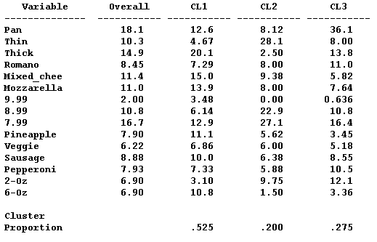
Identifying Segments Based on
Conjoint Part Worths
Note: You should not use standardize option in segmentation software when determining segments.

Slide 34
Other Issues That Can Be Addressed
Revenue/profit potential of a new product
Find optimal product by segment
Assess cannibalization potential of new product

Slide 35
Situations Where Conjoint Analysis Might Be Valuable
The new offering involves important tradeoffs affecting design, production, marketing, or other operational variables.
The offering is realistically decomposable into a set of basic attributes.
Consumer choices with respect to the offering and its market tends to be high involvement.
Factorial combinations of basic attribute levels are believable.
Desirable new offerings alternatives can be synthesized from basic alternatives.
The alternatives can be realistically described, either verbally or pictorially. (Otherwise, actual product formulations should be considered).
Perceptions of hypothetical combinations are reasonably homogeneous across members of the target group.

Slide 36
Conjoint Enhancements
Adaptive Conjoint
Choice-based Conjoint
Internet data collection tools
Improved input/output
Notes:
For more advanced classes, this slide can be used as a springboard to explore the different issues above. Otherwise the slide (and the following slide) should be skipped.

Slide 37
Summary: Utility of Conjoint Analysis
Design new offerings that enhance customer value.
Forecast sales/market share/profit of alternative offerings.
Identify market segments for which a given concept/offering has high value.
Identify the “best” concept/offering for a target segment.
Explore impact of alternative pricing and service strategies.
Plan production in flexible manufacturing systems.

Slide 38
Session 8
What is Conjoint Analysis and how can it be used for product development?
How can results of Conjoint Analysis be interpreted?
What are pros& cons of Conjoint Analysis? How can it be linked with other statistical methods?

