Slide 1
CASLA Week 3
Collaborative and Responsive Leadership
CASLA 554 Cohorts 3 & 4
March 13, 2014

Slide 2
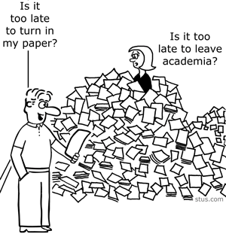
Housekeeping
Q: When Will Assignments Be Graded?
A: I certainly think that the Sunday deadline should be rewarded with graded assignments by the following Thursday’s class session so that office hours can be used to respond to questions.
I will be working night and day on getting caught up. Bear with me.
Notes:
Frisk Dewitt Middle School and improvement plan for Colin Edwards as a follow-up to conference memo (summary of conference).

Slide 3
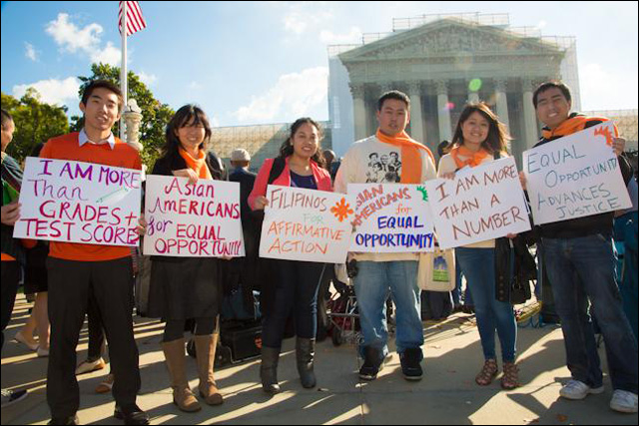
Dateline: Equity Policy
Affirmative Action is Back
in the News…
Senate Constitutional Amendment 5 (SCA5)
Passed by the California Senate on
Jan. 30 and is before State Assembly
Reverses Prop. 209’s prohibition on race, ethnicity and/or gender as a consideration in government institutions and specifically admissions to state universities
Vocal opposition from some Asian American groups
Chinese Americans leading the opposition to the amendment
http://www.scpr.org/blogs/multiamerican/2014/03/10/16027/sca-5-asian-americans-affirmative-action/
Notes:
American comfort around discussions of poverty and the discomfort and difficulty we have discussing race

Slide 4
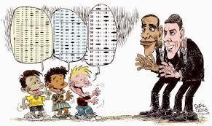
Dateline: Equity Policy
…and so is Compensatory Education
Heads Start Wins; Special Education Loses
Head Start gets a (small) boost of $280 million in 2015
after a $1 billion increase from feds last year
Funding for pre-school age students with disabilities and the rest of special education stagnant
Section 619 of IDEA has fallen from a high of $802 per child in 1992 to $471 per child in 2012-13
Part C of IDEA, the infants and toddlers program served 334,000 children in 2012-13 has seen per child allocation decline from $1979 in 1999 to $1257 last year
http://blogs.edweek.org/edweek/speced/2014/03/some_disappointed_with_white_h.html?intc=es
Notes:
In advance of our exploration of special education as equity policy, some are upset that Obama administration is increasing funding of early ed but has sustained decreases in funding for those pre-school aged children with the greatest needs.

Slide 5
Culturally Responsive Teaching and Learning (Hollie)
Asset not Deficit
Culture not Race
Validate and Affirm not Demean and Devalue
Build and Bridge, not Diminish and Degrade
Break Out Activity
“From an ethnocultural perspective, being African American does not mean one is Black, if Black is seen as an ethnic identity no different from Irish, Armenian, or Jewish. Being Caucasian-American does not mean that one is White Anglo Saxon Protestant or Catholic...”
Think about this statement and Hollie’s notion of cultural determinations being essential to our students’ identities and stories. What are the implications for equity work at the school site level?
Notes:
Duncan Andrade quote recap
An equitable education is better defined as a culturally relevant education in that it is designed to address the material conditions of students’ lives while maintaining a high level of intellectual rigor.
The measurement of an equitable education would require significantly greater attention to qualitative assessments of schools and classrooms to determine the specific needs of the community and how those are being met, or not. As it stands, we have an almost exclusive commitment to quantitative ‘equal’ assessments through state and national testing and measurement of the allocation of human and monetary resources.
Poverty is only one aspect of the material conditions
Since the head start, or the inequity, that educational equity work is meant to address is based in large part on US schooling’s foundation of deculturalization of Others by dominant culture (WASP) hegemony, then rejecting this premise is foundational/integral to…
Complex cultural identities narrowly defined by race and racism
Is Barack Obama Black?

Slide 6
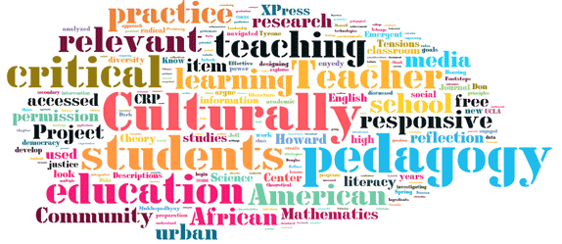
Five Principles of Culturally Responsive Pedagogy
the eradication of deficit-based ideologies of culturally diverse students;
disrupting the idea that Eurocentric or middle class forms of discourse, knowledge, language, culture, and historical interpretations are normative;
a critical consciousness and sociopolitical awareness that reflects an ongoing commitment to challenging injustice, and disrupting inequities and oppression of any groups of people;
an authentic and culturally informed notion of care for students, wherein their academic, social, emotional, psychological, and cultural well-being are promoted;
And recognition of the complexity of culture, in which educators allow students’ personal culture to be used as an enhancement in their quest for educational excellence.
Source: Tyrone Howard & Clarence L. Terry Sr (2011) Culturally responsive pedagogy for African American students: promising programs and practices for enhanced academic performance,Teaching Education, 22:4, 345-362

Slide 7
Ethnocultural Behaviors:
Culture of Underserved Students
Culture of School
Sociocentric
Collaborative
High Movement Contexts
Subjective
Relational
Dynamic Attention Span
Sense of Immediacy
Spontaneous
Individualistic
Competitive
Low Movement Contexts
Objective
Linear
Static Attention Span
Standardized
Prompted
Source: Hollie, Sharroky (2012) Culturally and linguistically responsive teaching and learning: classroom practices for student success
Notes:
Verbal Overlap
Relational
My lead team, Michelle Langer, and me
I mentioned this when we established norms. Unfortunately, students are expected to know these school norms from the very first day they set foot in the school.

Slide 8
When a Cultural Misunderstanding Exists Between the School and the Home/Community
Students exhibiting ethnocultural behaviors are often labeled as:
Defiant
Discourteous
Disruptive
Disrespectful
Disobedient
Deviant
Notes:
“Failure for teachers students alike”

Slide 9
When a Cultural Misunderstanding Exists Between the School and the Home/Community
Or worse:
“there exists a consistency in overrepresentation (in special education). For example in California, a Black student is twice as likely to be labelled LD as a White student, and in Montana, over five times more likely (Parrish 2002). Furthermore, when data is averaged from all fifty states, Black students are almost 1.5 times as likely to be labelled LD, almost twice as likely to be labelled emotionally disturbed, and thrice as likely to be labelled mentally retarded.” (Losen and Orfield 2002)
Notes:
The inequity within equity policy

Slide 10
What’s Next?
Assignment Due Sunday, March 9th :
Case Study#1 Collaborative.docx
Read for Next Time:
Culturally Responsive Teaching and Learning – Ch. 3
Culturally Proficient Education – Ch. 5 (Emphasis on Belief 3)
Breaking containment-the power of narrative knowing: countering silences within traditional special education research.pdf
What Every Principal Needs to Know about Special Education pg. 14-18
Notes:
Hollie (2012) posits that “part of being culturally and linguistically responsive is to combat the long lasting effects of deculturalization through validation and affirmation of the home language and culture,” legitimizing them and making them positive.
Hollie’s book will frame the inequity that exists within the equity policy that is IDEA

