Slide 1
CASLA Week 1
Collaborative and Responsive Leadership
CASLA 554 Cohorts 3 & 4
February 27, 2014

Slide 2
Housekeeping

Slide 3
Our Agreements
Attack the issues, not the person
Seek first to understand
Agree on what important words mean
Find common ground
Keep an open mind
Do not interrupt others
Listen first
Set aside unproductive patterns for listening
Don’t make negative assumptions; assume positive intent
Respect differing points of view
Speak your truth
Keep things confidential
CASLA is a safe place
Trust one another
No name calling

Slide 4
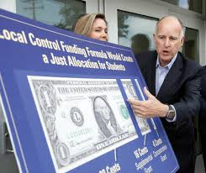
Advantaging the Disadvantaged
Creating affirmative action programs in our individual schools (in the meantime) and through policy (long-term)
Hiring an additional IA vs. LCFF
Redistributive Aspects and
“Educational Wealth”
The best teachers in the poorest schools
Greater funding for underresourced schools and districts underserving students as an investment in competitive advantage
Notes:
So I am looking at equity as an interaction between educational, economic, and political factors. Or as the Brazilian economist Francisco Ferreira outlines, without Equity policy determining public spending on education, societies are sentenced to remain economically and educationally inequitable forever. Ferreira posits that if public spending were to outpace private spending (which is generally the province of the wealthy to provide themselves a competitive advantage*) absent of other variables (or due to interaction with them), there would be no benefit—in terms of educational wealth*—to attending private schools. Put another way, public schools would represent the value add for rich folks. Of course if this were true, longitudinally, then redistribution would occur.
*$20,000-$30,000 a year on K-12 private school education
**that’s not to say that there would not be perceived value along religious, political, philosophical lines some of which we
understand to be an attraction of private schools for families (Jewish, Catholic and other parochial schools, Black independent
schools, Japanese Saturday Schools)
Source: Education for the Masses: the interaction between wealth, educational, and political inequalities. Economics of Transition, Volume 9 (2) 2001, 533-552

Slide 5
Affirmative Action?
Culturally Responsive Teaching and Learning
Compensatory Ed
IDEA
LCFF
RtI
Gender
Specific Programs
Equity
Notes:
Responsive leadership means creating our own affirmative or positive action policies or programs within our schools that advantage the disadvantaged.
Note: “Gender-specific programs” include programs to increase the number of female students in STEM (girlswhocode.com and blackgirlscode.com) and black male academies (urbanprep.org)

Slide 6
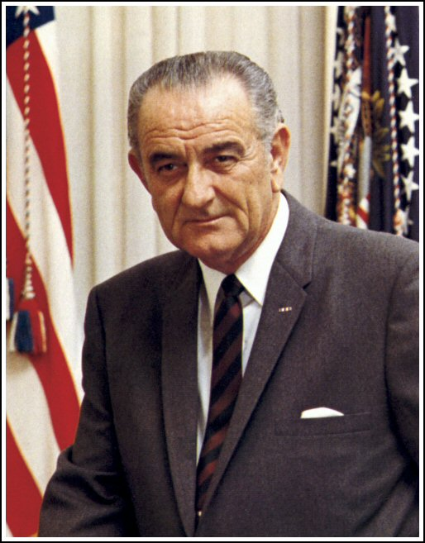
Compensatory Education
Elementary and Secondary Education
Act of 1965
Part of President Lyndon B. Johnson’s “War on Poverty”
The most important federal legislation addressing education ever passed by Congress
Reauthorized every 5 years
Current authorization is No Child Left Behind Act of 2001 (NCLB) by President George W. Bush
http://www2.ed.gov/policy/elsec/leg/esea02/pg1.html
Notes:
36th President of the US.
Authorization intially occurred every 3 years

Slide 7
Compensatory Education
Elementary and Secondary Education Act of 1965
Title I—Financial Assistance To Local Educational Agencies For The Education Of Children Of Low-Income Families
Title II—School Library Resources, Textbooks, and other Instructional Materials
Title III—Supplementary Educational Centers and Services
Title IV—Educational Research And Training
Title V—Grants To Strengthen State Departments Of Education
Title VI—General Provisions

Slide 8
Compensatory Education
Title I
Explicit equity policy to close the achievement gap between low-income urban or rural school children and middle-class suburban school children
School-wide
Targeted Assistance
Educational Consolidation and Improvement Act 1981 (Reagan)
Shifted resource control from feds to states and local jurisdiction
Hawkins Stafford Elementary and Secondary School Improvement Act 1988
Focused on school improvement through classroom instruction
Program Improvement (PI) and School-wide projects
Improving America’s School’s Act 1994
Accountability tied to ELA and Math standards
http://www.titlei.org/
Notes:
I’ve never been a Title I coordinator or the synonymous categorical programs adviser. Has anyone performed these roles? Note: these are LAUSD specific titles. They may or may not be

Slide 9
Compensatory Education
Head Start (1965)
Part of Johnson’s Great Society and War on Poverty
Legislation enacted as Economic Opportunity Act of 1964
It is estimated that over 30 million children ages 3-5 have been served by Head Start
In 1994 Early Head Start brought services to children from birth to 3 years of age.
Birth-to-Five pilot (2014) will “give communities greater flexibility in designing Head Start and Early Head Start programs to better serve the needs of young children and communities from birth until they enter pre-k or kindergarten.”
http://www.acf.hhs.gov/programs/ohs
Notes:
30 million youngsters have been provided education, social services, and health services through Head Start.

Slide 10
Compensatory Education
Again, the debate rages on….
YES for NCLB!
Student test scores have been increasing since NCLB took effect in 2002. In particular, the test scores of minority students have increased the most in this time.
Additionally, the overall achievement gap between minority students and the white majority has decreased between 1999 and 2004.
The percentage of classes taught by a highly qualified teacher has risen to over 90 percent across the nation.
Nearly 450,000 eligible students have received free supplemental educational services (tutoring) or public school choice.
The regular testing has allowed schools to identify the individual students in need of additional aid to reach grade level proficiency.
The increased school choice option for parents provides an additional incentive for both schools and teachers to reform any ineffective educational strategies.
Results have shown that the nation is still on track to reach the 2014 deadline for universal grade level proficiency in math and reading.
In the past year the number of schools across the nation who have met their AYP has increased.
NO for NCLB!
The federal government has consistently failed to fund the program to requires.
Achievement is measured only by on annual multiple-choice reading and math tests.
Teachers are increasingly only teaching “to the test”.
The only students who are not held to the same achievement standards are those with severe physical or mental disabilities.
Due to the intense focus on math and reading proficiency, fewer resources and time are devoted to subjects such as art, physical education, social studies and science.
Analysis of the academic reports by organizations who are unaffiliated with the federal board of education have come to mixed conclusions regarding the success of NCLB in raising math and reading achievement.
Many education professionals argue that it is impossible to compare data on a nation-wide scale because each state defines and assesses proficiency differently. (CCSS will fix this)
The term “scientifically-based” education programs is not specifically defined and allows ample room for interpretation.
More schools have been identified as “in need of improvement”
Notes:
NCLB is different because initial support was bipartisan but now debate falls along party lines.
Head Start falls squarely along conservative and progressive idealogical lines.

Slide 11
What’s Next?
Assignments Due Sunday, March 2nd :
It’s Being Done
Chapters 9 or 10 assignment
Equity Scavenger Hunt

