Slide 1
Project Lifecycle and IT Product Life Cycle

Slide 2
Definitions
Project Life Cycle
  “a collection of project phases.” (Schwalbe, 2014)
Product Life Cycle
  Systems Development Life Cycle (SDLC)
  “framework for describing the phases of developing information systems.” (Schwalbe, 2014)

Slide 3
Project Life Cycle
A project life cycle is a collection of project phases that defines
  what work will be performed in each phase
  what deliverables will be produced and when
  who is involved in each phase, and
  how management will control and approve work produced in each phase
A deliverable is a product or service produced or provided as part of a project

Slide 4
Project Life Cycle continued
Phases vary by industry and product
PMBOK Guide, 5th Edition calls the phases:
  Starting the project
  Organizing and preparing
  Carrying out the project work
  Finishing the project
NB the phases of the project life cycle are not the same as the project management process groups of initiating, planning, executing, monitoring and controlling, and closing

Slide 5
Project Life Cycle continued
Traditional project phases
Traditional phase | Also called: | Focus on: | Project life cycle phase
Concept | Project feasibility | Planning | Starting the project
Development | Project feasibility | Planning | Organizing and preparing
Implementation | Project acquisition | Delivering actual work | Carrying out the project work
Close-out | Project acquisition | Delivering actual work | Finishing the project

Slide 6
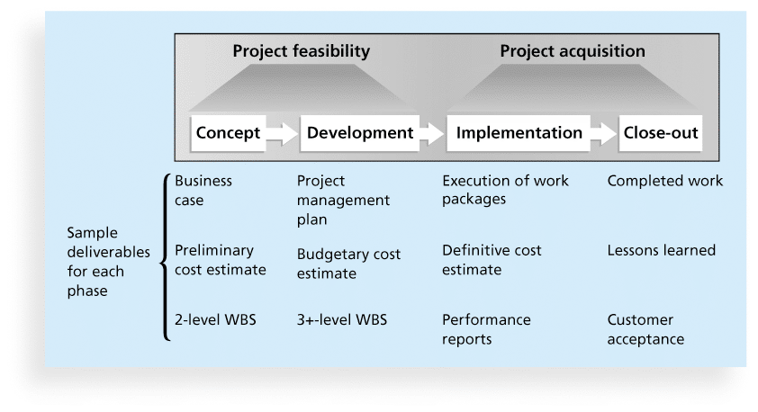
Project Life Cycle continued
General phases of the traditional project life cycle

Slide 7
Project Life Cycle continued
Early phases of a project life cycle
  resource needs are usually lowest
  the level of uncertainty (risk) is highest
  project stakeholders have the greatest opportunity to influence the project
Middle phases of a project life cycle
  the certainty of completing a project improves
  more resources are needed
Final phase of a project life cycle focuses on
  ensuring that project requirements were met
  the sponsor approves completion of the project

Slide 8
Project Phases and Management Reviews
A project should successfully pass through each of the project phases in order to continue on to the next
Management reviews, also called phase exits or kill points, should occur after each phase to evaluate the project’s progress, likely success, and continued compatibility with organizational goals

Slide 9
Product Life Cycle
Products also have life cycles
The Systems Development Life Cycle (SDLC) is a framework for describing the phases involved in developing and maintaining information systems
Systems development projects can follow
  Predictive life cycle: the scope of the project can be clearly articulated and the schedule and cost can be predicted
  Adaptive Software Development (ASD) life cycle: requirements cannot be clearly expressed, projects are mission driven and component based, using time-based cycles to meet target dates

Slide 10
Product Life Cycles: Predictive Life Cycle Models
Also called Planned Methodologies
Waterfall model: has well-defined, linear stages of systems development and support
Spiral model: shows that software is developed using an iterative or spiral approach rather than a linear approach
Incremental build model: provides for progressive development of operational software
Prototyping model: used for developing prototypes to clarify user requirements
Rapid Application Development (RAD) model: used to produce systems quickly without sacrificing quality

Slide 11
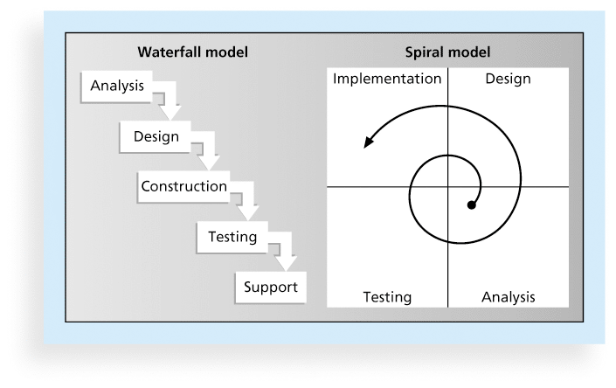
Product Life Cycle continued
Waterfall and Spiral life cycle models

Slide 12
Product Life Cycle: Adaptive Software Development
Also called Incremental Development
Most used: Agile software development
  popular to describe new approaches that focus on
    close collaboration between programming teams and business experts
    Versioning
    Flexibility
  Not suitable for all projects
  Examples of Agile Methodologies
    SCRUM
    Xtreme
PMBOK certification as an Agile Certified Practitioner has been available since 2011.

Slide 13
Agile Manifesto
We are uncovering better ways of developing software by doing it and helping others do it. Through this work we have come to value:
  Individuals and interactions over processes and tools
  Working software over comprehensive documentation
  Customer collaboration over contract negotiation
  Responding to change over following a plan
That is, while there is value in the items on the right, we value the items on the left more.

Slide 14
Agile Methods: Scrum
According to the Scrum Alliance, Scrum is the leading agile development method for completing projects with a complex, innovative scope of work.
The term was coined in 1986 in a Harvard Business Review study that compared high-performing, cross-functional teams to the scrum formation used by rugby teams.

Slide 15
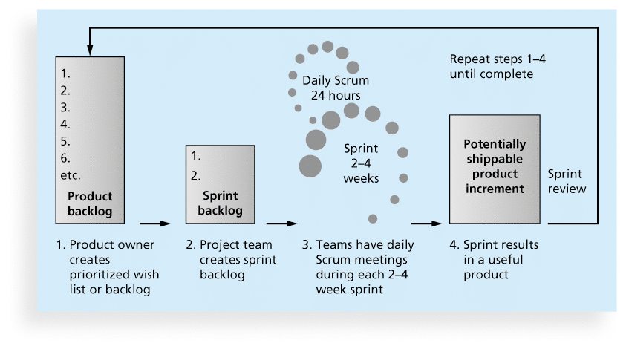
Scrum Framework

Slide 16
Concluding words:
Projects should successfully pass through each phase of the project life cycle
Products must pass successfully through each phase of the product life cycle
The two life cycles exist in parallel

Slide 17
References
Schwalbe, K. (2014) Information Technology Project Management, 7th Edition, Cengage Learning
Sommerville, I. (2016) Software Engineering, 10th Edition, Pearson

