Slide 1
MEDIA INFLUENCE PROJECT
Name:
Professor:
Course:
Date:

Slide 2
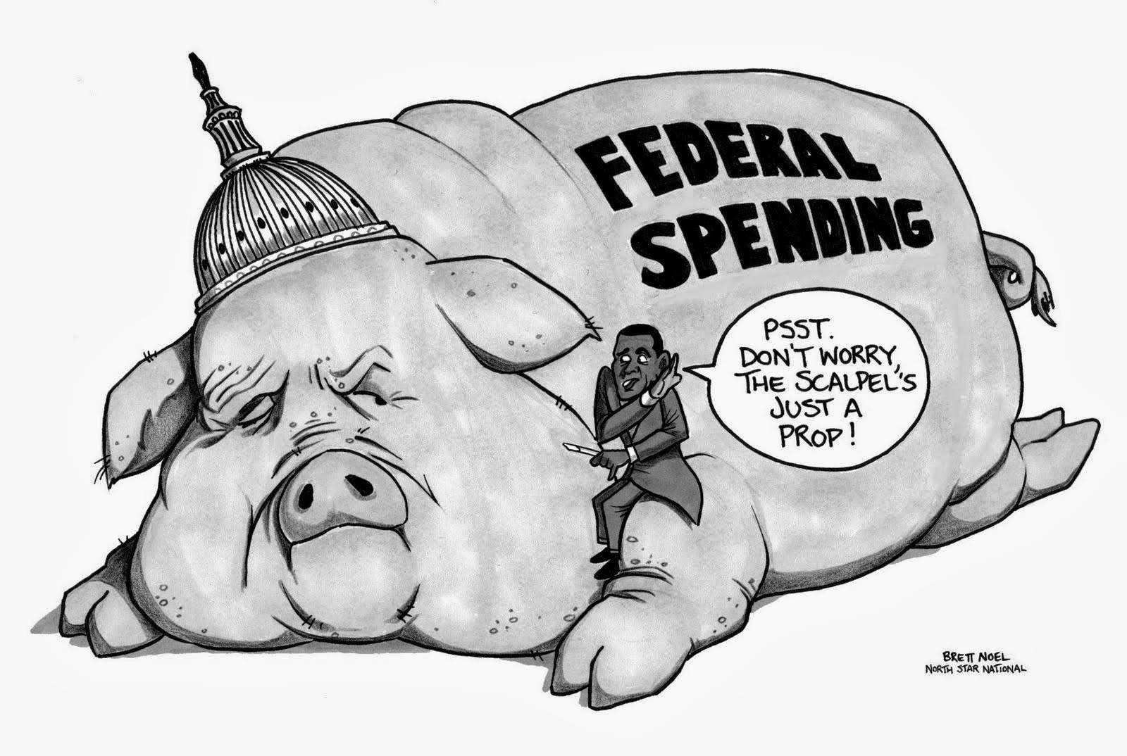
Federal Spending

Slide 3
Federal Spending
The picture is an effective illustration on how the federal government spends huge amounts of money miscellaneously.
Most members of the congress leave the public office as millionaires, wealthier than they entered.
The statistics reveal on the high life expenditure by the politicians on the tax payers money.
Most Americans work hard to make ends meet thus action must be taken to put the act onto a halt.
http://www.econmatters.com/2013/09/22-facts-us-government-is-too-big-and.html , By Michael Snyder

Slide 4
American Horror story
Whitehead, J. (2016). American Horror Story: The Shameful Truth About The Government’s Secret Experiments. Retrieved from http://www.mintpressnews.com/american-horror-story-shameful-truth-governments-secret-experiments/216270/
The article portrays the government from a negative perception based on its acts of breaking the law.
Through this, the article is biased on the actions taken by the government thus calling for action from civil rights movements.
To the American people, it is crucial to understand the heinous act by the government thus dictate their capacity to vote right people into the oval office.

Slide 5
U.N Report
Norton, B. (2016). Scathing U.N. report: “Structural racism” endures in U.S., and the government has failed to protect African-Americans’ rights. Retrieved from http://www.salon.com/2016/10/07/scathing-u-n-report-structural-racism-endures-in-u-s-and-the-government-has-failed-to-protect-african-americans-rights/
The United states government is condemned for its human rights crisis of police killings, mass incarceration thus calling for reparations.
The black community are continually killed by police officers.
The report calls for repatriations and policies to stop racism.
The report is not political but rather a concern from the humanitarian organization.

Slide 6
Human experiments
The Hotlist, (2014). U.S. Government's Secret Human Experiments Exposed. Retrieved from https://www.youtube.com/watch?v=dgC-3So9pZU
The information relayed by the piece is calling for action against the use of humans in experiments being conducted by the governments.
The American society is informed on its significance based on the fact that this is not the first time the government has been implicated on such heinous acts.
The environmental protection agency failed to include the long term risks associated with their practices.
Despite the intense effort by Hotlist, the effectiveness of the matter is minimal.

Slide 7
The American Government
Trudeau, T. (2016). The American Government Does NOT Represent The American People!. Retrieved from http://www.pravdareport.com/opinion/feedback/12-09-2016/135593-american_government-0/
The article by Trudeau is focused on the actions by the government where he identifies them as not the reflection of the American people.
Despite the fact that the piece is not political, it calls for other nations such as Russia not to label the American people based on the actions of their government.
Trudeau calls for the Americans to realize that their democracy and votes no longer counted after DNC rigged the system thus sabotaging Bernie Sanders campaign.

