Slide 1
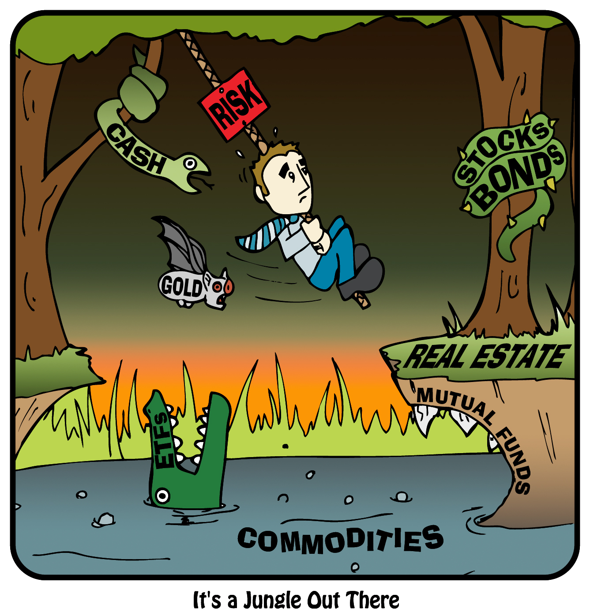
.
(Powell, 2009)
BOND PRICING and ANALYSIS
OVERVIEW
Thomas J. Powell
Northcentral University
Notes:
Introduction – Bonds, and what will be discussing as an overview today:
Types of bonds
Should bonds be part of our investment strategy?
Interest rate theories
Yield curves
Risks and risk mitigation and uncertainty
Duration and convexity
Immunization strategies for portfolio management

Slide 2
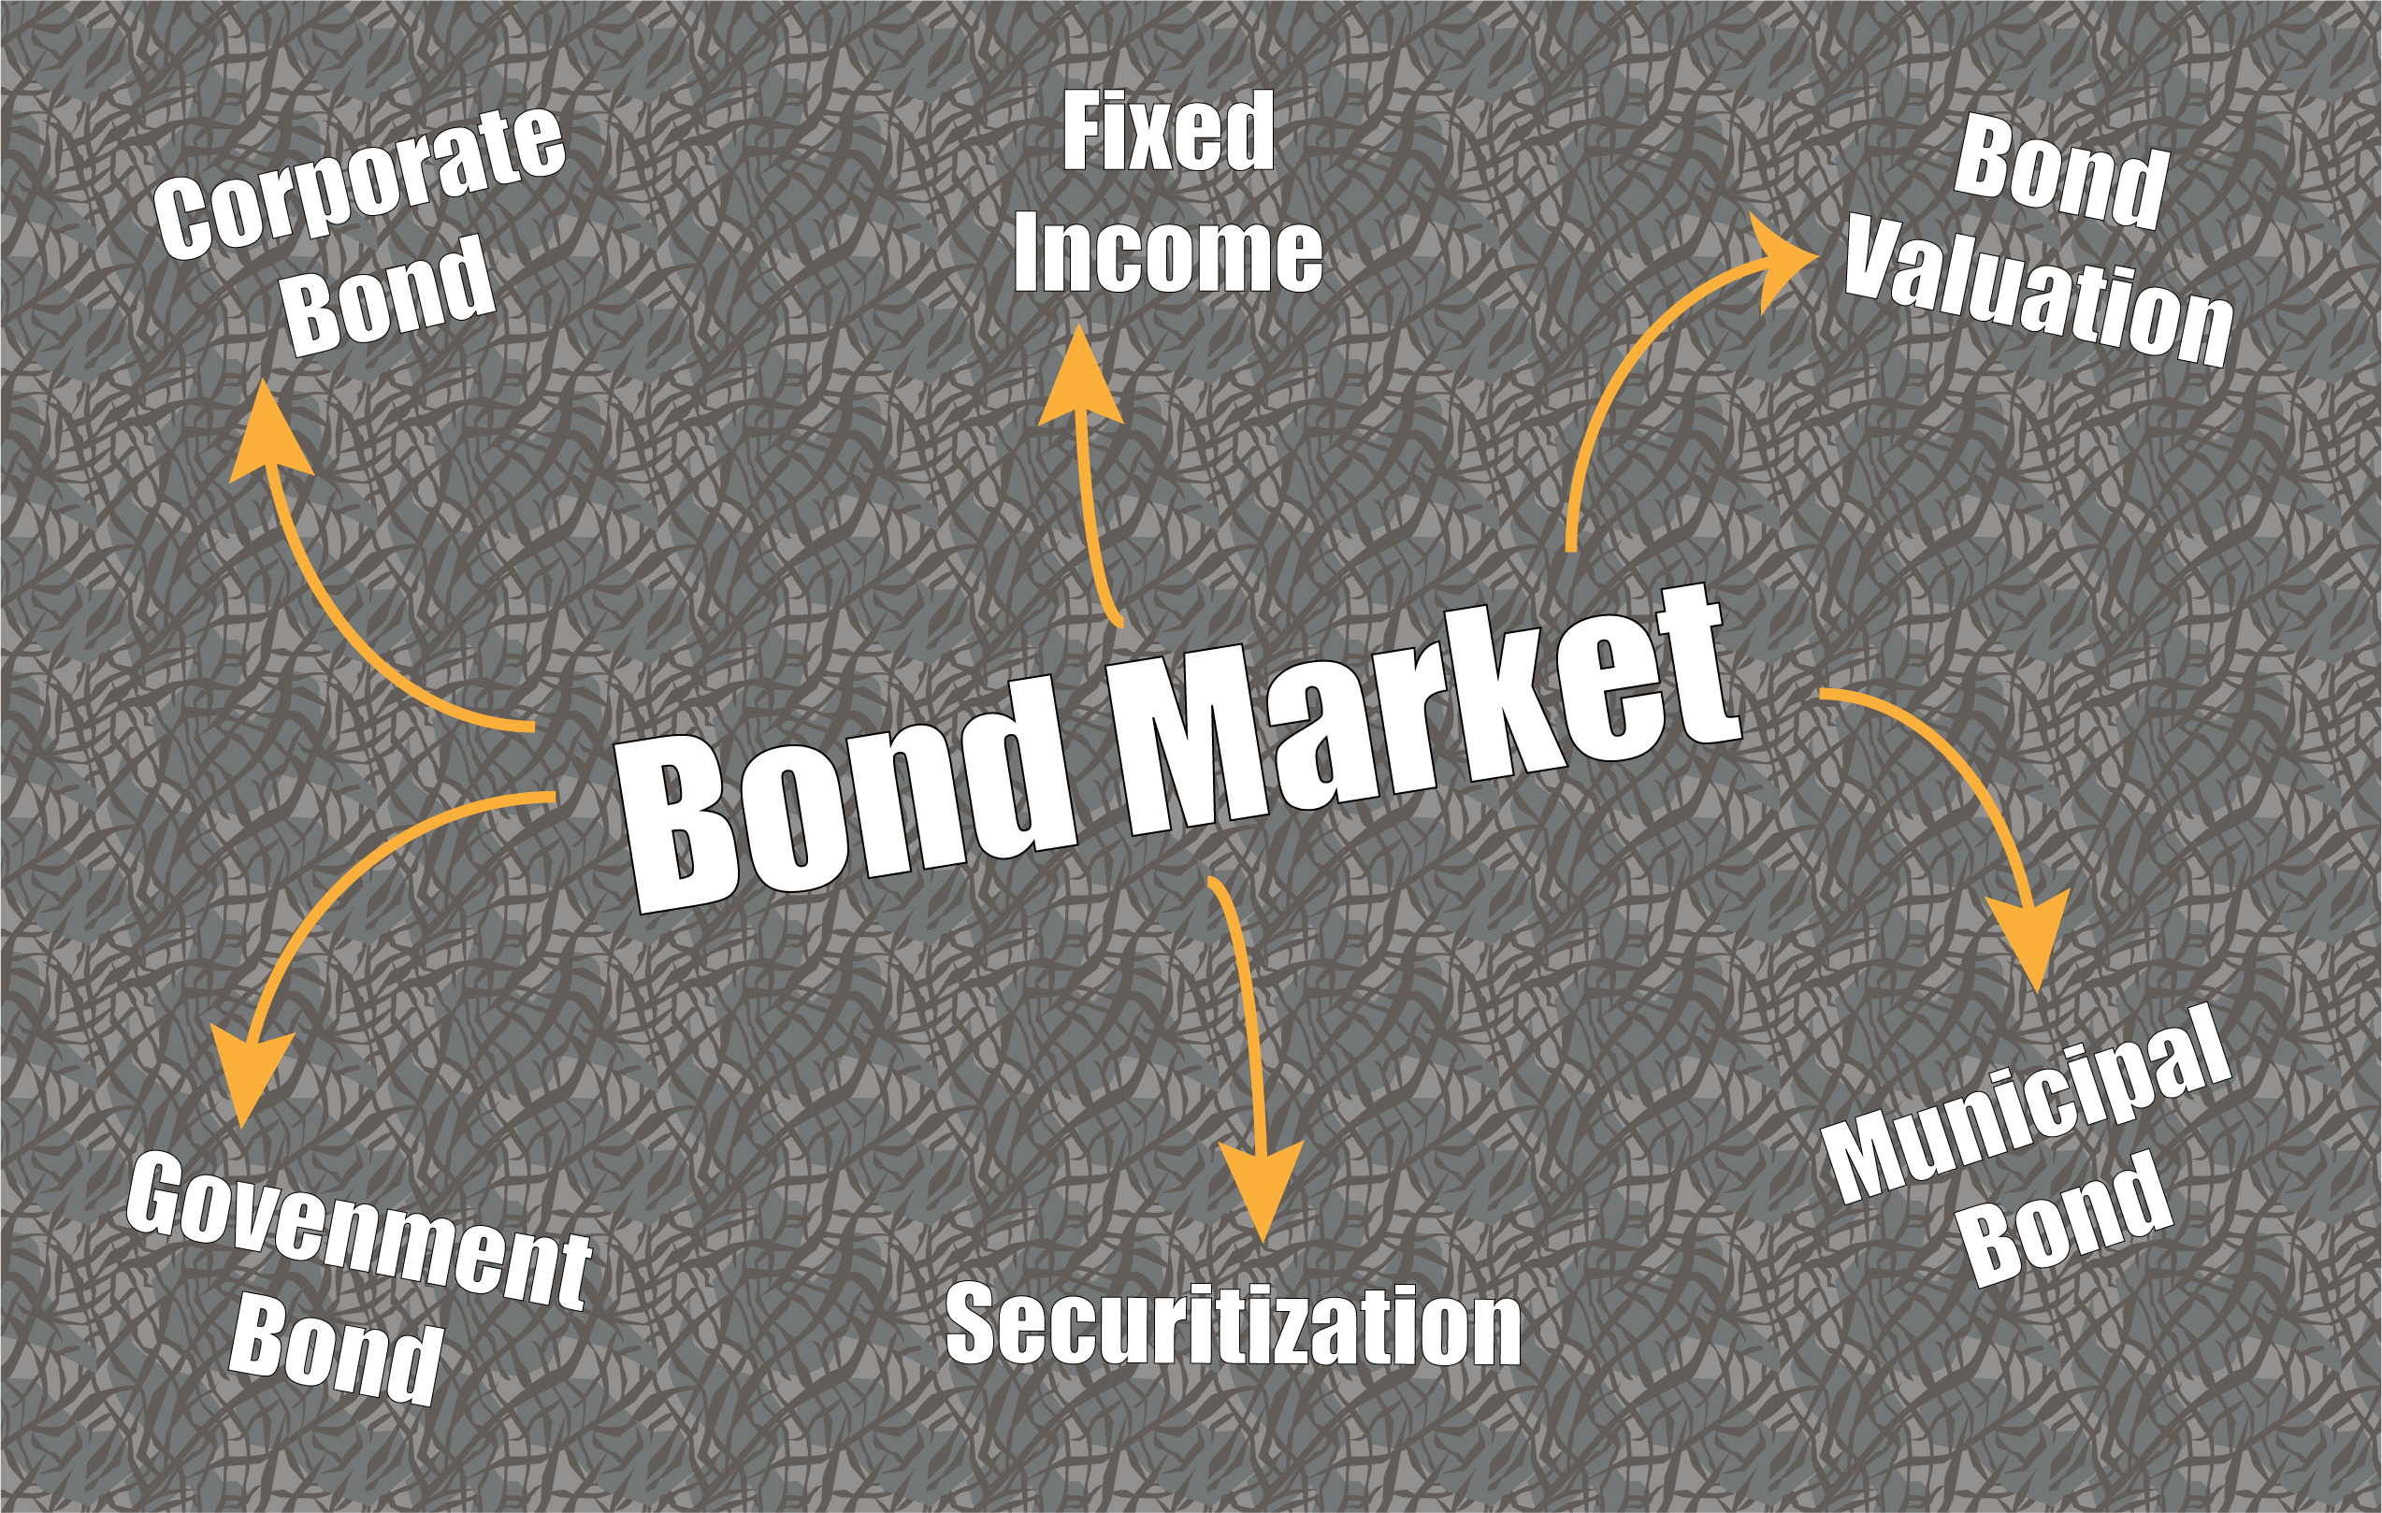
Notes:
(Bodie, Kane & Marcus, 2013; Treasury.gov, n.d.)
Corporations and governments issue bonds in order to fund projects, meet capital shortfalls, and for growth strategies.
The buyer of a bond is a “lender” and the issuer is a “borrower” with interest being paid by the issuer to the buyer in exchange for the use of the funds.
Principal, or the face value, is returned at the time of maturity, with the length of time to maturity from issue being called ”term”.
What are typical investments under the term Bond?
U.S. Treasuries: Guaranteed by US Govt and considered the safest bonds from default risk and have low relative yields
exempt from state and local taxes, not federal taxTreasury bills: "T-bills" have the shortest maturities -- 13 weeks, 26 weeks, and one year. You buy them at a discount to their $10,000 face value and receive the full $10,000 at maturity. The difference reflects the interest you earn.
Treasury notes: mature 2 to 10 years, pay interest semiannually
Treasury bonds: maturities at 10 years, pay interest semiannually
Zero-coupon bonds: Treasury-based securities sold by brokers that are discounted to maturity – do not make interest payments
Inflation-indexed Treasuries: Pays a real rate of interest on a principal amount based on movement of CPI
Mortgage-backed securities: MBSs represent an ownership stake in a pool of mortgage loans and often yield between 2% - 4% more than Treasuries of comparable maturities.
Corporate bonds: value depends on the creditworthiness of the company offering them ranging from investment-grade to junk bonds.
Municipal bonds: "Munis" are issued by state and local governments
interest exempt from federal taxes

Slide 3
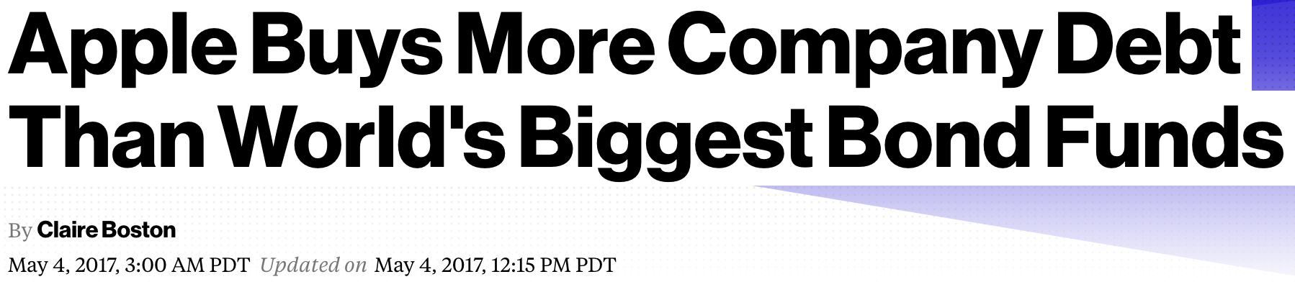
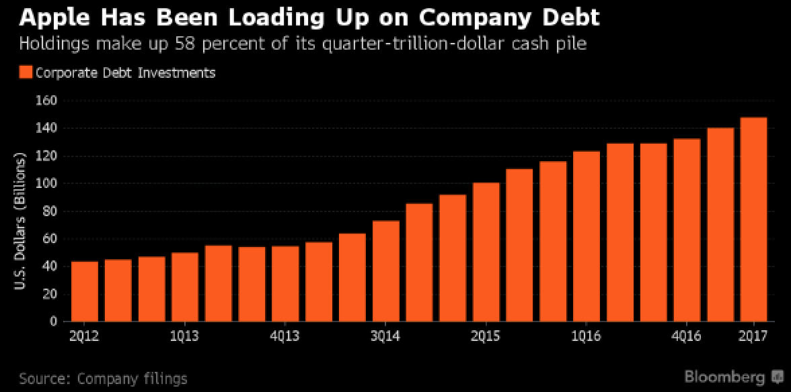
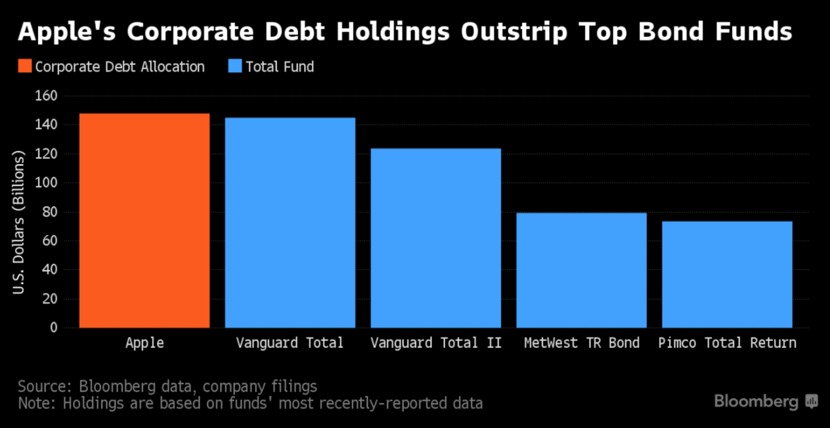
Including Bonds into our Capital Strategy
(Boston, 2017)
Notes:
(Weil, 2017; Boston, 2017)
Should Bonds be Part of Our Capital Investment Strategy?
Approximately 52% of the cash held by publicly traded, nonfinancial companies invested into bonds at the start of 2017.
Apple: $99B
Oracle $29B
Amgen: $16B
Several reasons are listed for this investment strategy of the large corporate buyers including the possibility of repatriation of profits to US through tax changes
Many analysts forecast the trend to remain as long as economic growth stays modest.
A question we will explore is what happens when yields rise and prices drop.

Slide 4

Let’s Talk Risks
Inflation Risk
Interest Rate Risk
Call Risk
Credit Risk
Liquidity Risk
Market Risk
(Powell, 2009)
Notes:
Some of the primary risks with bonds:
Inflation risk: Rising inflation devalues the fixed returns of bond payments with the longer terms having a higher risk of inflation.
Interest rate risk: Bond prices move in the opposite direction of interest rates.
rates rise, bond prices fall
bond prices rise when interest rates fall
the longer the term of the bond the greater the risk of price fluctuation -- or volatility
Call risk: Many corporate and muni bond issuers reserve the right to redeem, or "call," their bonds before they mature, at which point the issuer is required to pay bondholders only par value. Typically, this happens if interest rates fall and the issuer sees it can lower its costs by selling new bonds with lower yields.
With Residential Mortgage Backed Securities (RMBS), a prepayment can occur because of falling interest rates available to borrowers. Full principal repayment is received but then must be reinvested at the lower rates.
With Commercial Mortgage Backed Securities (CMBS), a prepayment can occur but is usually offset with a defeasance fee, thus mainting the original bond holders payment stream constant through to term.
Credit risk: Non-payment or slow payment from the issuer. Us Treasuries are considered “risk-free” whereas junk bonds are considered high risk
Liquidity risk: Treasuries are generally considered liquid; however corporate - especailly junk bonds, and many munis are thinly traded and can be considered illiquid.
Market risk: Bonds follow supply and demand – during the economic meltdown a US Treasury was valuable whereas a RMBS was sold only at a steep discount – if at all.

Slide 5
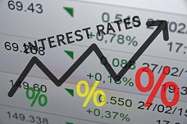
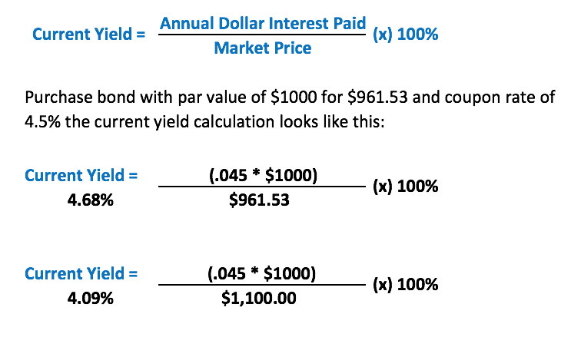
Basic Pricing Concept
$1,000 Bond Price at Issue
(face value / par value)
4.50% Annual Interest
(coupon rate)
$45.00 Annual Payment Total
(coupon payment)
Current Yield Calculation
Notes:
(Bodie, Kane & Marcus, 2013; Treasury.gov, n.d.)
Pricing of Bonds
Calculation of Bond Yield
A bond's face value, or price at issue, is known as its "par value." Its interest payment is known as its "coupon."
$1,000 bond paying 4.50% a year (coupon rate) = $45 coupon payment.
prices of bonds fluctuate but the coupon payments stay constant
Bonds are bought and sold on the secondary market for premiums and discounts and sometimes at par:
Discount Price example of price paid for $1,000 face value at $961.53 at 4.50% coupon = current yield of 4.68%
Premium Price example of price paid for $1,000 face value at $1,100.00 (quoted as 110) at 4.5% = current yield of 4.09%
Par Value = price paid is same as issue price
The basic pricing calculation simply divides the coupon payment into the price paid for the bond
does not include gains (discount), or losses (premium)

Slide 6
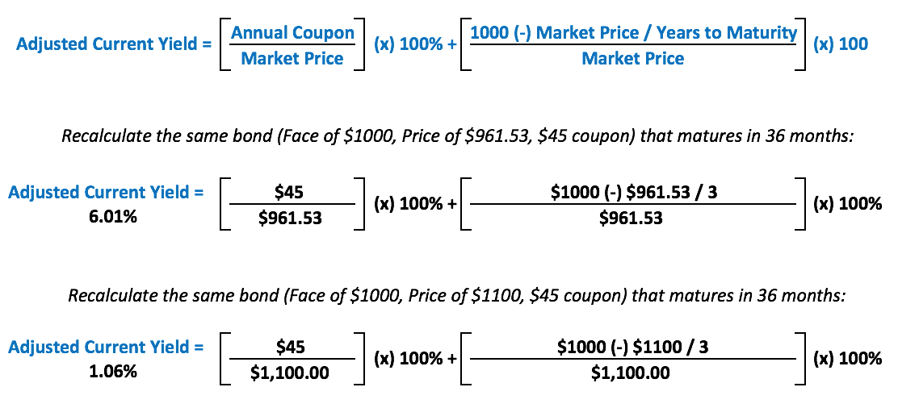
Basic Pricing Concept
Adjusted Current Yield Calculation
Notes:
(Bodie, Kane & Marcus, 2013; Treasury.gov, n.d.)
How Bonds Adjust over time for Premium, Par, and discount
The adjusted current yield formula accounts for discounts or premiums of a bond. The modified current yield formula accounts for the discount or premium into the yield.
The adjusted current yield of 6.01% is higher than the current yield of 4.68% due to the gain realized from the discount price of $961.53 instead of $1000;
whereas the adjusted current yield of 1.06% is dramatically lower than the current yield of 4.09%.
This occurs because of the $100 premium to the purchase + the short time left to maturity

Slide 7
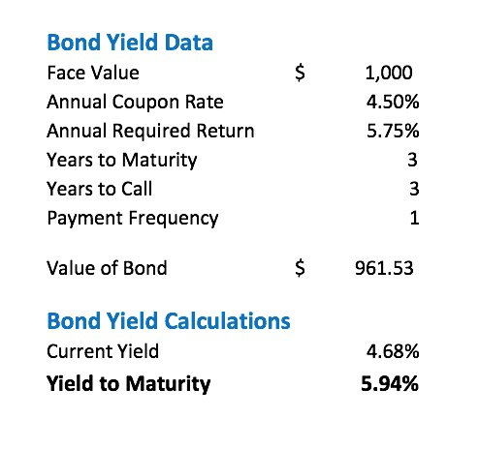
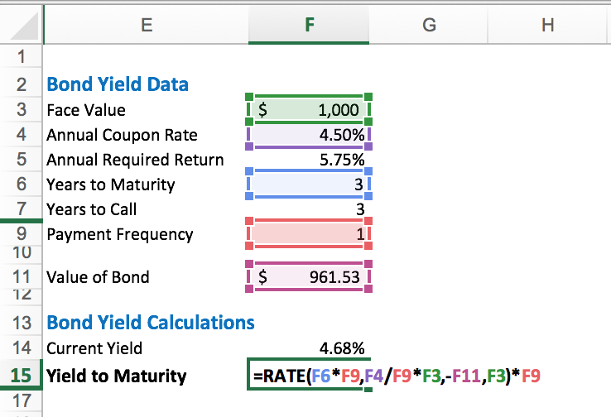
YTM Pricing Concept
Excel makes YTM much quicker to calculate!!
Notes:
(Bodie, Kane & Marcus, 2013; Treasury.gov, n.d.)
How Bonds Adjust over time for Premium, Par, and discount
Yield to maturity (YTM) is the total return expected if the bond is held to maturity and is the interest rate by which the PV of all the future cash flows are equal to the bond's price.
Without a bond calculator or excel, the general pathway to find YTM is through trial and error.

Slide 8
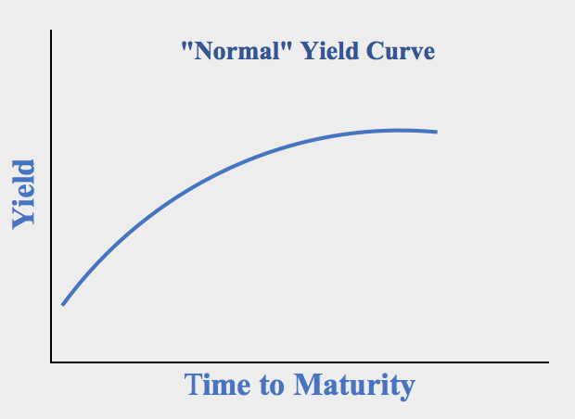
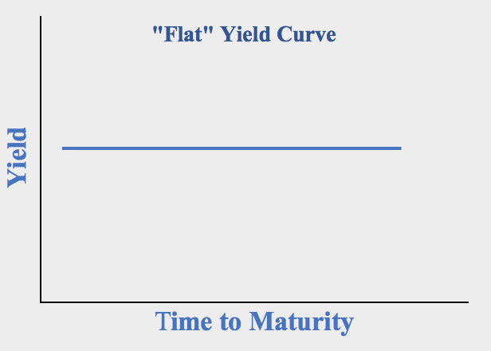
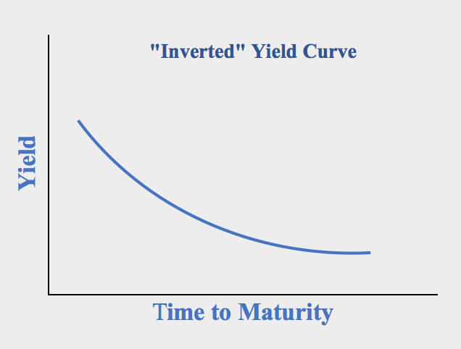
Yield Curves
Notes:
(Bodie, Kane & Marcus, 2013; Treasury.gov, n.d.)
Yield Curve
A graph that plots similar bonds yields ranging for shortest period to longest period, and lowest rate to highest
Three primary shapes:
short-term yields are lower than long-term yields curve is referred to a "normal" yield curve.
generally indicates strong economic growth whereby investors look for a higher rate of return for taking added risk of lending for a longer time period
short-term yields are higher than long-term yields the curve is referred to as “inverted yield curve
investors expect a slowing economy with little to no inflation, leading to lower interest rates to spur growth
little or no difference between short and long-term yields a flat yield curve is created
Uncertainty in the market place as to growth or slowdown -
Three main theories:
Expectation theory: rising short-term interest rates are what create a normal yield curve whereas falling rates cause an inverted curve
2. Liquidity preference hypothesis: investors desire the liquidity of short-term bonds thus causing flat and inverted curves to be
3. Segmented market hypothesis: different investors confine themselves to certain segments of maturity causing the yield curve to reflect current views of the economy through investment policies

Slide 9

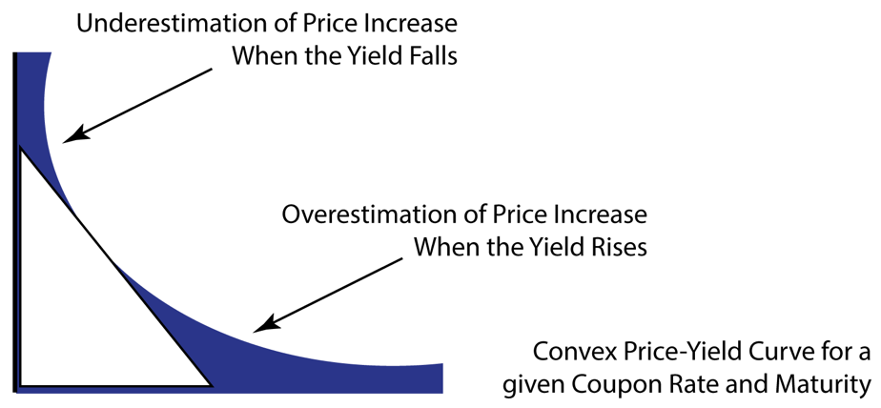
Convexity
Price
Yield
Notes:
(Viceia, 2012; Bodie, Kane & Marcus, 2013; Treasury.gov, n.d.)
Duration and how it is useful in the context of bond portfolio analsyis
Price risk measurement value for duration
How duration can measure the dynamics of price and re-investment rate risk across time for a bond portfolio
Duration is an estimate of the interest rate sensitivity of a portfolio.
Unfortunately, duration has limitations when used as a measure of interest rate sensitivity.
A relationship between the changes in price and yield is convex, thus Convexity:
the curved line represents the change in prices given a change in yields
the straight line represents the estimated change in price via the duration statistic.
the shaded area shows the difference between the duration estimate and the actual change in price

Slide 10
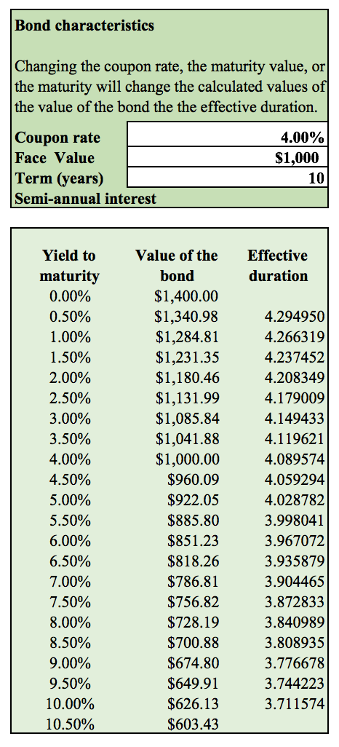
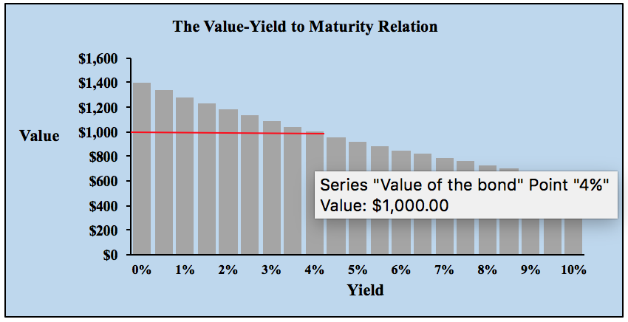
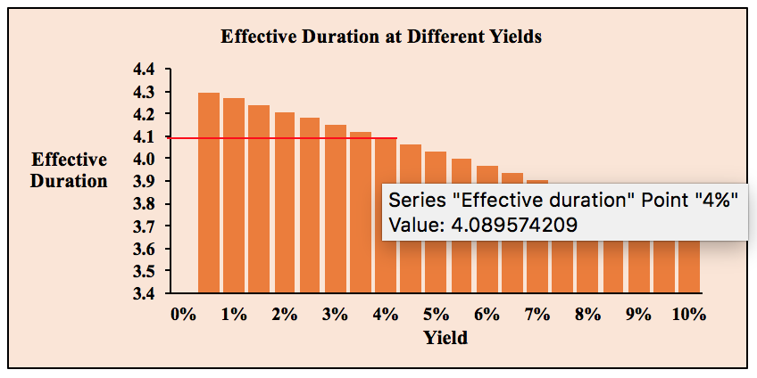
Notes:
(Christensen, Lopez & Mussche, 2017, Bodie, Kane & Marcus, 2013; Treasury.gov, n.d.; Financial Industry Regulatory Authority, 2017)
Duration reveals how much risk a bond investor faces from changes in interest rates. The bond's price, maturity, coupon and yield to maturity are all factors that go into the calculation for duration.
In general –
as maturity increases, duration increases
as a coupon increases, duration decreases
as interest rates increase, duration decreases and the bond's sensitivity to further interest rate increases drops
bonds with high yields / coupons, the duration is lower (this is because the bondholder receives more of a return on the investment faster)
Interesting factoid: duration for a Zero Coupon Bond is equal to its time to maturity whereas duration for traditional bonds is less than time to maturity and changes as coupons are received

Slide 11
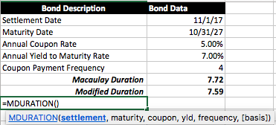
Macauly Duration and Modified Duration
Notes:
(Bodie, Kane & Marcus, 2013; Treasury.gov, n.d.; Zaremba, 2017)
Macauly Duration was created by Frederick Macaulay in 1938
Used to calculate a bond’s basic duration
The Modified Duration is an adjusted version of the Macauly duration and takes into account how interest rate fluctuations affect a bond's durations
Duration can help investors understand how sensitive a bond is to changes in prevailing interest rates. By multiplying a bond's duration by the change, the investor can estimate the percentage price change for the bond.
Example: duration of 7.59 years whereby yields increased by 50 basis points (0.50%), the approximate percentage change in the bond's price would be: -7.59 x .005 = -0.03795 or -3.795%, ($1,000 – 37.95 = $962.05)

Slide 12
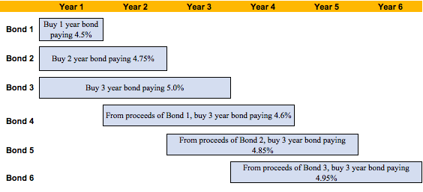
Laddering
Notes:
(Bodie, Kane & Marcus, 2013)
A bond ladder is a strategy that staggers the maturity of various bonds in a portfolio
Example:
$1,500,000 to invest
$500,000 in a 1 year bond at 4.5% (bond 1)
$500,000 in a 2 year bond at 4.75% (bond 2)
$500,000 in a 3 year bond at 5.0% (bond 3)
$500,000 + proceeds from bond 1 is reinvested in year 2 (bond 4)
$500,000 + proceeds from bond 2 is reinvested in year 3 (bond 5)
$500,000 + proceeds from bond 3 is reinvested in year 4 (bond 6)
Each year is a "rung" of the ladder Advantages:
benefit from increases in interest rates
diversification can help stabilize income stream
liquidity each year if needed
Disadvantages:
friction cost of transactions
falling interest rates will produce lower yields

Slide 13
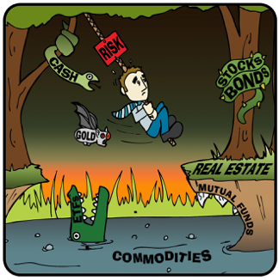
Opportunity in Change
Notes:
(Lydon, 2013; Treasury.gov, n.d.; Blinder, 2012; Conerly, 2017)
Flattening Yield Curve
Federal Reserve actions is pushing short-term rates higher
Long-term rates rates remain stable
Yield curve is flattening which typically imply the market is looking at lower inflation expections and weaker economic
** Short term cash is earning more ☺
** Long-term bonds are becoming more risky due to the historically low interest rate levels
*** ETFs may be a good tool to research in today’s market
As the group now has an executive overview of bonds and possible strategies, how do we take advantage of the current market conditions and use excess cash to increase our company’s returns??
Thank you

Slide 14
References
Blinder, A. S. (2012). Revisiting Monetary Policy in a Low-Inflation and Low-Utilization Environment. Journal Of Money, Credit & Banking (Wiley-Blackwell), 44141-146. doi:10.1111/j.1538-4616.2011.00481.x
Bodie, Z., Kane, A., & Marcus, A. J. (2013). Investments New York, NY McGraw-Hill-Irwin 9780077641986.
Boston, C. (2017). Apple Buys More Company Debt Than World's Biggest Bond Funds. Bloomberg L.P. Retrieved from: https://www.bloomberg.com/news/articles/2017-05-04/apple-buys-more-company-debt-than-the-world-s-biggest-bond-funds
Christensen, J. E., Lopez, J. A., & Mussche, P. L. (2017). Measuring Interest Rate Risk in the Very Long Term. FRBSF Economic Letter, 2017(12), 1-5.​
Conerly, B. (2017). Interest Rate Forecast 2017-2018. Forbes Business. Retrieved November 07, 2017, from https://www.forbes.com/sites/billconerly/2017/02/27/interest-rate-forecast-2017-2018/2/#691a8fa73c8b.
Financial Industry Regulatory Authority (n.d). Duration-What an Interest Rate Hike Could Do to Your Bond Portfolio. Retrieved from: https://www.finra.org/file/finra-investor-alert-duration%E2%80%94what-interest-rate-hike-could-do-your-bond-portfolio-pdf-english

Slide 15
References (continued)
Gamber, E. (2017). Projections of Interest Rates. Congressional Budget Office. Retrieved November 07, 2017, from https://www.cbo.gov/publication/52391.
Lydon, T. (2013). Battle Rising Rates with ETFs. Journal Of Financial Planning, 26(10), 38.​
Powell, T. (2009). Standing In The Rain: Understanding, Surviving and Thriving in the Worst Financial Storm Since the Great Depression.
Treasury.gov (n.d.). Retrieved November 01, 2017, from https://www.treasury.gov/resource-center/data-chart-center/interest- rates/Pages/TextView.aspx?data=realyield
Viceira, L. M. (2012). Bond risk, bond return volatility, and the term structure of interest rates. International Journal Of Forecasting, 28(Special Section 1: The Predictability of Financial Markets), 97-117. doi:10.1016/j.ijforecast.2011.02.018
Weil, D. (2017, September 28). When Corporations Buy Corporate Bonds. Retrieved November 07, 2017, from https://www.institutionalinvestor.com/article/b14ywvmwmf4qj3/when-corporations-buy-corporate-bonds
Zaremba, L. (2017). Does Macaulay Duration Provide The Most Cost-Effective Immunization Method – A Theoretical Approach. Foundations Of Management, 9(1), 99.

