Slide 1
Chapter 5 Fallacies of Argument
Fallacy: A flaw in the structure of an argument that renders its conclusion invalid or suspect

Slide 2
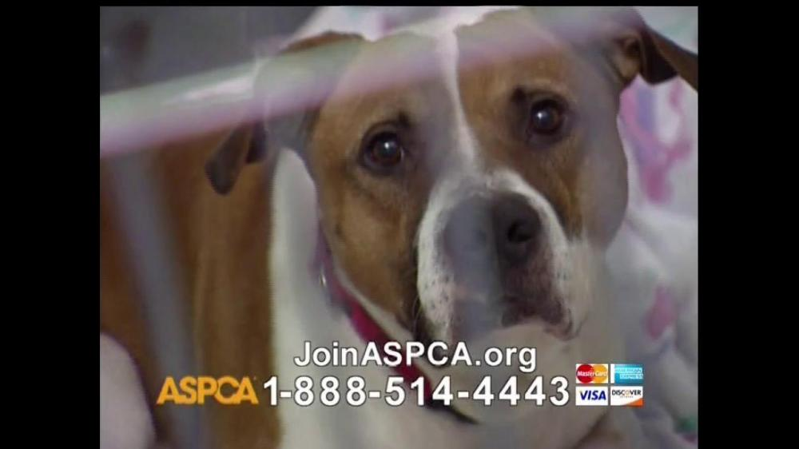
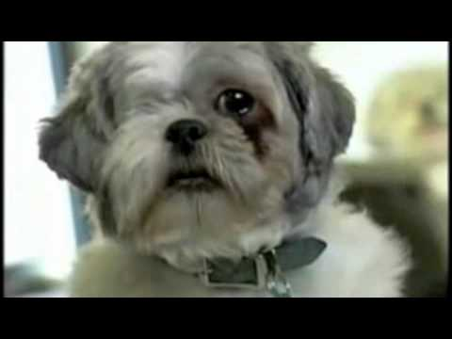
Fallacies Of Emotional Arguments

Slide 3
Scare Tactic or Appeal to fear
Presents an issue in terms of exaggerated threats or dangers
To reduce complicated issues to simple threats or to exaggerate a possible danger well beyond its actual likelihood. Example: Because of the possibility of a terrorist hijacking or a mechanical failure, flying on a plane is too dangerous and should be avoided altogether. Example: Because of the possibility of poisoning of Halloween candy by some people who give it out to trick-or-treaters, communities should ban trick-or-treating.

Slide 4
Either-or Choice or false dichotomy
Only presenting two possible alternatives to an issue, with one being obviously better than the other
To reduce complicated questions, which can be effectively answered in multiple different ways to only two opposing answers. Example: Either you support the President in everything he says and does or you are not a patriotic American. Example: Either you worship God or you worship Satan.

Slide 5
Slippery Slope
An exaggeration that a relatively inconsequential action will have serious adverse consequences in the future
To greatly exaggerate the supposedly inevitable future consequences of an action by suggesting one small step will initiate a process that will necessarily lead the way to a much bigger result. Example: If you restrict my right to say whatever I want anywhere I want however I want this is the beginning of totalitarianism in America. Example: If we let one homosexual couple live on our street before you know it our neighborhood will start to become like Greenwich Village in New York or the Castro District in San Francisco.

Slide 6
Overly Sentimental Appeal
An appeal that is based on excessive emotion
Relying entirely on manipulatively heart-warming or heart-wrenching appeals to emotion to win support for what has not been otherwise rationally justified.
Example: “I don’t care of you are full. Eat all of your dinner. Someone somewhere in the world is starving right now.”
Example: “After marrying Kim Kardashian and buying a 20 million dollar mansion, Kanye West is in debt and has asked for funding for his next album. Since we are fans, we should donate money to him.”

Slide 7
Bandwagon Appeal
A course of action is recommended because everyone else is doing it
Suggesting that simply because a lot of others are doing it, you should too. Example: Everyone else has the iPhone 6s; therefore, you should too. Example: Everyone else is going out and getting drunk tonight, so you should too.

Slide 8
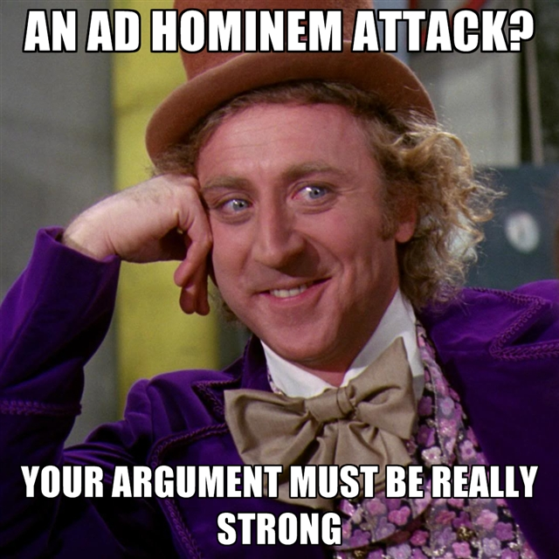
Fallacies Of Ethical Arguments

Slide 9
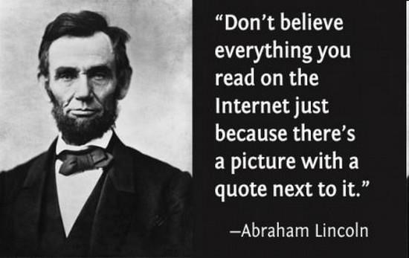
False Authority
A claim is based on the expertise of someone who lacks appropriate credentials
Suggesting that you should listen and follow what someone has to say about something that he or she is in fact not a credible, reliable authority on.
Example:

Slide 10
Dogmatism
A claim is supported on the grounds that it’s the only acceptable conclusion in a community
Proposing that there simply cannot be any other possible way of making sense of and engaging with an issue but the one you represent. Example: There’s no way that anyone can argue that abortion is anything other than murder. Example: There’s no way a man could ever love a man or a woman could ever love a woman as much as a man and a woman can love each other.

Slide 11
Ad Hominem
A claim is answered by irrelevant attacks on the writer or speaker’s character rather than the argument that is being presented
Attacking the character of a person rather than engaging with the claim, reasons, and evidence she or he is setting forth. Example: In listening to what you have to say I have this to say in reply: only an idiot would argue for pursuing a peaceful solution to this conflict. Example: Here’s what I think about what you have written: anyone who opposes the death penalty for murder is a criminal at heart.

Slide 12
Stacking the Deck
When a writer tries to prove a point by focusing on only one side of the argument while ignoring the other.
Just as gamblers attempt to stack the deck in their favor, writers stack the deck when they show only one side of an argument.
Example: When a person who’s less than honest is trying to sell his old car, he’ll list all the good qualities and omit all the faults: the tires are new, the stereo is fantastic, and I just changed the oil (but he fails to mention the oil and radiator leaks and the nearly broken transmission).

Slide 13
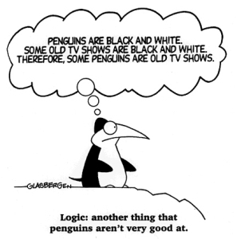
Fallacies Of Logical Arguments

Slide 14
Hasty Generalization
An inference drawn from insufficient data
Drawing a conclusion, especially a sweeping one, from insufficient evidence. Example: English teachers are nitpicky. Example: Because my Honda broke down, then all Hondas must be junk.

Slide 15
Faulty Causality
Assumption that one event is caused by another sequential event
Also referred to as “Post Hoc, Ergo Propter Hoc,” which translates as “After This, Therefore, Because of This”
The faulty assumption that because one event follows another, the first necessarily caused the second. Example: The administration closed the smoking court in our school at the end of last year, and fights among students have gone down this year; therefore, closing the smoking court caused the reduction in fights among students. Example: Bill bleached his hair blonde last week, and this week three other guys at the same school did the same; therefore the latter all changed their hair color because Bill did.

Slide 16
Begging the Question
A claim is based on the very grounds that are in doubt/dispute
Assuming as true the very claim that is disputed, in a circular argument Example: I can’t be guilty of embezzlement; I’m an honest person. Example: You can’t give me a C; I’m an A student.

Slide 17
Equivocation
A lie given the appearance of truth using deceptive language
An argument that gives a lie an honest appearance, by insisting on what is only partially or formally true. Example: I did not have sex with that woman (if by sex you mean intercourse). [ Bill Clinton, in response to the nature of his relationship with Monica Lewinsky] Example: Yes, I smoked marijuana, but I did not inhale it. [ Bill Clinton, in response to accusations that he smoked marijuana in college.]

Slide 18
Non Sequitur
Claims, reasons, and warrants fail to connect logically
An argument which leaves out a necessary portion in a logical sequence, seeming to suggest a logical connection when in fact one does not exist. Example: If you are really my friend, you’ll lend me five hundred dollars. Example: She is a feminist; she must hate men.

Slide 19
The Straw Man
An opponent’s position is misrepresented as being more extreme than it actually is, so that it’s easier to refute
Straw man arguments often oversimplify opposing views or disregard inconvenient points in favor of points that are easy to argue against.
In many instances, the person committing the straw man fallacy highlights the most extreme position of the opposing side
Example:
Opposing argument: Teens should be taught about contraception methods so they can practice safe sex should they choose to have intercourse.
Straw man argument: Proponents of sex education want to give kids license to have sex with no consequences.

Slide 20
Red Herring
Changes the subjects abruptly to throw readers or listeners off the trail.
Gets its name from the old British hunting practice of dragging a dried herring across the path of a fox in order to throw the hounds off the trail.
Example:
There's too much fuss and concern about saving the environment. We can't create an Eden on earth. And even if we could, remember Adam and Eve got bored in the Garden of Eden anyway!
Example:
Why should I study math? I don't want to be a math teacher.

Slide 21
Faulty Analogy
A comparison between two objects or concepts that is inaccurate or inconsequential
Drawing an analogy that is based upon faulty equations or identifications of terms Example: It has been scientifically proven that people need to drink a certain amount of water every day to keep healthy. Water is a liquid and so is beer. Therefore, people should be able to substitute beer for water, drinking as much beer each day as doctors recommend people drink water, in order to keep healthy. Example: Students in Kindergarten at Jefferson Elementary School did better when given milk and cookies in class than when not; therefore, students at CSUF will do better too if they are given milk and cookies in class.

