Slide 1
Notes:
Classroom Design Activity
Design your own classroom with this template. Slide 1 is your floor plan. You may copy items from Slides 2 and 3 and paste them onto this floor plan.
Arrange the items by dragging them to the desired position in the floor plan and rotating them appropriately. Then fine-tune their position by using the arrow keys.
You may also change the color of the walls. Select a wall (or multiple walls by holding down the Shift key while clicking on them), then edit the wall’s Shape Fill color in the application’s toolbar above.

Slide 2
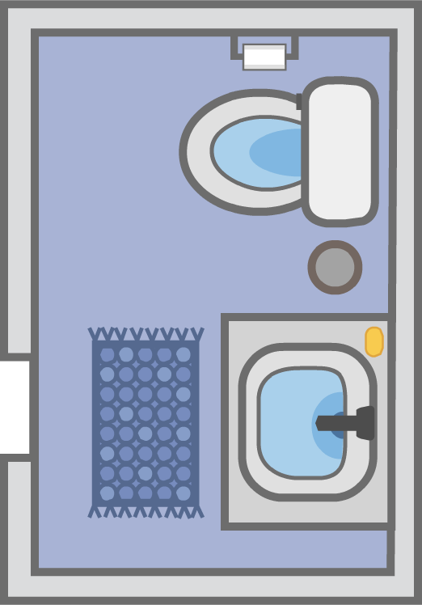


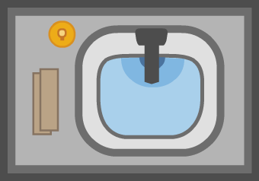






















STRUCTURE
Door
Window
Fire
alarm
Fire
extinguisher
Sink
Bathroom
FURNISHINGS
Mirror
Bulletin
board
Student
desk
Teacher’s
desk
Square
table
Half circle
table
Step
stool
Changing
table
Storage
cabinet
Cubbies
Bookshelf
SEATING
Teacher’s
chair
Toddler
chair
K-3
chair
High
chair
Infant
swing
Infant
chair
Rocking
chair
Cushion
Beanbag
chair
Notes:
Classroom Items
Copy items from this slide, and paste them onto the floor plan in Slide 1.

Slide 3
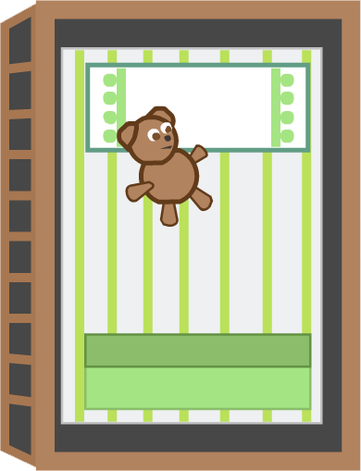
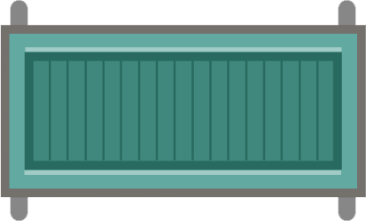

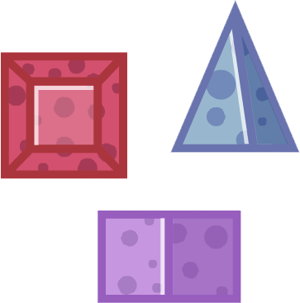

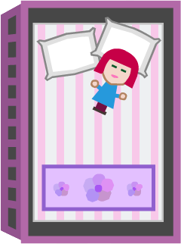


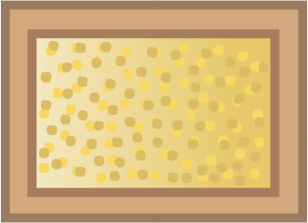

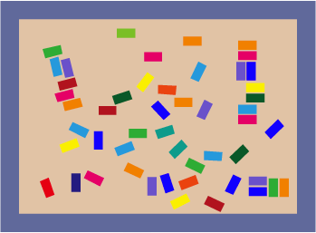

SLEEP
Cot
Mat
Crib
PLAY
Foam
blocks
Easel
Play
house
Computer
Climbing
unit
Sand
table
Water
table
Lego
table
Doll
crib
CENTER LABELS (the text within the Labels can be edited)
Art
Math
Science
Literacy
Music
Library
Dramatic Play
Construction Play
Notes:
Classroom Items
Copy-and-paste an item from these slides onto the floor plan in Slide 1.

Slide 4
Notes:
Example Classroom Design

