Slide 1


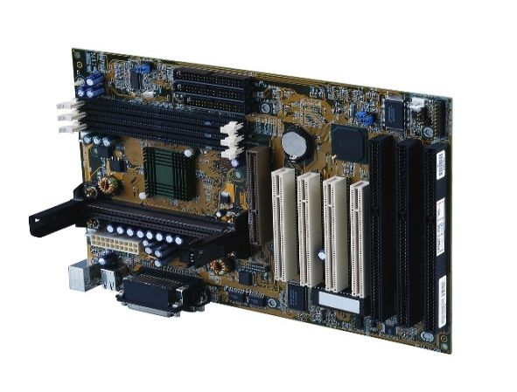
Sorrell College of Business
Information Systems

Slide 2
Why should YOU consider a career in Information Systems?

Slide 3
Source: Bureau of Labor Statistics, Department of Labor (May 2011)

Slide 4
Information Systems Salaries
IS majors have one of the highest starting salaries of all the undergraduate degree programs in Business Schools. The average starting salaries of our IS graduates in 2012 was $57,705 with top students commanding salaries as high as $72,000.

Slide 5
Source: Bureau of Labor Statistics, Department of Labor, Aug-Sep 2012

Slide 6
Information Systems
Information Systems (IS) is the study of people, technology, organizations and the relationships among them.
IS professionals help firms realize maximum benefit from investment in personnel, equipment, and business processes.
Information Systems is a people-oriented field with an emphasis on service through technology. If you have an interest in technology and have the desire to use technology to improve people’s lives, a degree in IS may be for you.

Slide 7
Information Systems Need
Businesses use information systems at all levels of operation to collect, process and store data. IS professionals are an invaluable member of the management team.
IS professionals create andmanage information systems for data management (i.e., storing, searching and analyzing data).

Slide 8
Information Systems
A common misconception is that IS only concerns computer programming. However, programming is just a small part of the IS curriculum.

Slide 9
Information Systems Careers
Business Analyst
Privacy Analyst
Web Developer
Technical Support Specialist
Business Intelligence Analyst
Security Specialist
IT Consultant
Database Administrator
Systems Developer

Slide 10
IS – Do You Qualify?
Do you enjoy working with people?
Would you enjoy the chance to work on global problems with people from all over the world?
Do you enjoy analyzing and solving problems?
Do you want to create innovative, cutting-edge technology solutions and be recognized for doing it?
Do you want to learn how to make businesses more efficient, effective and competitive?

Slide 11
IS – Do You Qualify?
Then you should consider IS - the field that is experiencing a critical shortage of professionally trained individuals. A field where demand is skyrocketing with projected growth rates of 38 percent – the fastest of any business discipline.

Slide 12
Interested ?
Troy University has a new online offering in Information Systems as part of its bachelor's degree in business program.
Students interested in acquiring in-depth specialization in Information Systems are encouraged to apply.
Contact Dr. Ronald Shehane at shehaner@troy.edu to discuss your career plans and what IS can do for you.

