Slide 1
The Gilded Age and the Progressive Era
1870s-1910s

Slide 2
The Gilded Age
Gilded Age: The name for the period 1877–1900 that suggested the amazing achievements of the period were like a thin gold layer that covered many unresolved political, economic, and social problems.
Era/period during which the United States seemed to prosper (economically, politically, socially), but in reality the U.S. was plagued with many difficulties and problems.

Slide 3
The Gilded Age
From 1870s-1900, American presidents were relatively ineffectual.
  True political influence resided with the party boosters
    Some were wealthy businessmen and industrialists
  Boosters used their influence to campaign for presidents and secure electoral votes
  Presidents were indebted to boosters and had to repay favors
    Many pieces of legislation (or lack thereof) were examples of repaying said favors
American presidents had their hands tied and were often unable (or failed) to deal with the demands of the American public.
  Examples: improve labor standards and conditions for the working class; address plight of farmers; clear violations of African-Americans civil rights

Slide 4
The Gilded Age
Clear evidence of the weak presidents during the Gilded Age:
  From 1876-1896, no president was ever re-elected to consecutive terms
  In presidential elections from 1876-1892, no president-elect won a majority of the popular vote
Presidents were further hamstrung because of the lingering spoils system.
  Spoils system: political patronage; president rewards his close companions and supporters with government positions
  Question: What is a potential problem with the spoils system?

Slide 5
The Gilded Age
Spoils system somewhat curtailed after the assassination of Republican president James Garfield (elected in 1880, assassinated in 1881)
  Vice-president was Chester A. Arthur
Arthur assumed presidency and approved of civil service reform legislation.
  1883: Pendleton Civil Service Act required that 15 percent of government positions be subject to being staffed by individuals who pass a civil service exam

Slide 6
The Gilded Age
Big business and industries benefited from weak and ineffectual presidents.
  In addition to being boosters for presidents, wealthy businessmen and industrialists were boosters for Congressmen and local and state officials
Example of benefit for business and industry: high tariffs.
  Tariffs: taxes on imported foreign goods/products
Big business and industry benefited from high tariffs, as tariffs were a disincentive for Americans to buy foreign goods/products.
  Americans were more likely to buy goods/products from American big business and industries
  Higher tariffs = Greater profits for big business and industries

Slide 7
The Gilded Age
Two Gilded Age presidents did make some effort to reduce tariffs and have fairer business practices in the U.S.
President Arthur created the U.S. Tariff Commission in 1882 to investigate impact of tariffs on the American people.
  1883: tariffs were reduced by a mere 5 percent
President Cleveland, a Democrat, helped create the Interstate Commerce Commission (ICC).
  ICC: reviewed railroad prices and ensured that prices would be reasonable for American customers
  Unfortunately, the ICC suffered from lack of enforcement power and was not effective in regulating railroad rates

Slide 8
The Gilded Age
After the Arthur and Cleveland presidencies, influential businessmen and industrialists supported Republican Benjamin Harrison for president in 1888.
  Boosters helped to secure necessary electoral college votes for Harrison
  Harrison ran on a platform of high tariffs
  Tariffs would remain high for the next decade
1890: Sherman Anti-Trust Act
  Federal legislation designed to breakup trusts and eliminate monopolies
  Not enforced in 1890s

Slide 9
The Gilded Age
Consequences of Gilded Age politics:
  Gross violations of civil rights for African-Americans in the South
  Protests, demonstrations, and strikes by American farmers and laborers

Slide 10
The (Un)Reconstructed South
The American South remained impoverished during the Gilded Age
South dependent upon the North
  Relied on the North for money and industrial development
Modernization efforts not felt in many areas throughout South
  Education was deficient
  Social (racial) problems persisted
  Black Codes, literacy tests, and poll taxes disenfranchised African-Americans

Slide 11
The (Un)Reconstructed South
Dominant form of employment was sharecropping.
  Sharecropping: laborers would work on a landowner’s land in exchange (payment/compensation) for a portion of the crops grown
  Many free African-Americans and poor whites worked as sharecroppers
  Sharecropping contracts stipulated the responsibilities and obligations of both the land owner and the laborers
Excerpt from an 1866 sharecropping contract:
“The said [landowner] agrees to furnish… all necessary farming utensils to carry… and to give unto said Freedmen whose names appear below one half of all the cotton, corn and wheat that is raised on said place for the year 1866 after all the necessary expenses are deducted out that accrues on said crop.”

Slide 12
The (Un)Reconstructed South
Excerpts from an 1866 sharecropping contract:
“Outside of the Freedmen’s labor in harvesting, carrying to market and selling the same and the said Freedmen whose names appear below covenant and agrees to and with said [landowner] that for and in consideration of one half of the crop before mentioned that they will plant, cultivate, and raise under the management control and Superintendence of said [landowner], in good faith, a cotton, corn, and oat crop under his management for the year 1866.”
“We [the Freedmen] furthermore bind ourselves that we will obey the orders of said Ross in all things in carrying out and managing said crop for said year and be docked for disobedience.”

Slide 13
The (Un)Reconstructed South
Question: based on the previous excerpts, what is a potential danger of the sharecropping system?
  If there is this potential danger, then why would African-Americans subject themselves to sharecropping?
Question: since sharecropping was clearly problematic, why was it allowed in the South?

Slide 14
Jim Crow Laws and Plessy vs. Ferguson
Jim Crow laws implemented throughout southern states during 1870s and 1880s
  Jim Crow laws: allowed for segregated facilities for blacks and whites
    E.g., all-black train cars and all white train cars
  Segregated facilities were justified because they were to be “separate, but equal”
    However, segregated facilities were clearly unequal
  Jim Crow laws directly violated the Fourteenth Amendment
Jim Crow laws upheld after the infamous Supreme Court case Plessy vs. Ferguson

Slide 15
Jim Crow Laws and Plessy vs. Ferguson
Plessy vs. Ferguson (1896): Supreme Court declared “separate but equal” facilities not illegal and, therefore, not a violation of the Fourteenth Amendment
Plessy vs. Ferguson legalized racial segregation in the South
  African-Americans in the South essentially left to fend for themselves
  Southern segregation would persist until the 1960s

Slide 16
The Gilded Age: Farmers’ Response
Farmers faced several hardships during the Gilded Age.
  Expensive tools, equipment, and supplies
  High-interest loans and defaulting
  Overproduction and reduced profits
  High railroad rates
  High tariffs: farmers were consumers of foreign goods/products
Farmers began to organize in order to affect change.
  Similar to labor union organization in chapter 18
Farmer’s Alliance formed in mid-1880s.
  Union of over 2.5 million farmers
  Many of the Alliance’s demands were not met

Slide 17
The Gilded Age: Farmers’ Response
Populist party created in the wake of lackluster government response
  Populist party (people’s party) created by the Farmer’s Alliance
  Goal: elected representatives to government so as to affect change/push Farmer’s Alliance agenda through
Populist platform:
  Government regulation of railroads
  Lower tariffs
  Creation of a federal income tax
Populist party enjoyed some success.
  State legislators, a governor, and some Congressmen elected to office from the Populist party
  Even had candidates in presidential elections in 1890s and 1900s

Slide 18
The Gilded Age: The Depression of 1893
Populist party gained further membership after a major economic depression.
Depression of 1893 was worst depression in American history.
  Until the Great Depression
Cause: years of speculation in railroad industry.
  Rise of the railroad industry gave false impression that the industry would continue to grow
  Businesses, other industries, and banks heavily invested in railroads
  Once railroad industry began to decline, some investors pulled their investments resulting in a precipitous economic decline

Slide 19
The Gilded Age: The Depression of 1893
Business and industry failures resulted in high unemployment.
  From 1893 to 1894, unemployment increased from 3 percent to 19 percent
  As many as 3 million Americans unemployed by 1895
Question: To whom or what did the American people turn for help/assistance?

Slide 20
The Gilded Age: The Depression of 1893
“Immediately following the economic downturn, people sought relief through their elected federal government. Just as quickly, they learned what farmers had been taught in the preceding decades: A weak, inefficient government interested solely in patronage and the spoils system in order to maintain its power was in no position to help the American people face this challenge. The federal government had little in place to support those looking for work or to provide direct aid to those in need. Of course, to be fair, the government had seldom faced these questions before. Americans had to look elsewhere.” (Pg. 593 U.S. History)
Question: Where did some Americans turn to?

Slide 21
Presidential Election of 1896
Many working-class Americans joined the Populist party
By 1896, Populist party grew to seriously contend in the presidential election.
Democratic party nominated William Jennings Bryan for president.
  Proposed currency reform and was sympathetic to the plight of farmers
  Populist party also endorsed Bryan for president
Republican party nominated William McKinley
  Promoted a stable economic policy and the preservation of the gold standard as the basis of American currency

Slide 22
Presidential Election of 1896
McKinley won the election.
  First president elect during Gilded Age to receive a majority of the popular vote
  Election of 1896 had highest voter turnout in American history to that point
    Nearly 80 percent of eligible voters
Populist party declined after 1896
  Economy rebounded at the end of the decade
  War with Spain in 1898 increased demand for agricultural products, resulting in higher profits and greater purchasing power for farmers

Slide 23
The Progressive Era
Recall definition of the Gilded Age: The name for the period 1877–1900 that suggested the amazing achievements of the period were like a thin gold layer that covered many unresolved political, economic, and social problems.
Era/period during which the United States seemed to prosper (economically, politically, socially), but in reality the U.S. was plagued with many difficulties and problems.
The Progressive Era a period when several attempts were made to address the unresolved issues of the Gilded Age.

Slide 24
The Progressive Era
Progressivism a series of social justice movements during the late 1800s and early 1900s
Response to inequality, inequities, and oppression caused by industrialization and urbanization and the federal government’s failure to pass legislation.
Uniqueness of Progressivism:
  Not one single or unified movement
  A series of movements throughout the U.S.
  Progressive movements began at the grassroots level

Slide 25
The Progressive Era
Many Progressive movements began as responses to journalistic exposés of the problems plaguing America.
Journalists known as muckrakers.
Muckraker Jacob Riis famously documented, both in print and in photos, the living conditions of poor working class Americans in New York in his famous work How the Other Half Lives.
Other muckrakers exposed other problems in America:
  Poor working conditions and standards for the working class
  Child and female labor
  Poor food quality
  Racial discrimination

Slide 26
The Progressive Era
The works and publications of muckrakers resonated with many white, middle class Americans.
  Especially true of middle class women
Recall that the middle class was a growing group of professionals who valued/emphasized education and training.
  Middle class had enough earning/spending power to afford college education to improve their opportunities and lives
    Included middle class women
Many middle class men and women believed that the less fortunate should have a chance to improve their lives and opportunities.
  Many Progressives were from the middle class

Slide 27
The Progressive Era
Similar to labor and farmers’ unions, Progressives believed that government action was necessary for change.
  However, the weak and ineffectual government during the Gilded Age did not give Progressives much confidence that the government could adequately respond
Progressives believed that the people should exert more control in government.
  With the people exercising more control in government, the government would better able to address the problems in America
  Similar to the Populist party

Slide 28
The Progressive Era
Progressives successfully pushed for the following policies:
  Direct primary
  A series of legislative and election reforms
Direct primary: process by which the people directly vote for their party’s representative for president.
  Prior to direct primaries, only party delegates at conventions could vote for the party’s representative for president

Slide 29
The Progressive Era
Legislative and election reforms:
  Legislative initiative: allowed the voting public to place proposals on the ballot
  Referendum: voters can put an existing law on an upcoming ballot to either affirm it or reject it
  Recall election: the voting public can petition and vote to have a public official removed from office
  Passage of the Seventeenth Amendment: voters directly voted for Senators
    Prior to Seventeenth Amendment, Senators were selected by state legislatures

Slide 30
The Progressive Era
Progressive led crusades against child and female labor.
Progressives helped to create the National Child Labor Committee (NCLC)
  Created in 1904
  Pushed for outright ban of child labor in industries
In 1912, NCLC instrumental in the creation of the U.S. Children’s Bureau.
  A federal agency that investigated and proposed solutions for the general welfare of children

Slide 31
The Progressive Era
Progressive reformers made several efforts to improve working conditions for women, but first real progress made only after a terrible tragedy.
1911: fire engulfed a garment industry in New York.
  Several female garment workers were trapped on the eighth floor
  Doors were deliberately blockaded by management to keep union organizers out of the industry
  146 women died, either from the blaze, trampling and blunt-force trauma, or leaping to their death
Tragedy was highly publicized and put pressure on the government to pass work place safety laws and standards.

Slide 32
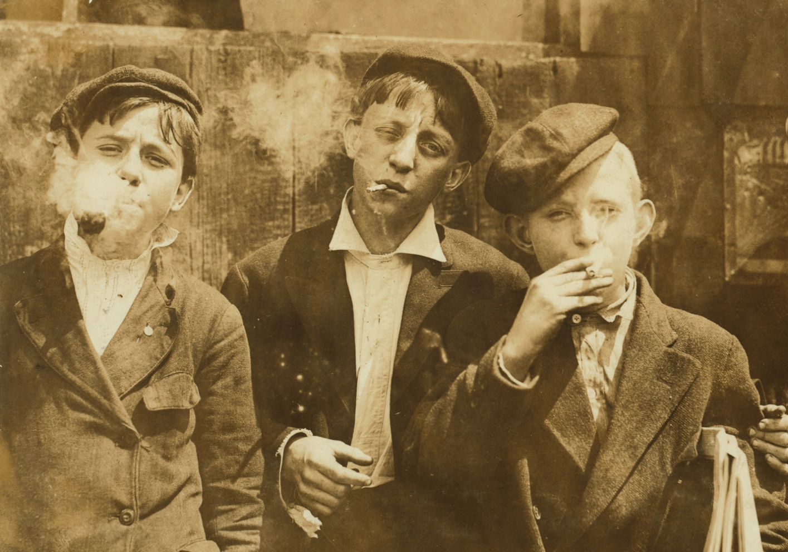
Examples of Progressive Reform Efforts
Other targets of progressive movement were saloons, brothels, & cinemas
  Moral vices
  Set bad/poor examples for the youth
  Opposition to cinemas because films contained suggestive themes
Due, in part, to progressive efforts, Eighteenth Amendment was passed
  Prohibited possession, importation, and sale of alcohol
  Prohibition would be in effect from 1919 to 1933

Slide 33
The Progressive Era
Other efforts were taken to improve the lives of women, efforts to achieve true political equality for women.
  Female suffrage
Movement for female suffrage dates back to the 1848 Seneca Falls convention.
  Female reformers issued the Declaration of Sentiments calling for female suffrage
Passage of the Fifteenth Amendment during Reconstruction resulted in a greater demand for female suffrage.

Slide 34
The Progressive Era
American expansion West actually contributed to female suffrage.
  In 1900, some new western states gave women the right to vote in state and local elections
    A means to attract a greater number of female migrants
1890: creation of the National American Women’s Suffrage Association (NAWSA)
  NAWSA pushed for federal legislation (a constitutional amendment) guaranteeing women the right to vote
Success was not immediate, but by 1920 efforts finally paid off with the passage of the Nineteenth Amendment.
  “The right of citizens of the United States to vote shall not be denied or abridged by the United States or by any State on account of sex.”

