Slide 1
FOOD SERVICE MANAGEMENT & OPERATIONS Name: Institution: Date:

Slide 2
Introduction
News Title:
Revenue-Management: The-Impact-of-External-Factors-on-Hotel, Market Data
Retrieved from: http://www.hotelnewsnow.com/Articles/290316/The-impact-of-external-factors-on-hotel-market-data
Published on:
11 SEPTEMBER 2018 7:10 AM

Slide 3
Article Summary
For businesses in the hotel industry to improve their performance, revenue managers should keep an eye on external influences.
These external influences include factors, such as distribution mix, the impacts of guest experiences, and foreign-currency exchange rate
The author, Dan Kubacki suggests that all hotel revenue-managers have the opportunity of learning a lot by focusing on the external influences as well as their effects on performance of the business.

Slide 4
CONT’
The news article talks about the conference at the Hotel-Data-Conference whereby various speakers got a chance to talk about management of revenues in the hotel businesses.
Bobby-Bowers and Jess-Petitt studied the hotel-market performance in New York, and analyzed outside elements, such as currency exchange-rates, distribution mix, and guest experiences that were likely to clarify the lack of consistencies in the performance of a hotel property.

Slide 5
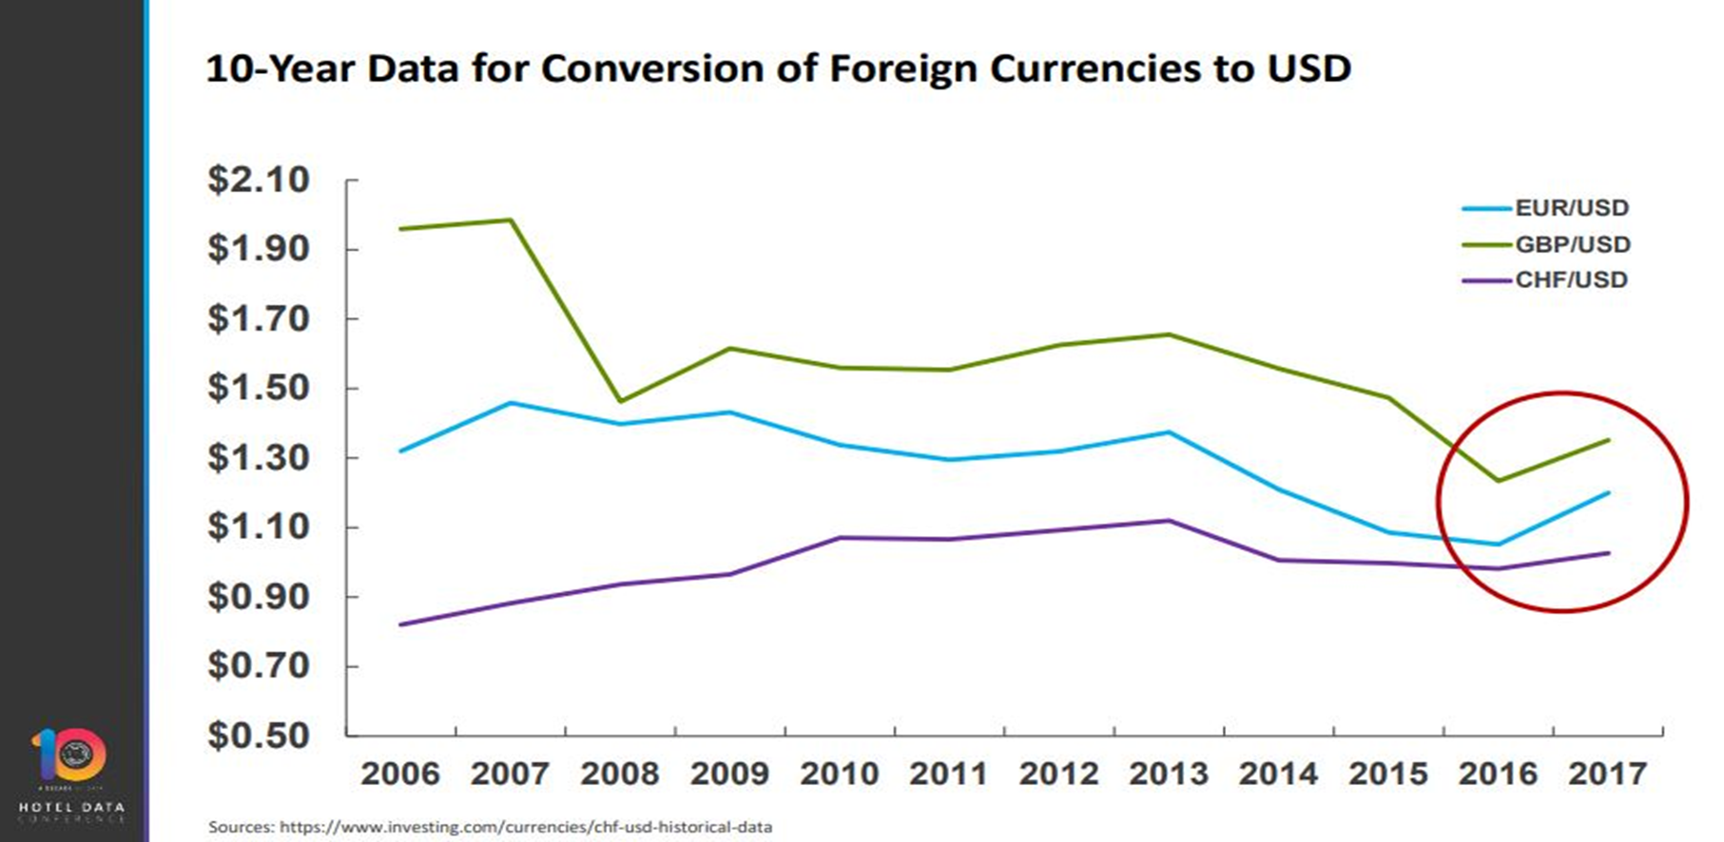
Retrieved from STR (Smith Travel Research)
Notes:
A gateway market like New York tends to see more inbound international demand, which is something hoteliers can somewhat predict by monitoring currency conversion rates
When currency fluctuations happen from any of these countries, we see a significant shift in markets that tend to have those countries as feeder markets. It is an important thing to keep track of, not just in major gateway cities, but it can be something that impacts other markets as well that depend on leisure travel.

Slide 6
Most Important Concept
In this news article, the most important concept is the advice by the speakers that hotel managers should look into both internal and external aspects of the business.
They should strike a balance between the two so that they do not overdo things in one section.
Substantially concentrating on the external factors can help managers assess the performance of the business and invest in the right aspects of the business.
Notes:
Excessively concentrating more efforts on the external factors at the expense of the internal factors may result to the business failing terribly terribly.

Slide 7
Implications of the information
The information offered in this article is very important for people operating any kind of business, and especially in the hotel industry.
If revenue managers in the hotel industry get to apply this information by focusing on external factors, their businesses would experience tremendous success.
Therefore, from the article they can learn that looking into the external factors, such as currency exchange-rates, guest experiences, and distribution mix can eliminate the inconsistences found in hotel performance.

Slide 8
Conclusion
To stay competitive in the market, managers should always adjust the business strategies to act as a reflection of the environment within which it operates.
External factors have a critical role to play in molding the future of businesses in various industries.
It is important to always analyze the outside influences when reviewing business strategies.

Slide 9
References
http://www.hotelnewsnow.com/Articles/290316/The-impact-of-external-factors-on-hotel-market-data

