Slide 1
Chapter 9
Corporate-Level Strategy: Horizontal Integration, Vertical Integration, and Strategic Outsourcing

Slide 2
Learning objectives
Discuss how corporate-level strategy can be used to strengthen a company’s business model and business-level strategies.
Define horizontal integration and discuss the primary advantages and disadvantages associated with this corporate-level strategy.

Slide 3
Learning objectives
Explain the difference between a company’s internal value chain and the industry value chain.
Describe why, and under what conditions, cooperative relationships such as strategic alliances and outsourcing may become a substitute for vertical integration.

Slide 4
Corporate-Level Strategy and the Multibusiness Model
Corporate-level strategies should be chosen to promote the success of its business-level strategies.
  This allows a firm to achieve a sustainable competitive advantage, leading to higher profitability.

Slide 5
Corporate-Level Strategy and the Multibusiness Model
Levels of business model:
  Business model and strategies for each business unit or division in every industry in which it competes
  Higher-level multibusiness model that justifies its entry into different businesses and industries

Slide 6
Horizontal Integration
Acquiring or merging with industry competitors to achieve the competitive advantages that arise from a large size and scope of operations
Acquisition: Company uses its capital resources to purchase another company.
Merger: Agreement between two companies to pool their resources and operations and join together to better compete in a business or industry.

Slide 7
Benefits of Horizontal Integration
Lowers the cost structure
Increases product differentiation
Leverages a competitive advantage
Reduces rivalry within the industry
Increases bargaining power over suppliers and buyers

Slide 8
Problems with Horizontal Integration
Difficult to implement
Conflict with the Federal Trade Commission (FTC)
  Increase in prices
  Abuse of market power
  Crushing potential competitors

Slide 9
Vertical Integration
When a company expands its operations either backward or forward into an industry
  Backward vertical integration - Produces inputs for the company’s products
  Forward vertical integration - Uses, distributes, or sells the company’s products

Slide 10
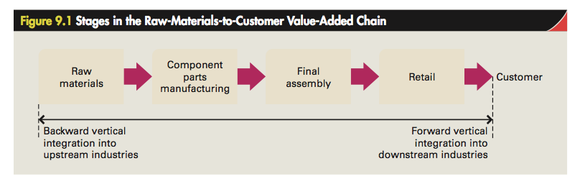
Stages in the Value-Added Chain

Slide 11
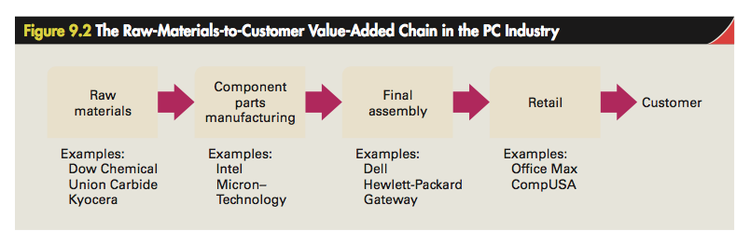
PC Industry Value-Added Chain

Slide 12
Increasing Profitability Through Vertical Integration
Vertical integration increases product differentiation, lowers costs, and reduces industry competition when it:
  facilitates investments in efficiency-enhancing specialized assets.
  protects product quality.
  results in improved scheduling.

Slide 13
Problems with Vertical Integration
Increasing cost structure
Disadvantages that arise when technology is changing fast
Disadvantages that arise when demand is unpredictable
Vertical disintegration: When a company decides to exit industries either forward or backward in the industry value chain to its core industry to increase profitability

Slide 14
Cooperative Relationships
Quasi integration: Use of long-term relationships, or investment into some of the activities normally performed by suppliers or buyers
  In place of full ownership of operations that are backward or forward in the supply chain

Slide 15
Competitive Bidding and Short-Term Contracts
Competitive bidding strategy - Independent component suppliers compete to be chosen to supply a particular component.
Short-term contracts - Last for a year or less
  Does not result in specialized investments
  Signals a company’s lack of long-term commitment to its suppliers

Slide 16
Strategic Alliances and Long-Term Contracting
Strategic alliances: Long-term agreements between two or more companies to jointly develop new products or processes
  Substitute for vertical integration
  Avoids bureaucratic costs
Component suppliers benefit because their business and profitability grow as the companies they supply grow.

Slide 17
Strategies to Build Long-Term Cooperative Relationships
Hostage taking: Means of exchanging valuable resources to guarantee that each partner to an agreement will keep its side of the bargain
Credible commitment: Believable promise or pledge to support the development of a long-term relationship between companies
Each company should possess a kind of power to discipline its partner, if the need arises.

Slide 18
Strategic Outsourcing
Decision to allow one or more of a company’s value-chain activities to be performed by independent, specialist companies
Virtual corporation: Companies that pursue extensive strategic outsourcing to the extent that they only perform the central value creation functions that leads to competitive advantage

Slide 19
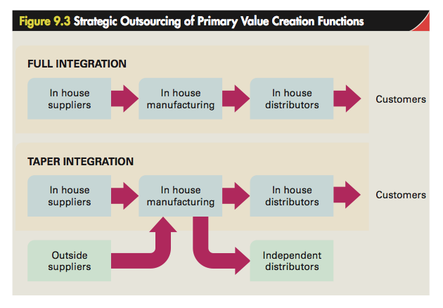

Slide 20
Benefits of Outsourcing
Lower cost structure
Enhanced differentiation
Focus on the core business

Slide 21
Risks of Outsourcing
Holdup
  Risk that a company will become too dependent upon the specialist provider of an outsourced activity
Increased competition
  Building of an industry-wide resource that lowers the barriers to entry in that industry
Loss of information and forfeited learning opportunities

