Slide 1
Contents
Introduction/Contacts
Description Of Module (& LOs)
Module Structure
Programme (Lectures, Tutorials, Etc.)
Assessment
Engagement
Reading
How To Do Well
What To Do Now

Slide 2
New for 2016 - 2017
All of these changes have resulted from student feedback
Module entirely staffed by full-time faculty
New rules to improve fairness & groupwork
New updated scenarios to work with
Attendance monitoring
Engagement monitoring
Open Session in Collaborate
Dozens of smaller changes/tweaks to module content in direct response to feedback

Slide 3
It’s New So…
Things WILL go wrong
Be patient
Work with us

Slide 4
What Is The Business Game?
Team-based activity
Teams own & operate a mobile phone company (think Samsung, HTC, etc.)
Tasks involve marketing, production management, logistics, etc.
Each team member has specific role e.g. finance
Tasks carried out & results seen via computer simulation
Teams work in competition against other teams. Each team’s decisions influence the market but there are other factors too
Typically 5 people in a team, 6 teams per tutorial group
25+ tutorial groups
Teams selected by us using lots of criteria

Slide 5
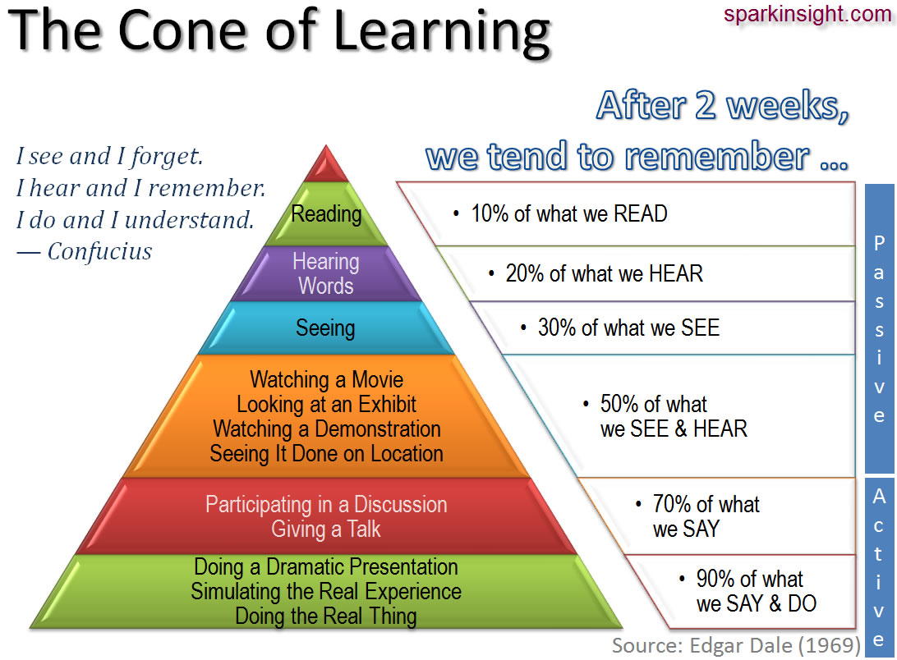
Why Use Games In Teaching?

Slide 6
Why Use Games for Teaching?
Interactive
Engaging
Motivating
Collaborative
Challenging
Competitive
Social

Slide 7
Why Use Games for Teaching?
Games provide:
Clear feedback
A sense of progress
The possibility of success
A chance to satisfy your curiosity
A chance to solve a problem

Slide 8
Learning Objectives (1)
Demonstrate professional skills and abilities needed by managers, including problem solving and reflective practice.
Reflective practice is a critical skill needed by all modern business professionals
All disciplines require problem solving ability

Slide 9
Learning Objectives (2)
Apply (in a simulated environment) theories and techniques covered in first and second year modules.
This module integrates your learning from Years 1 & 2
You also get to apply theories and techniques in a fairly realistic environment and see the results
Take the opportunity to experiment and try out ideas

Slide 10
Learning Objectives (3)
Communicate effectively through different means: in writing (e.g. proposals), face-to-face (e.g. presentations) and by other means (e.g. e-mail).
Professional level presentation – important for placements (assessment centres) and future employability
Business plan – style and substance (professional business writing)
Real tests of your ability to become a professional

Slide 11
Learning Objectives (4)
Work productively in diverse groups composed of students of different cultures, ethnic groups and genders.
Key skill(s) wanted by employers
Most of you will work in teams for the whole of your careers
Experience will give you lots of examples to use in interviews, etc.

Slide 12
Module Structure
8– 9 lectures
Alternating tutorials – once every two weeks
Practice game sessions in Weeks 7/8
Game starts properly at end of Term 1 (Weeks 09/10)
Programme is fluid and subject to change
If opportunities arise for guest speakers, etc.
In response to feedback/needs of students
In response to other changes e.g. in University, in the news, etc.

Slide 13
Learning Hours
Lectures 10 hours
Tutorials 12 hours
Practical sessions (simulation) 8 hours
Own time meetings 15 hours
Reading 5 hours
Group report and presentation: 30 hours
preparation and delivery Reflective journal 20 hours
Total 100 hours

Slide 14
Lecture Programme
Week | No. | Topic
1 | L1 | Introduction To Module
2 | L2 | Business Game Simulation
3 | L3 | Business Plan
4 | L4 | Finance
5 | L5 | The role of Marketing on Business Plan and Strategy
6 | L6 | Carbon Week – No Lecture
7 | L7 | The role of Operations on Business Plan and Strategy
8 | L8 | Presentations
9 | L9 | Careers
10 | L10 | No Lecture
11 | L11 | No Lecture
12 | L12 | No Lecture

Slide 15
Assessment
Made up of group component and individual component
Group component is 20%
Individual component is 70%
Continuous Assessment 10%

Slide 16
Assessment
Preparation
Scheduled sessions e.g. lectures
Tutors will give additional guidance
Chance to practice some things in class
Lots of resources online e.g. presentation techniques

Slide 17
Reading
No set text but your existing books may be useful
You will be given advice/guidance on useful information sources in a little while (and on Weds)

Slide 18
How To Do Well
Attend all sessions
Ask questions
Plan & review performance
Be decisive
Be flexible

Slide 19
Work Smart
There is a lot of work to do BUT…
You can keep within the 100 learning hours by working smart:
Don’t meet unnecessarily - use seminar sessions
Refer to the marking schemes
Plan ahead
Plan for contingencies e.g. if someone drops out
Review progress regularly and correct problems quickly
Don’t be afraid to talk to your tutors
Don’t be afraid to use the systems we have put in place for group issues e.g. red/yellow cards

