Slide 1
Objectives
By the end of this lecture students should be able to:
Understand the difference between Financing and Investment Decisions
Understand the concept of budgeting
Explain the role of the Financial Manager and the goals of the corporation
Discuss how the firm and the financial markets interact
Apply some concepts in the context of the BG: you are a US-based mobile phone manufacturer.

Slide 2
Why is finance important?
Whatever you specialize in e.g. Marketing, HR, IT – in the end all corporate functions are evaluated at least in part in financial terms.
  If you expand production to a new continent– how can you finance that? Borrow, issue shares? What is the return? (save on transports costs, tariffs?)
  Marketing has huge budgets you will need – to justify how it is to be spent, and then whether or not it was successful/ E.g: you want to launch a new phone, what is the expected return?
  If you want to recruit new staff, or pay bonuses – can you justify the increased wage costs?
Understanding basic finance helps everyone make better decisions.
If you are the Finance director you need to ensure the other directors consider the financial impacts of their decisions.

Slide 3
Financial Management
Financial and Tax management
  Financial planning and control
  Making decisions with regard to funds
  Interacting with capital markets
  Minimising Tax burden
All organizations need to manage their finances
  Private sector firms
  Not-for-profit organizations, Charities
  Public sector

Slide 4
Four Key Words
Investors, be they firms or individual, needs to consider:
Return
    How much are you likely to make?
Risk
    What are the risks involved?
When a firm raises money it usually comes down to a choice between
Equity (Shares)
  Investors “buy” part of the company
Debt (Overdraft, Loans, Bonds)
  Investors lend money and will expect it back

Slide 5
Two Types of Decisions
Firms have two types of decisions to make
  Investment decisions: What type of projects to invest in, these are also called Capital Budgeting decisions:
  build new plants/factories
  launch new products,
  expand overseas, etc.
  Financing decisions: How to pay for what you want to do e.g. borrow money,
  issue shares (EQUITY)

Slide 6
Investment Decisions
Types of investment decisions
  Large investments in long-term assets
    Assets can be tangible or intangible
  Spending now in the hope of later returns
    Increase existing production capacity;
    Increase retail outlets;
    Purchase new plant or machinery; or
    Enter new markets
    Research and development or marketing campaigns
    New IT infrastructure
  Problem
The future is uncertain - this creates RISK

Slide 7
Financing Decisions
Where does the money come from?
  Sell new shares
  Borrow from banks (e.g. loans, overdrafts)
  Issue bonds
  Retained earnings
Need to consider
  How much will each one cost?
  Short-term and long-term financing needs
  If you retained earnings can you pay dividends?
  Do you need to restructure old debt/equity?

Slide 8
The Financial Manager
It is the role of the financial manager to make both types of the decision
In practice the financial manager is rarely a single individual. The board of directors will generally make such decisions in larger firms

Slide 9
Who is the Business Run For?
What should the objectives of the firm be? When making decisions who does the Financial Manager need to consider?
Investors?
  Shareholders
  Bondholders?
Other stakeholders?
  Employees
  Consumers
  The local community
  Government
Society as a whole?

Slide 10
Shareholder Wealth
Generally agreed the ultimate goal of the firm should be to maximise shareholder wealth
But remember:
  Ethical behaviour avoids potential litigation and may improve corporate image and hence value
  The law clearly provides some constraints
  Reputation, honesty and integrity are becoming increasingly valuable

Slide 11
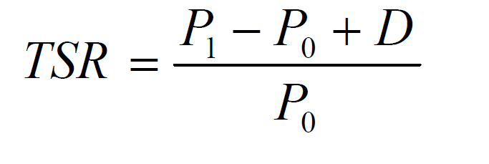
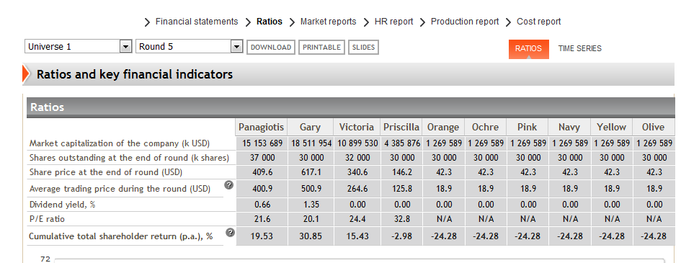
What is Shareholder Wealth?
Shareholder wealth is based on the share price of the company and any dividends that are paid
Total Shareholder Return (TSR) equals
Share price appreciation (Capital gain) PLUS
Dividends (Capital Income)
Where P₀ = initial price, P₁ = final price, D = total dividend

Slide 12
Maximising Shareholder Wealth
Not as easy as it sounds!
  Some seemingly extravagant costs can be justified
  Where is the balance between lowering costs and lowering quality/morale/customer service?
  Short term gains can lead to long term losses.
  It is not the same as maximizing:
    Profit or return on capital employed:
    Sales or Market share
    Company size

Slide 13
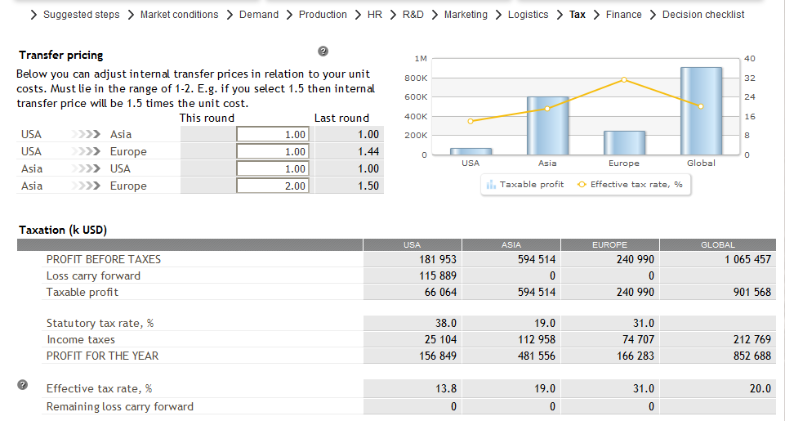
Managing tax by changing transfer prices

Slide 14
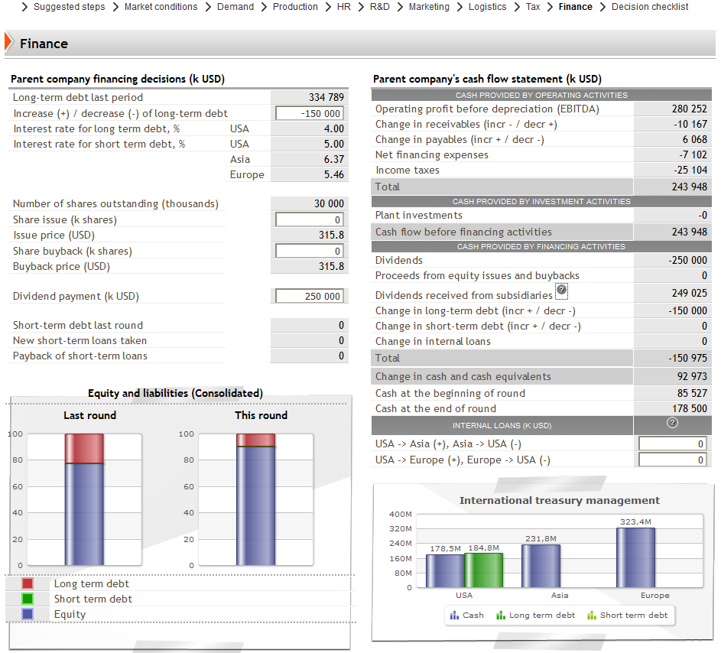
Pay dividends, reduce debt and ensure all divisions have cash

Slide 15
Conclusion
For your Business Plan
Consider investments needed to achieve your strategy
  New product launches, new production plants etc. when will you do these and how will you finance them.
Set policies
      How will dividends be use to share your profits with shareholders?
      Will you use budgeting rules? Eg. X% of revenue is spent on advertising
For the game
Actively manage tax through the distribution of profits
Actively manage your shareholder return with dividends etc.

