Slide 1
ALPHOTEC
Think Forward. Think Better.

Slide 2
Introduction
Company name: Alphotec
Objectives
7% of the global market share in the 4th year (2019)
Break Even in 2nd year
Repay 15% of our loan every year
Mission Statement
“Think better, Think forward.”
Financial Structure
Issue 10,000 shares at £100 per share = Raise in £1,000,000 of share capital
Lend £2,000,000 from Bank, VC, or Private investors

Slide 3
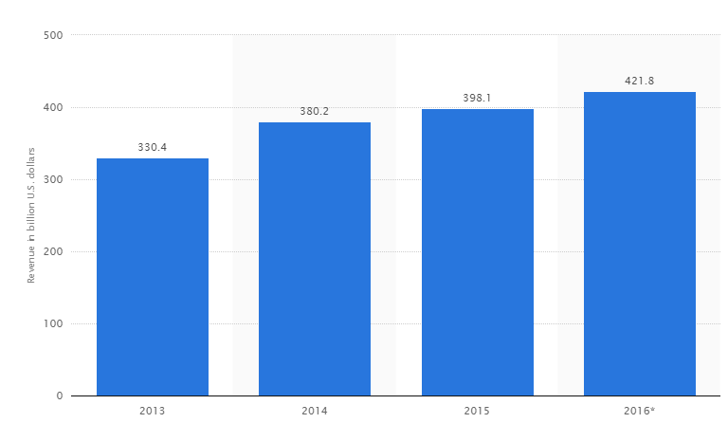
Current Global market size for smartphones
Global smartphone industry worth $398 billion as of 2015
Number of smartphones sold in 2015 peaked at 1.4 billion units
I in every 4 people in the world now have access to a smartphone
China responsible for a quarter of total sales of smartphone sales

Slide 4
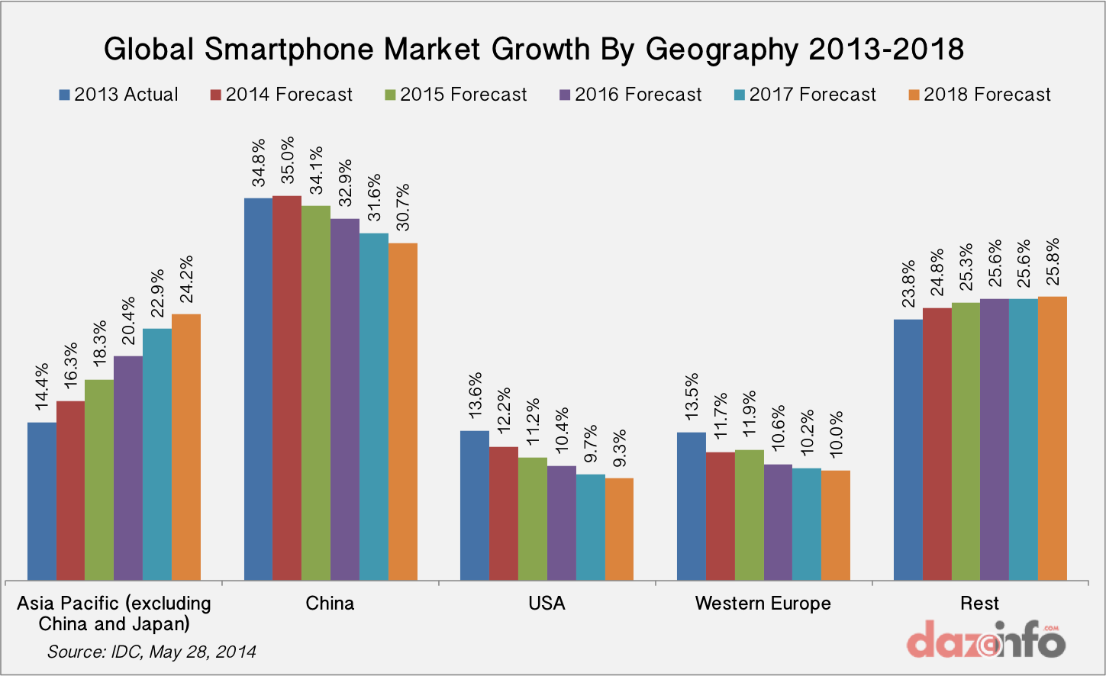
Market Segmentation
Target Market Segments (By region)
-Asia pacific (India fastest growing market for smartphones)
-China (Largest market for smartphones in the world)
-Europe Market
-USA
Target Market by Age group
-16-54 year olds in all geographical regions
http://seekingalpha.com/article/3238866-will-india-be-the-next-domino-to-fall-to-apple

Slide 5
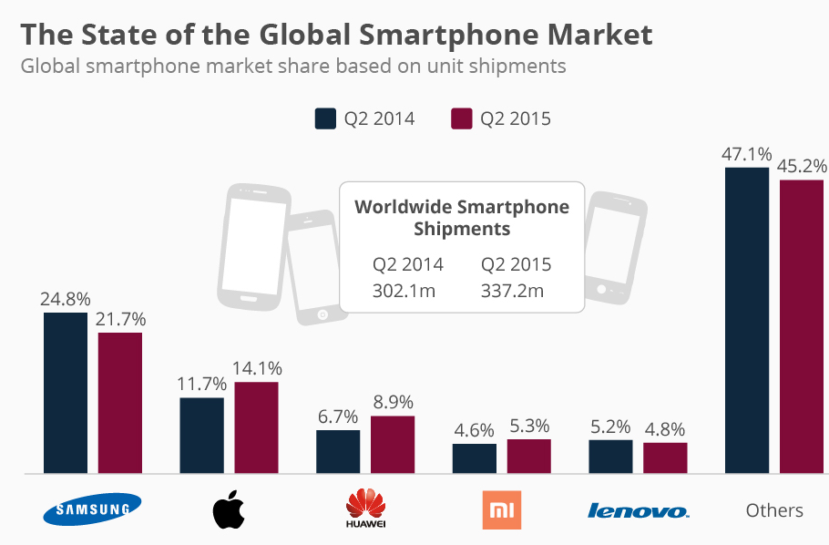
Competition
Our 3 Main Competitors:
1. Samsung (21.7%)
2. Apple (14.1%)
3. Huawei (8.9%)
Asia pacific is a driver for majority of our competitors growth in market share. We plan to capitalize on the growth in these rapidly developing markets
Source: IDC

Slide 6
Our Product
Alpho I
Alpho II
Alpho X
(Due to Launch in 2019)
64 GB Capacity
4.7 inch screen(1334 x 750-pixel resolution)
12MP Camera
1080p HD video
Build in battery 3200 mAh
128GB Capacity
5.5 inch screen (1920 x 1080-pixel resolution)
12MP Camera
1080p HD video
Build in Battery 4200 mAh
128GB Capacity
5.5 inch screen (1920 x 1080-pixel resolution)
12MP Camera
1080p HD video
Build in Battery 4200 mAh
Touch ID
Wireless headphone
Price
Alpho I : £ 299
Alpho II : £ 399

Slide 7
Promotion
Promotion
Social media promotion: Instagram ,Facebook, Twitter ,YouTube adverts, T.V adverts etc
Use influential figures or events as Brand ambassadors
£ 80,000 marketing budget

Slide 8
SWOT Analysis
INTERNAL | Strengths Strong culture of innovation Price penetration strategy | Weaknesses human resources Finance
EXTERNAL | Opportunities Rapidly growing smartphone market Increasing digitalisation | Threats Economies of scale of competitors Strong Brand loyalty

Slide 9
Operations

Slide 10
Operations
Main Objectives
To produce cost effective phones whilst delivering maximum quality
Plant locations & Investments
3 factories in USA producing a total of 440k units per annum
Contract production to local Chinese firms in order to increase total units produced to 890k units per annum by mid-2018.
This will reduce costs as our main markets we serve is within Asia pacific

Slide 11
Production
Strategies for cost reduction
Develop strong relationships with suppliers with the aim of dealing cheaper prices for supplies
Outsource back office functions to IT firms in India to reduce salaries & wages costs by mid 2017 (known to reduce costs by 20% of UK & US companies)
Utilise plastic in producing phones as opposed to stainless steel
Reduce transport by 60% in mid 2018 as we outsource production to main market, Asia

Slide 12
Personnel and R&D

Slide 13
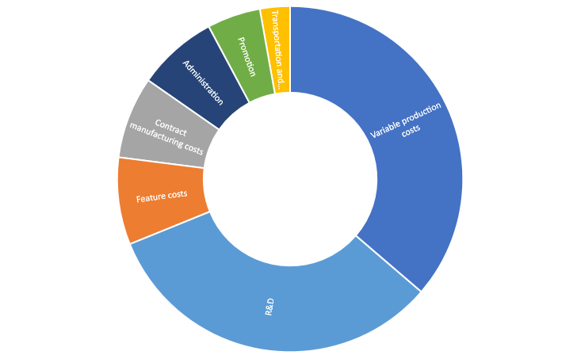
Personnel and R&D
Human Resource Staffs: 200 (2016), 100(2017)
Salary Levels: £2000/ Month
Recruitment Costs: £68

Slide 14

Personnel and R&D
Recruitment process
Online Assessment (Numerical, Verbal reasoning tests)
Assessment day where correspondents work as a group to ascertain team working skills
Interview to know more about prospective staff and to ensure they are right for the role
Employed
Step 1: Online Application Form
Step 2: Online Assessment
Step 3: Assessment Day
Step 4: Face to face Interview
Apply for the job

Slide 15
Training
Development
Training
Skills
Experience
Attitude
Education
Knowledge
Training Budget £300
In-Company Training
Training Course specific to their area every year
Problem Solving Skill
Improve the communication skills and leadership skills
Company will pay for the training fee

Slide 16
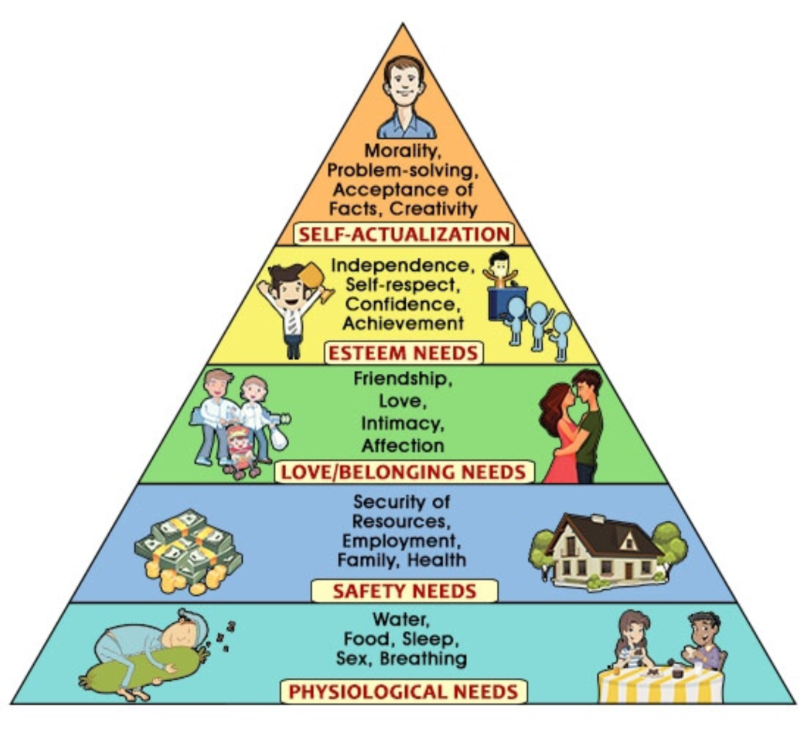
Motivation
Giving staff power to make decision
Listen to their opinion
Opportunity to take charge in projects
Opportunity for promotion
Staffs gathering every month
Provide a safe environment for the staff
Health Care for their family
High wages fulfil the physiological needs
Bonus for staff when they achieve their target

Slide 17
Finances

Slide 18
Main Objectives
Break even by 2nd year (mid-2017)
Maintain positive cash flow
Achieve positive net profit
Repaying long term loans
Dividend payout 3% of positive profit

Slide 19
Sources of funds
Issuance of 10,000 shares
Long term loans
Retained earnings

Slide 20
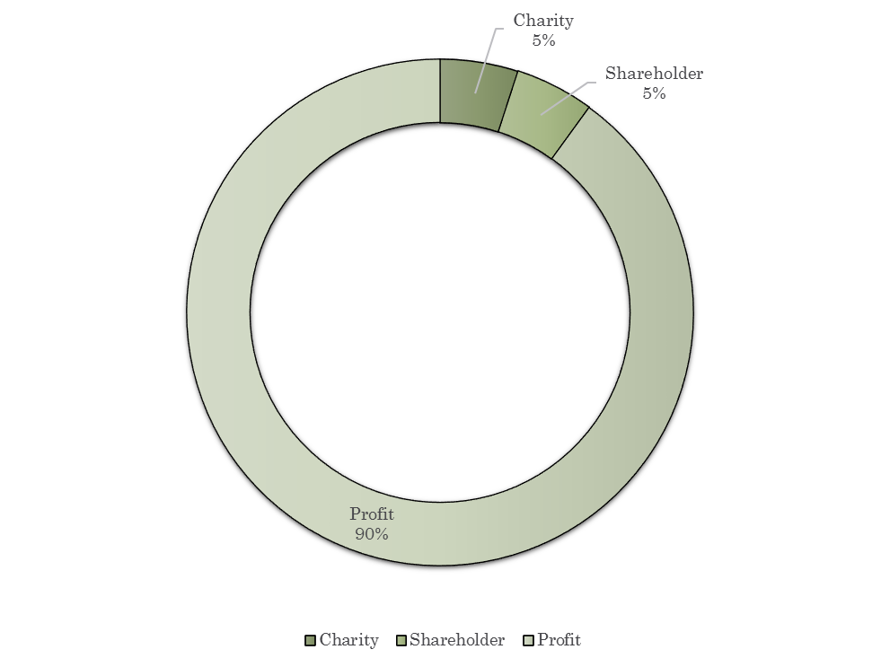
Shareholder Reward
Shareholders will be rewarded with a dividend pay-out of 3% of the firm’s positive earnings
Charities will be given 5% of the firms’ positive earnings with the aim of staying committed to its Corporate Social Responsibility

Slide 21
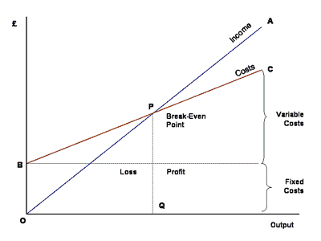
Break Even
In Asia break-even point of sales at 2286.7 & £388,743.6 in terms of sales

Slide 22
Cash flow forecasts
Operation
Cash |  |  | 1,276,720
Cash paid for
Inventory Purchase |  |  | -264,000
General Operation |  |  | -112,000
Wage Expenses |  |  | -123,000
Interest |  |  | -13,500
Income tax |  |  | -32,800
Net Cash Flow from Operation |  |  | 731,420
Investing Activity
Cash Paid For
Purchase of factories |  |  | -640,000
Net Cash Flow from Investing activity |  |  | -640,000
Financing Activity
Cash Paid for
Dividends (5%) |  |  | -53,000
Net Cash Flow from Financing Activity |  |  | -53,000
Net Increase in Cash |  |  | 38,420

Slide 23
Profit and Loss Account Year 1
 | Alphotec
Sales revenue | 1,540,611
Costs and expenses
Variable production costs | 476,871
Feature costs | 107,134
Contract manufacturing costs | 0
Transportation and tariffs | 36,956
R&D | 10,000
Promotion | 5,000
Administration | 98,802
Costs and expenses total | 712,678
OPERATING PROFIT BEFORE DEPR. (EBITDA) | 827,933
Depreciation from fixed assets | 126,225
OPERATING PROFIT (EBIT) | 701,708
Net financing expenses | 3,184
PROFIT BEFORE TAXES | 698,524
Income taxes | 34,480
PROFIT FOR THE ROUND | 664,044

Slide 24
We are ALPHOTEC
Think better, Think forward.

