Slide 1
Learning Objectives
Understand what is required to the setting of marketing objectives
Introduce a series of activities leading to the formulation of plan to achieve your marketing objectives

Slide 2
Business Game Update
Virtual Sessions are available through Blackboard collaborate.
  Every Friday between 1200-1400
  Book an appointment using WASS
  Benefits:
    I can accommodate larger group.

Slide 3
More about marketing plans?
The content here presented is non-exhaustive and aim to contribute to the general understanding of the role of marketing within a business plan.
Key sources used:
Business Model Generation
  Osterwalder, A, Pigneur, Y, & Clark, T 2010, Business Model Generation. [Electronic Resource] : A Handbook For Visionaries, Game Changers, And Challengers, n.p.: Hoboken, NJ : Wiley, c2010.
Marketing Plans
  McDonald, M, & Wilson, H 2011, Marketing Plans. [Electronic Resource] : How To Prepare Them, How To Use Them, n.p.: Chichester, West Sussex, U.K. : Wiley, 2011
Living Supply Chains
  Gattorna, J. (2006). Living supply chains: how to mobilize the enterprise around delivering what your customers want. Pearson Education.
GC-Decision_making_guide-en_EN.pdf

Slide 4
Why is marketing planning necessary?
To help you to:
Identify sources of competitive advantage
Force an organized approach to developing strategy
To communicate with and get support from other functions within the business

Slide 5
An overview of an example of activities
Mission Statement
Financial Summary
Situation review
Marketing Strategy
Customer segments
Market overview
Value Proposition
Opportunities/ Threats
Channels
Revenue Streams
Strengths/ Weaknesses
Pricing & Demand Forecast
Issues to be addressed
Key Resources

Slide 6
Situation Review
Situation review
Market overview
Market overview
Opportunities/ Threats
Market Structure
Market trends
Key market segments
Gap analysis
Strengths/ Weaknesses
Issues to be addressed

Slide 7
Watch the customer, not only the competitor
Companies should start to understand what is going on inside their own businesses….
…a myopic focus on competitors and external environment can limit understanding of internal cultural capability, which is so critical to executing strategy
Adapted from Gattorna (2006, p. 10)

Slide 8

Customer Segments
Defines the different groups of people or organizations an enterprise (Your group/ your company) aims to reach and serve
Segments are distinct groups of customers with common needs, common behaviours or other attributes.
http://cdn2.business2community.com/wp-content/uploads/2012/06/customer-segmentation-image.jpg

Slide 9

Customer Segments
Examples:
Lifestyle: sports, gamers…
For example, historically, Sky is a TV provider for sports lovers due to its Sky sports channels. BT saw an opportunity to compete and now has a strong coverage via BT sports. What the customers have in common?
Age: 15-25; 25-40, 40-55, …
Income… Just to name a few
http://www.liftpointconsulting.com/wp-content/uploads/2014/05/Customer_Segmentation_3.jpg

Slide 10
Customer Segments
Customer groups represent a separate segments if:
Their needs require and justify a distinct offer
They are reached through different Distribution Channels
They require different types of relationships (Between the business and the customer – CRM)
They have substantially different profitability
They are willing to pay for different aspects of the offer (1st Class)

Slide 11
Customer Segments
There are different types of Customer Segments. Here are some examples:
Mass market: focus on large group of customers with broadly similar needs and problems
Niche market: businesses targeting niche markets cater to specific, specialized customer segments. The offer is tailored to the specific requirements of a niche market
Diversified: serves two unrelated customer segments with very different needs and problems (McCafe, McDonald's)

Slide 12
Customer Segments
There are different types of Customer Segments. Here are some examples:
Mass market: focus on large group of customers with broadly similar needs and problems
Niche market: businesses targeting niche markets cater to specific, specialized customer segments. The offer is tailored to the specific requirements of a niche market
Diversified: serves two unrelated customer segments with very different needs and problems (McCafe, McDonald's)
Who are “our” most important customers?

Slide 13
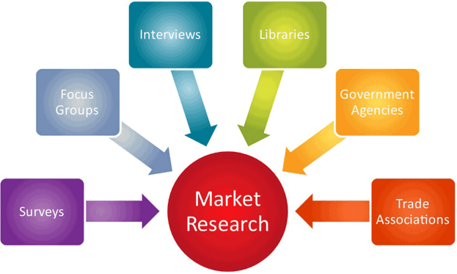
Market Research
I know “Who are “our” most important customers?”…
What do they want from a phone? – identify customer’s needs/ speak to your customer. What is value for them?
If I read using my phone: big screen?
If I practice sports: light weight/ small?
….
Identify what is Valued from the perspective of the customer
https://www.tasktilldone.com/blog/wp-content/uploads/2014/11/market-research-small.png`

Slide 14

Market Research
Listen to the voice of the customer!
https://encrypted-tbn1.gstatic.com/images?q=tbn:ANd9GcTcXVrxPCB23h8OVGmZQPMQDVvxW4_IHlbf2zUxI4WaCjuYuWxE

Slide 15
Value proposition
Describes the products/ services that create value for a specific Customer Segment
Why customers should buy “your” product (and not the competitor’s)?
Which one of our customer needs are we satisfying?
A value proposition creates value for a customer segment through a distinct mix of elements catering to that segment needs
Examples: price, design, performance, just to name a few.

Slide 16
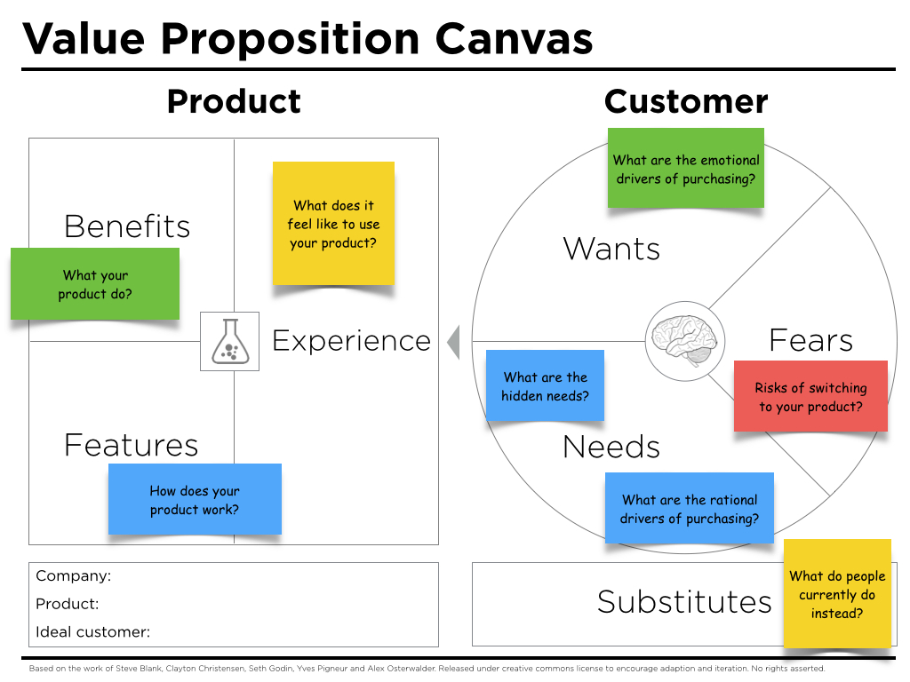
Value proposition
http://www.peterjthomson.com/wp-content/uploads/2013/11/value-proposition-canvas-questions.jpg

Slide 17
Value proposition
Describes the products/ services that create value for a specific Customer Segment
Why customers should by “your” product (and not the competitor’s)?
Which one of our customer needs are we satisfying?
A value proposition creates value for a customer segment through a distinct mix of elements catering to that segment needs
Examples: price, design, performance, just to name a few.
Why customers should by “your” product?
What is your USP?

Slide 18
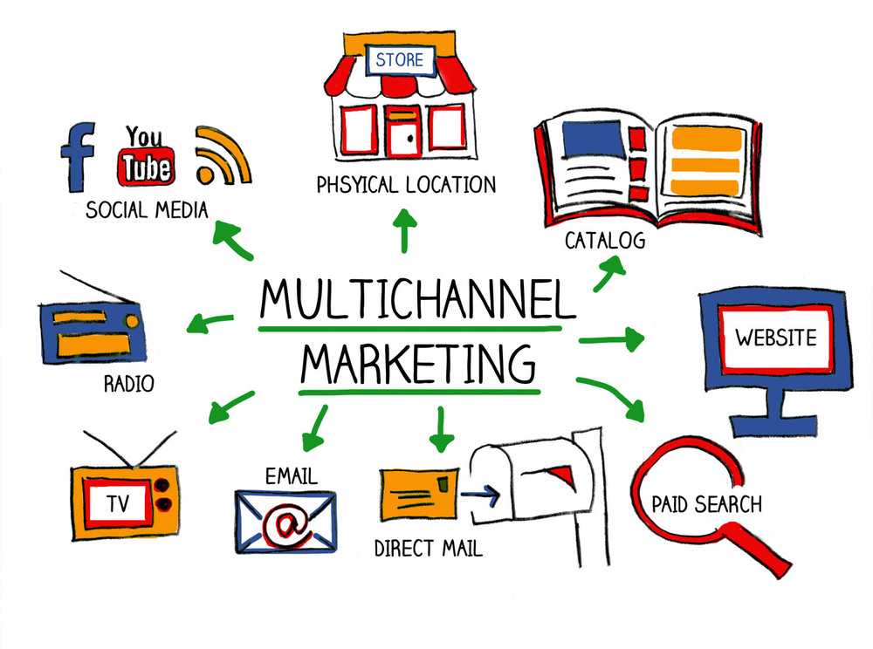
Channels
Describes how a company communicates with and reaches its customer segments to deliver a Value Proposition
Are customer touch points that play an important role in the customer experience
http://www.multichannelmarketingacademy.com/wp-content/uploads/2015/02/multichannel_marketing.jpg

Slide 19
Channels
Channels serve several functions, including:
Raising awareness among customers about a company’s products
Helping customers evaluate a company’s Value Proposition
Allowing customers to purchase specific products and services
Delivering a value proposition to customers
Providing post-purchase customer support (After sales)

Slide 20

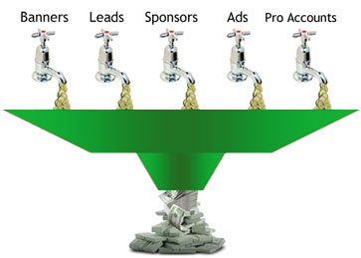
Revenue Streams
For what are our customer really willing to pay?
A business plan can involve two different types of Revenue Streams
  Transaction revenues (similar to what happens in the simulation)
  Recurring revenues resulting from ongoing payments to either deliver a Value Proposition to customers or provide post-purchase customer support
http://super-trainer.com/wp-content/uploads/2012/08/additional-income.jpg
https://d2v4zi8pl64nxt.cloudfront.net/1344635403_c0c0e39f319e8748e3b63bec5f048028.jpg

Slide 21
Pricing Mechanisms
Fixed Menu Pricing | Dynamic Pricing
List price – fixed prices for individual products, services, or other value propositions | Negotiation: price negotiated between two or more partners (special purchases)
Product feature dependent: price depends on the number or quality of value proposition features | Yield management: price depends on inventory and time of purchase
Customer segment dependent: price depends on the type and characteristic of a customer segment | Real-time-market: price is established dynamically based on supply and demand
Volume dependent: price as a function of the quantity purchased | Auctions: price determined by outcome of competitive bidding (eBay)

Slide 22
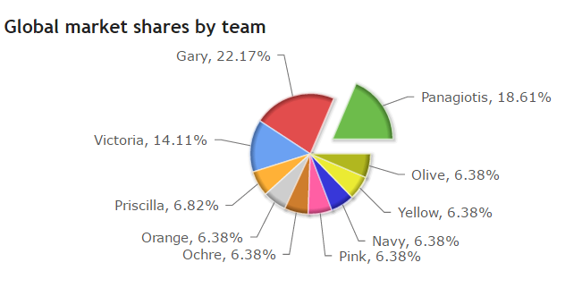
Demand forecast

Slide 23
Demand forecast
Based on your chosen:
customer segment (CS),
value proposition (VP),
Pricing, and
Channels
how much of the pie do you think you can get?
Remember these are all interconnected decisions and will influence each other!

Slide 24
Demand forecast
Example:
CS: Niche market – gamers
VP: high spec to run sophisticated games + good screen/ imagery
Price: Customer segment dependent – price premium charged
Channels – both web-sales and specialist stores
What is the total size of this (niche) market?
From the total of potential customer, what proportion am I expecting to reach/ sell to?
Do I have the capacity to match the expected demand?

Slide 25


Key resources
Connecting the dots between Marketing, Finance, Operations and HR and R&D.
This is not at the heart of your marketing decisions, but if not taken into consideration can lead to a flawed business plan.
How much all your marketing activities will cost ($ - finance)
How are you planning to produce and deliver (Operations)
How will you translate customer requirements in product features (HR and P&D)
Bob 1 year of practice
Ali 1 day of practice

Slide 26
Limitations/ Differences between your Business plan and the simulation
Although ideally you would be able to apply all aspects of your business plan when using the simulation (Cesim), some of the concepts presented here, while very relevant for a successful business plan may become redundant when using the simulation, eg.: Revenue streams, some of the pricing strategies.

Slide 27
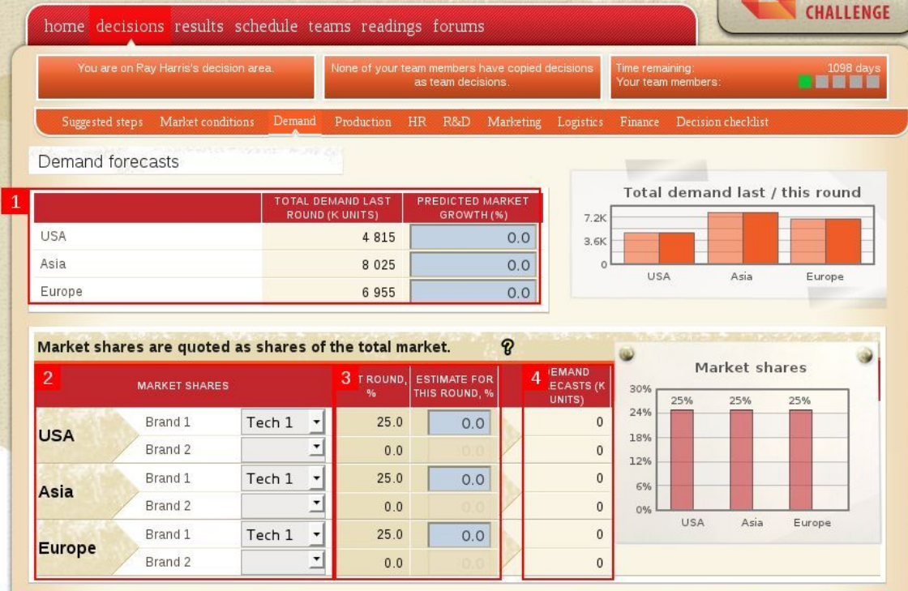
Demand forecast

Slide 28
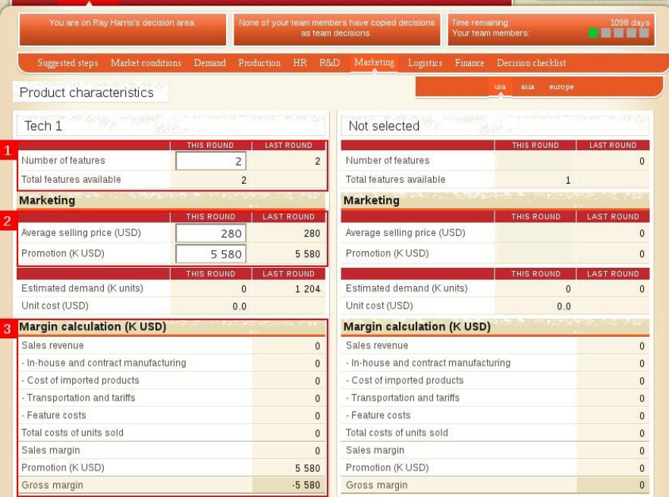
Marketing

Slide 29
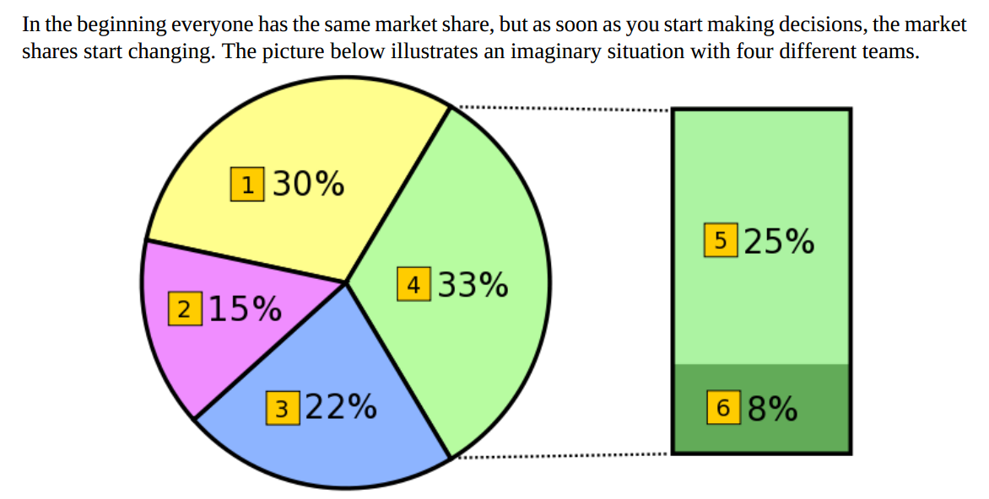
Market Share

