Slide 1
ECON 562
Macroeconomic Analysis & Public Policy
Module 3: Growth in Developed and in Developing Countries

Slide 2
Introduction
Developed Countries:
A balanced growth path
Developing Countries:
Convergence? (maybe)

Slide 3
Introduction
This module uses growth theory to explain growth patterns in both, developed and developing countries within a common framework.
We also ask the elusive question of why are there rich and poor countries?

Slide 4
ECON 562
Macroeconomic Analysis & Public Policy
Module 3a: Developed Countries

Slide 5
Developed Countries
The growth model shows that output per-capita rises along with increases in technology, capital, and labor.
The mix of these drivers of growth, thus determines how fast an economy grows.
Developed and developing countries exhibit different trends in these underlying factors.
$$g_{y}≈g_{z}+αg_{k}+\left(1−α\right)g_{l}$$
𝑔_𝑦≈𝑔_𝑧+𝛼𝑔_𝑘+(1−𝛼) 𝑔_𝑙
Notes:
The growth model shows that output per-capita rises along with increases in technology, capital, and labor.
$$g_{y}≈g_{z}+αg_{k}+\left(1−α\right)g_{l}$$
The mix of these drivers of growth, thus determines how fast an economy grows.
Developed and developing countries exhibit different trends in these underlying factors.

Slide 6
Developed Countries
First, since $0<α<1$ increase in $l$ or $k$ cannot sustainably drive growth, because of:
First, since 0<𝛼<1 increase in 𝑙 or 𝑘 cannot sustainably drive growth, because of:
Theoretically, diminishing marginal productivity.
Practically, a 1% increase in either leads to a less than 1% increase in per-capita growth; .32% from $g_{k}$ and .68% from $g_{l}$.
Practically, a 1% increase in either leads to a less than 1% increase in per-capita growth; .32% from 𝑔_𝑘 and .68% from 𝑔_𝑙.
Also, in the U.S. per-capita hours are trendless (neither rising, nor falling).
Notes:
Let’s see each engine at a time.
First, since $0<α<1$ increase in $l$ or $k$ cannot sustainably drive growth, because of:
Theoretically, diminishing marginal productivity.
Practically, a 1% increase in either leads to a less than 1% increase in per-capita growth; .32% from $g_{k}$ and .68% from $g_{l}$.
Also, in the U.S. per-capita hours are trendless (neither rising, nor falling).

Slide 7
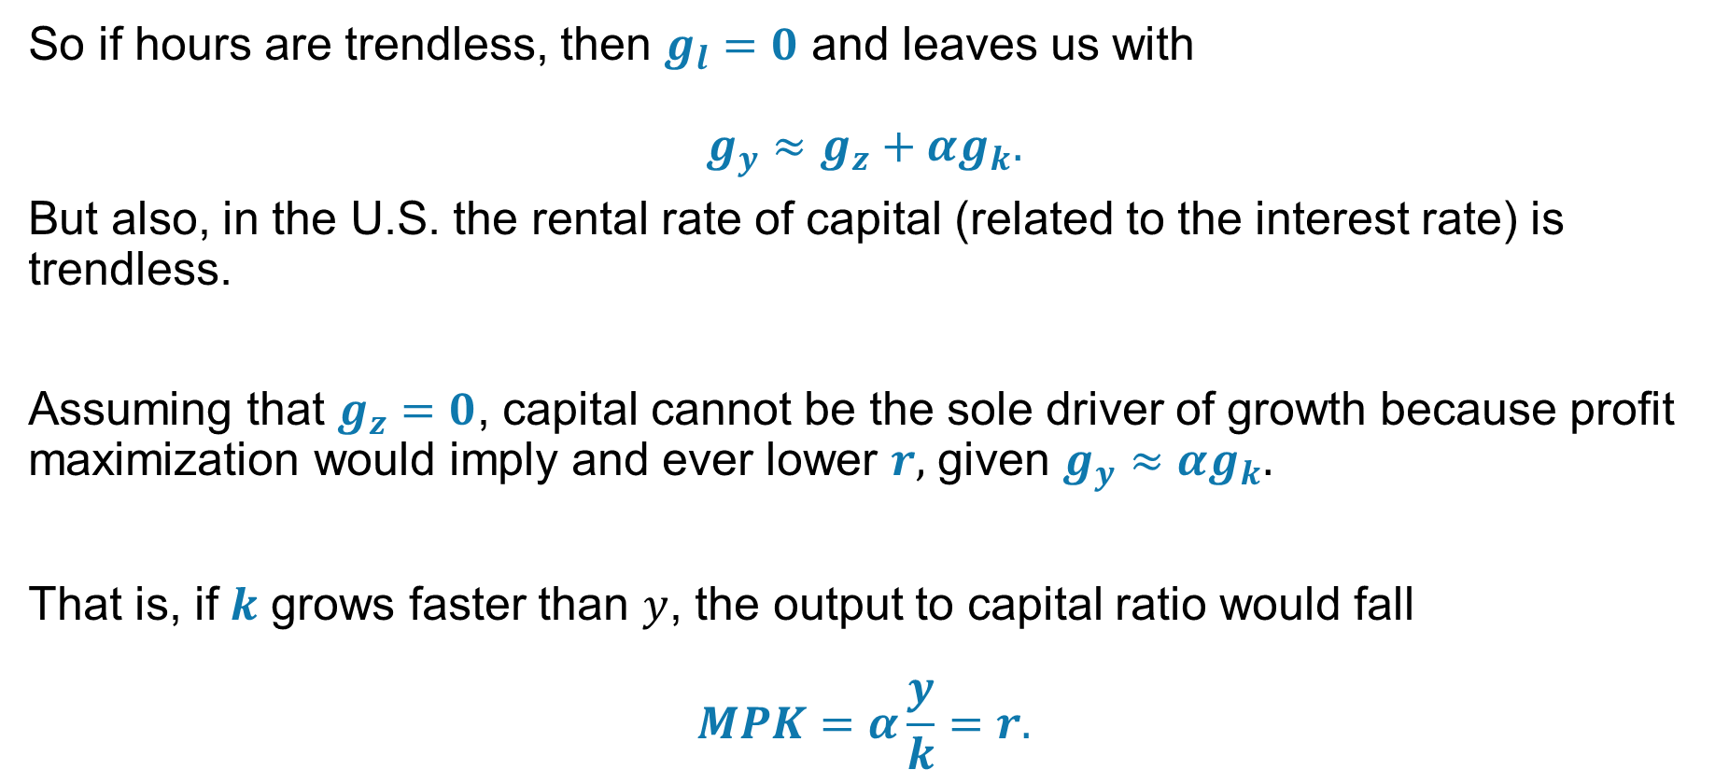
Developed Countries
So if hours are trendless, then $g_{l}=0$ and leaves us with
$$g_{y}≈g_{z}+αg_{k}.$$
But also, in the U.S. the rental rate of capital (related to the interest rate) is trendless.
Assuming that $g_{z}=0$, capital cannot be the sole driver of growth because profit maximization would imply and ever lower $r,$ given $g_{y}≈αg_{k}.$
That is, if $k$ grows faster than $y$, the output to capital ratio would fall
$$MPK=α\frac{y}{k}=r.$$

Slide 8
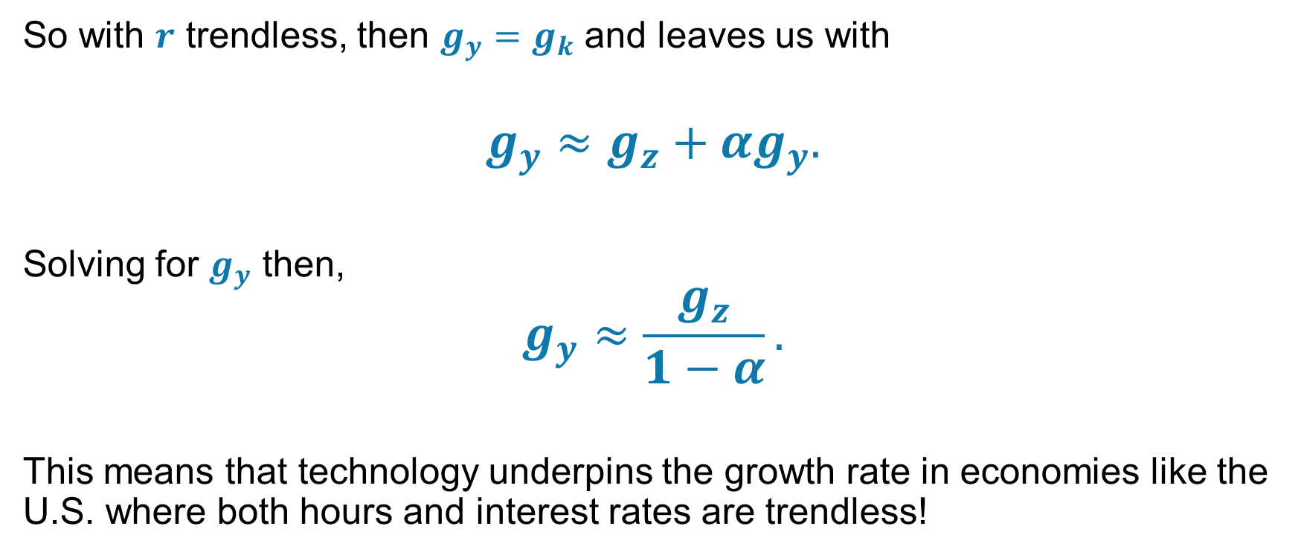
Developed Countries
So with $r$ trendless, then $g_{y}=g_{k}$ and leaves us with
$$g_{y}≈g_{z}+αg_{y}.$$
Solving for $g_{y}$ then,
$$g_{y}≈\frac{g_{z}}{1−α}.$$
This means that technology underpins the growth rate in economies like the U.S. where both hours and interest rates are trendless!

Slide 9
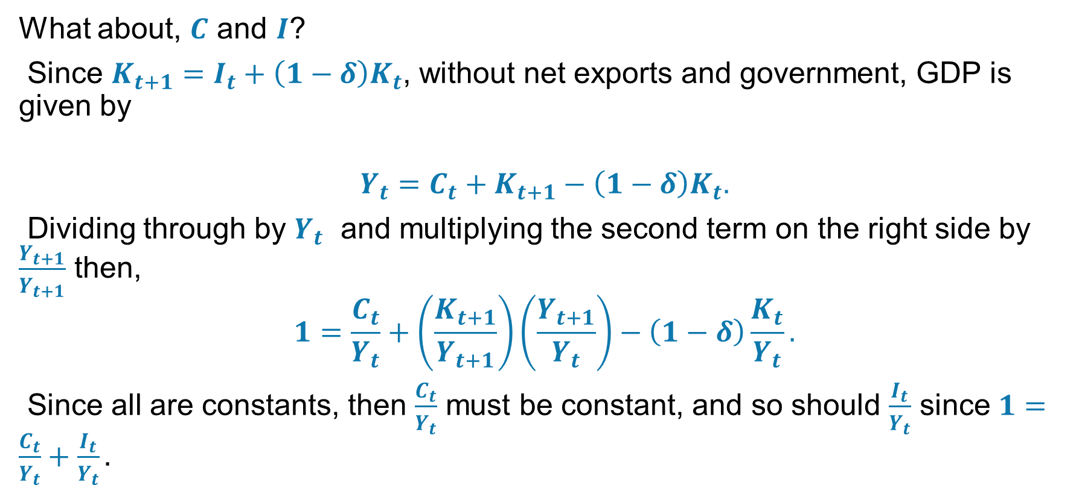
Developed Countries
What about, $C$ and $I$?
Since $K_{t+1}=I_{t}+\left(1−δ\right)K_{t}$, without net exports and government, GDP is given by
$$Y_{t}=C_{t}+K_{t+1}−\left(1−δ\right)K_{t}.$$
Dividing through by $Y_{t}$ and multiplying the second term on the right side by $\frac{Y_{t+1}}{Y_{t+1}}$ then,
$$1=\frac{C_{t}}{Y_{t}}+\left(\frac{K_{t+1}}{Y_{t+1}}\right)\left(\frac{Y_{t+1}}{Y_{t}}\right)−\left(1−δ\right)\frac{K_{t}}{Y_{t}}.$$
Since all are constants, then $\frac{C_{t}}{Y_{t}}$ must be constant, and so should $\frac{I_{t}}{Y_{t}}$ since $1=\frac{C_{t}}{Y_{t}}+\frac{I_{t}}{Y_{t}}.$

Slide 10
Developed Countries
The U.S. is on what is called a Balanced Growth path:
Real interest rates (marginal product of capital) are trendless,
Per-capita labor input is trendless,
Output, consumption, investment, and capital all increase at the same rate,
That rate is given by the growth rate of technology.
Notes:
The U.S. is on what is called a Balanced Growth path:
Real interest rates (marginal product of capital) are trendless,
Per-capita labor input is trendless,
Output, consumption, investment, and capital all increase at the same rate,
That rate is given by the growth rate of technology.

Slide 11
ECON 562
Macroeconomic Analysis & Public Policy
Module 3b: Developing Countries

Slide 12
Developing Countries
So why do developing economies grow faster than developed ones?
Labor $l$ is increasing as farm work is moving to more efficient factory work.
Labor 𝑙 is increasing as farm work is moving to more efficient factory work.
Technology $z$ is increasing as these economies adopt more modern processes.
Technology 𝑧 is increasing as these economies adopt more modern processes.
Capital $k$ is rapidly accumulating as new factories and infrastructure are being built.
Capital 𝑘 is rapidly accumulating as new factories and infrastructure are being built.
In developing economies all three inputs are growing rapidly. Eventually, they will grow at the same rate as technology.
Notes:
So why do developing economies grow faster than developed ones?
Labor $l$ is increasing as farm work is moving to more efficient factory work.
Technology $z$ is increasing as these economies adopt more modern processes.
Capital $k$ is rapidly accumulating as new factories and infrastructure are being built.
In developing economies all three inputs are growing rapidly. Eventually, they will grow at the same rate as technology.

Slide 13
Developing Countries
But why are there so many poor nations, and do not "catch up"?
One reason: The effective tax rate on capital income may be very high!
The capital-income tax is not just a tax on those who own the capital; it is a tax on all workers as well.
Workers need capital to be productive!
Notes:
But why are there so many poor nations, and do not "catch up"?
One reason: The effective tax rate on capital income may be very high!
The capital-income tax is not just a tax on those who own the capital; it is a tax on all workers as well.
Workers need capital to be productive!

Slide 14
Developing Countries
Consider the following arbitrage condition which compares the risk-free return (e.g. bank account) denoted by $\hat{r_{t}}$ to the after-tax net of depreciation marginal product of capital at the firm level $r_{t}$.
Consider the following arbitrage condition which compares the risk-free return (e.g. bank account) denoted by (𝑟_𝑡 ) ̂ to the after-tax net of depreciation marginal product of capital at the firm level 𝑟_𝑡.
$$\hat{r_{t}}=\left(1−τ_{k}\right)\left(r_{t}−δ\right)$$
(𝑟_𝑡 ) ̂=(1−𝜏_𝑘 )(𝑟_𝑡−𝛿)
If $\hat{r_{t}}>\left(.\right)$ resources shift from factories to banks and $r_{t}$ (MPK) rises.
If (𝑟_𝑡 ) ̂>(.) resources shift from factories to banks and 𝑟_𝑡 (MPK) rises.
If $\hat{r_{t}}<\left(.\right)$ resources shift from banks to factories and $r_{t}$ (MPK) falls.
If (𝑟_𝑡 ) ̂<(.) resources shift from banks to factories and 𝑟_𝑡 (MPK) falls.
Notes:
Consider the following arbitrage condition which compares the risk-free return (e.g. bank account) denoted by $\hat{r_{t}}$ to the after-tax net of depreciation marginal product of capital at the firm level $r_{t}$.
$$\hat{r_{t}}=\left(1−τ_{k}\right)\left(r_{t}−δ\right)$$
If $\hat{r_{t}}>\left(.\right)$ resources shift from factories to banks and $r_{t}$ (MPK) rises.
If $\hat{r_{t}}<\left(.\right)$ resources shift from banks to factories and $r_{t}$ (MPK) falls.

Slide 15
Developing Countries
For example:
You loan a $100 computer to a friend for a year.
The friend pays you $17.50. This is $r_{t}$.
The friend pays you $17.50. This is 𝑟_𝑡.
However, the equipment depreciates during the year by $δ=5.5\%$ -- it is only worth $94.50 after a year.
However, the equipment depreciates during the year by 𝛿=5.5% -- it is only worth $94.50 after a year.
So the pre-tax income is $17.50 - $5.5 = $12.00.
If the capital-income tax is $τ_{k}=50\%$, you keep 0.50*$12.00 = $6. This is $\hat{r_{t}}$.
If the capital-income tax is 𝜏_𝑘=50%, you keep 0.50*$12.00 = $6. This is (𝑟_𝑡 ) ̂.
Notes:
You loan a $100 computer to a friend for a year.
The friend pays you $17.50. This is $r_{t}$.
However, the equipment depreciates during the year by $δ=5.5\%$ -- it is only worth $94.50 after a year.
So the pre-tax income is $17.50 - $5.5 = $12.00.
If the capital-income tax is $τ_{k}=50\%$, you keep 0.50*$12.00 = $6. This is $\hat{r_{t}}$.

Slide 16
Developing Countries
For a given risk-free rate $\hat{r_{t}}$, if the tax on capital is high $τ_{k}$, then a high $r_{t}$ implies:
For a given risk-free rate (𝑟_𝑡 ) ̂, if the tax on capital is high 𝜏_𝑘, then a high 𝑟_𝑡 implies:
a high MPK, which implies
a low $K_{t}$, which implies
a low 𝐾_𝑡, which implies
a low $Y_{t}$ and low $w_{t}.$
a low 𝑌_𝑡 and low 𝑤_𝑡.
Notes:
So what do we learn?
For a given risk-free rate $\hat{r_{t}}$, if the tax on capital is high $τ_{k}$, then a high $r_{t}$ implies:
a high MPK, which implies
a low $K_{t}$, which implies
a low $Y_{t}$ and low $w_{t}.$

