Slide 1
Zombies and Ir

Slide 2

We have lots of references to zombies in our pop culture today:
https://www.youtube.com/watch?v=HcwTxRuq-uk
https://www.youtube.com/watch?v=c7ynwAgQlDQ
https://www.youtube.com/watch?v=_Kuy8YExHDI

Slide 3
So much so that an ir scholar even wrote a book about zombies

Slide 4
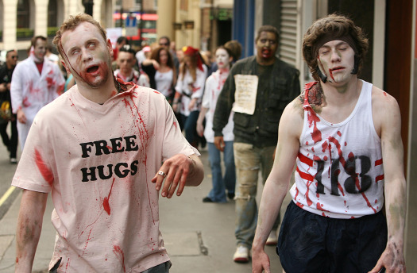
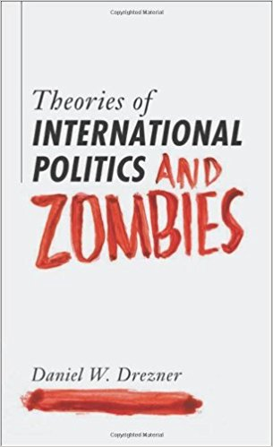
Zombies and international relations

Slide 5
Zombies and international relations
How do different theories of IR respond to the zombie apocalypse?

Slide 6
Zombies and international relations
A realist:
Because of the uneven distribution of capabilities, some governments will be better placed to kill the zombies than others
Fundamentally, the anarchical character of world politics would not be changed.
Still each state out for itself

Slide 7
Zombies and international relations
From a liberal perspective:
The zombie issue would cross borders and affect all states, so the benefits from policy coordination would be pretty massive, for instance in setting up a World Zombie Organization (WZO). Also, regional coordination would form a possible solution
But, if push comes to shove, you do what you need to do to protect your own state, such as building massive barriers between countries to keep out zombies

Slide 8
Zombies and international relations
Constructivists, on the other hand, might say…
that there are a number of possible ideas emerging in response to zombies
Do zombies have rights? Are they stateless?
What do we do with the groups of refugees who have fled zombie-filled cities? How do transnational/nonstate actors fit in?
And what might be the ideal way that we could work together as a world to best respond to a zombie attack?

Slide 9
Zombies and international relations
Which of these perspectives do you think would best deal with the zombie apocalypse?
Which perspective do you see reflected in media?
World War Z
Walking Dead
Others?

Slide 10
Zombies and international relations
Without copying from these slides, and using the sources you have read and watched up to this point, write a response paper answering the following question:
How would different schools of IR respond to the zombie apocalypse?
Use at least two direct quotes or ideas from the class resources. Reference at least two of the following schools of IR: realism, liberalism, and constructivism. Write up to 1 page, double-spaced.
Submit under Part 2, Activities and Assessments: “Mod2 Zombies and IR Theory”

